Slide 1
INTERPRETATION OF AUTOMATED PERIMETRY
Notes:
This presentation is intended to act as a practical guide to standard automated perimetry* and its role in the diagnosis and management of glaucoma.
The content was originally developed by Professor Ravi Thomas, currently Director of Glaucoma Services, Queensland Eye Institute, Brisbane, Australia and Visiting Professor at LV Prasad Eye Institute, Hyderabad, India.¹
Revised and edited in 2021 by A/Prof. Joseph Anthony Tumbocon from St. Luke’s Medical Center, Philippines
*Standard automated perimetry (SAP) refers to static computerised perimetry using white stimuli on a white background to evaluate the central visual field.²
References
1. Thomas R, George R. Interpreting automated perimetry. Indian J Ophthalmol 2001; 49: 125–40.
2. European Glaucoma Society. Terminology and Guidelines for Glaucoma. Savona, Italy: Editrice DOGMA, 2008 (3rd Edn). Available at: www.eugs.org/eng/EGS_guidelines.asp. Accessed: 10 June 2011.

Slide 2
Automated perimetry
© Thomas R
Notes:
Automated perimetry is the gold standard for diagnosis and management of glaucoma. A careful appraisal of an automated perimetry printout will enable the practitioner to identify a visual field defect, determine whether the defect is due to glaucoma and establish whether the lesion is progressing. However, interpretation requires both an understanding of the principles involved, and practice.
Reference
Thomas R, George R. Interpreting automated perimetry. Indian J Ophthalmol 2001; 49: 125–40.

Slide 3
Automated perimetry
Perimetry logic
Identifying field defects
Criteria for glaucomatous defects
Interpretation of Octopus fields
© Thomas R
Notes:
After reviewing the basic principles of automated perimetry, this module focuses on how to identify a defect in the visual field – and how to determine whether the defect is due to glaucoma. Sample printouts are provided throughout the module to familiarise the clinician with a systematic approach to interpretation. The module concludes with an introduction to the interpretation of Octopus fields.
Please note that advanced field defects and detecting visual field progression due to glaucoma are covered in Module 9: Monitoring for progression.

Slide 4
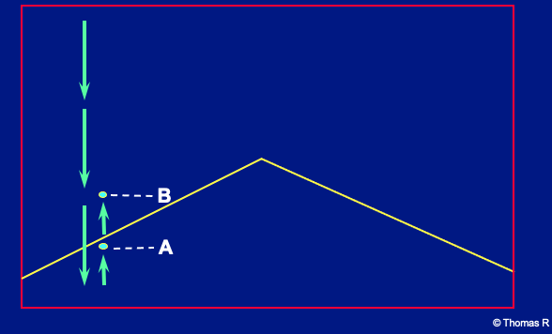
Bracketing strategy
© Thomas R
Notes:
The major advantage of automated perimetry is that it allows comparison of the patient’s visual sensitivity with stored normal thresholds.

Slide 5
Normal thresholds
Mean threshold in disease-free fields
In a given age group
At a given location in the visual field
Mean normal values are stored in the automated perimeter and compared against patient data
© Thomas R
Notes:
The normal visual threshold is the mean threshold in normal individuals in a specified age group and field location. Automated perimeters compare the patient’s sensitivity against stored values for normal individuals.
A young person with experience of perimetry will probably be able to detect a 40 dB target at the fovea.
Reference
Thomas R, George R. Interpreting automated perimetry. Indian J Ophthalmol 2001; 49: 125–40.

Slide 6
Computers and ease of interpretation
Sensitivity
+
Simple set of rules
Computer
Diagnosis
© Thomas R
Notes:
It is natural to expect that a sophisticated automated perimeter will permit a simple ‘XYZ’ approach to diagnosis, i.e. it should be possible to input the patient’s visual field sensitivity and a simple set of rules, and have the computer make the appropriate diagnosis. However, this approach is flawed due to the way the normal range for the visual threshold is defined.
Reference
Thomas R, George R. Interpreting automated perimetry. Indian J Ophthalmol 2001; 49: 125–40.

Slide 7
Perimeter logic (1)
Sensitivity determined at each location
Normal range developed
Normal range is arbitrary
- Includes the values of 95% of the normal population
© Thomas R
Notes:
The normal range is determined by measuring the retinal sensitivity at different regions in normal individuals, then arbitrarily defining the upper 95% of values as normal.
Reference
Thomas R, George R. Interpreting automated perimetry. Indian J Ophthalmol 2001; 49: 125–40.

Slide 8
Perimeter logic (2)
‘Abnormal’ values include the lowest 5% of those in normal individuals
Therefore, 5% of normal individuals will be labelled abnormal
‘Abnormal’ is not the same as diseased
© Thomas R
Notes:
As the lowest 5% of retinal sensitivity values found in normal individuals are labelled abnormal, it is important to recognise that abnormal is not the same as diseased. An abnormal field may be due to disease, but this depends on the testing situation.
Reference
Thomas R, George R. Interpreting automated perimetry. Indian J Ophthalmol 2001; 49: 125–40.

Slide 9
Perimeter logic (2)
General population – 100 tested
1% glaucoma; 99% normal
Six will have abnormal tests
1 glaucoma patient
5 normal individuals
© Thomas R
Notes:
The prevalence of glaucoma in the general population is 1%, therefore population screening of 100 individuals would be expected to produce six abnormal tests – one glaucoma patient and five individuals with values in the lowest 5% of the normal range.
Reference
Thomas R, George R. Interpreting automated perimetry. Indian J Ophthalmol 2001; 49: 125–40.

Slide 10
Perimeter logic (4)
Clinic population – 100 tested
30% glaucoma; 70% normal
33 will have abnormal tests
30 glaucoma patients
3 normal individuals
© Thomas R
Notes:
The situation in an ophthalmology clinic treating glaucoma patients would be quite different, with perhaps 30% of referred patients likely to have glaucomatous field defects. If 100 patients were tested, 33 might have abnormal fields, of whom 30 would be glaucoma patients and three (5% of 70) would be individuals falling in the lowest 5% of normal.
Note that the diagnostic yield increases with the prevalence of the disease. Testing is most useful when the disease prevalence is 30–70%.
Reference
Thomas R, George R. Interpreting automated perimetry. Indian J Ophthalmol 2001; 49: 125–40.

Slide 11
Interpretation is not child’s play
Automated perimeters still need interpretation
© Thomas R
Notes:
Automated perimeters cannot replace the clinician’s judgement. It is essential to interpret the results taking the clinical context into account.
Reference
Thomas R, George R. Interpreting automated perimetry. Indian J Ophthalmol 2001; 49: 125–40.

Slide 12
Before interpretation …
… a few principles
© Thomas R
Notes:
The next few slides outline some important principles for the clinician to bear in mind prior to interpreting automated perimetry.

Slide 13
Rely on threshold tests
First real evidence of glaucoma
Detect scotoma
Detect depression of the ‘hill’ of vision
May predict visual loss
© Thomas R
Notes:
The full threshold tests should be used wherever possible. They provide the first real evidence of glaucoma and may be able to predict visual field loss.
Reference
Thomas R, George R. Interpreting automated perimetry. Indian J Ophthalmol 2001; 49: 125–40.

Slide 14
Screening tests
Screening
Fishing
Fatigue
© Thomas R
Notes:
Screening tests should be reserved for genuine screening, together with specific situations, such as patients who are too fatigued to complete the full threshold test and detection of hemianopia.
Reference
Thomas R, George R. Interpreting automated perimetry. Indian J Ophthalmol 2001; 49: 125–40.

Slide 15
Interpreting decibel values is just half the challenge …
False positives
False negatives
Fixation
Fluctuation
Strategy
Experience
Technicians
Artefacts
© Thomas R
Notes:
Several factors complicate the interpretation of visual field printouts:
Comparison of patient data with stored normative data may be invalidated by false positives, false negatives and fixation losses. This information is highlighted on the printout.
Diagnosis may be complicated by short- or long-term fluctuations.
The type of information obtained is influenced by the perimetry strategy (program), the patient’s experience of perimetry, and the performance of the technician (both in terms of avoiding artifacts and properly instructing the patient).
Artefacts may occur with automated perimetry.
Reference
Thomas R, George R. Interpreting automated perimetry. Indian J Ophthalmol 2001; 49: 125–40.

Slide 16
© Thomas R
Notes:
This slide shows a constricted field. However, this is an artefact resulting from the use of a very high plus lens – the field defect disappeared when the field was repeated using an appropriate contact lens.
Unless otherwise stated, all perimetry printouts reproduced in this presentation were obtained using the Humphrey® Field Analyzer (HFA) [Carl Zeiss Meditec]. Interpretation of Octopus [Haag-Streit AG] fields is covered briefly at the end of the presentation.
Reference
Thomas R, George R. Interpreting automated perimetry. Indian J Ophthalmol 2001; 49: 125–40.

Slide 17
Optimising patient performance
Choose the most appropriate investigation
Test pattern and strategy
Ensure the patient is comfortably positioned
Support feet, back and arms
Adjust chin rest
Cover the other eye fully
Provide careful instructions prior to the test
Support the patient during the test
Give feedback on test performance
© Thomas R
Asia Pacific Glaucoma Guidelines 3rd ed. 2016.
Notes:
The 24–2 test pattern is appropriate for early-to-moderate damage and glaucoma suspects, while the 10–2 pattern is used for advanced damage or paracentral scotomas. The Swedish interactive threshold algorithm (SITA) test strategy (Humphrey field analyser) is appropriate for most patients and glaucoma suspects.
The patient should be carefully instructed and the technician should return regularly to supervise the test and provide encouragement.
If the patient’s performance proves unreliable, the test should be restarted and an attempt made to find and rectify the cause of the problem without blaming the patient. If the patient cannot cope, consider rescheduling the test. Patience is vital.
Other tips for better visual fields include checking the pupil size and noting any change, and using appropriate correction for near vision.
Reference
South East Asia Glaucoma Interest Group. Asia Pacific Glaucoma Guidelines, 2nd Edition. Sydney: SEAGIG, 2008. Available at: www.seagig.org/toc/APGGuidelinesNMview.pdf.

Slide 18
A word about the grey scale
Never use the grey scale alone for interpretation
It is useful to educate the patient and to identify false-positive and false-negative errors
© Thomas R
Notes:
While the grey scale is not normally used for diagnosis, characteristic patterns may be evident in fields with false-positive and false-negative errors. These are detailed in the following slides.
Reference
Thomas R, George R. Interpreting automated perimetry. Indian J Ophthalmol 2001; 49: 125–40.

Slide 19
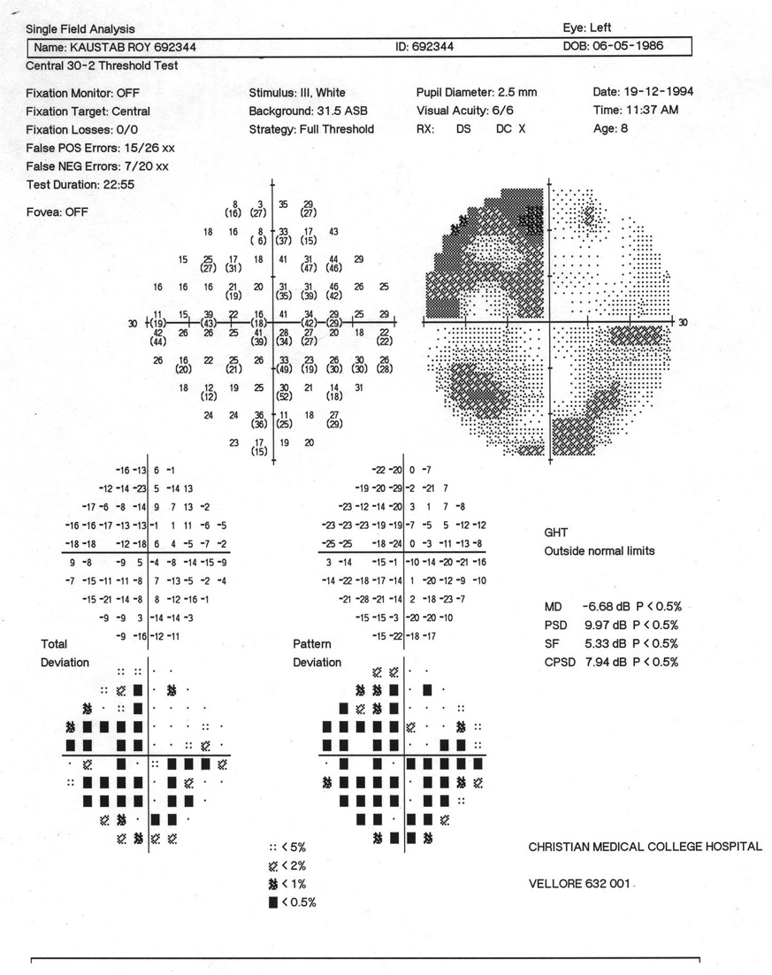
“White” scotomas associated with false positives
© Thomas R
Notes:
This slide shows multiple ‘white’ scotomas associated with a false-positive response.
Reference
Thomas R, George R. Interpreting automated perimetry. Indian J Ophthalmol 2001; 49: 125–40.

Slide 20
© Thomas R
Notes:
This enlargement of the previous slide shows that the thresholds in the periphery are not physiological, with some decibel values in the high 30s and 40s. As a comparison, the foveal threshold in a young, perimetrically trained individual might be 40 dB.
Reference
Thomas R, George R. Interpreting automated perimetry. Indian J Ophthalmol 2001; 49: 125–40.

Slide 21
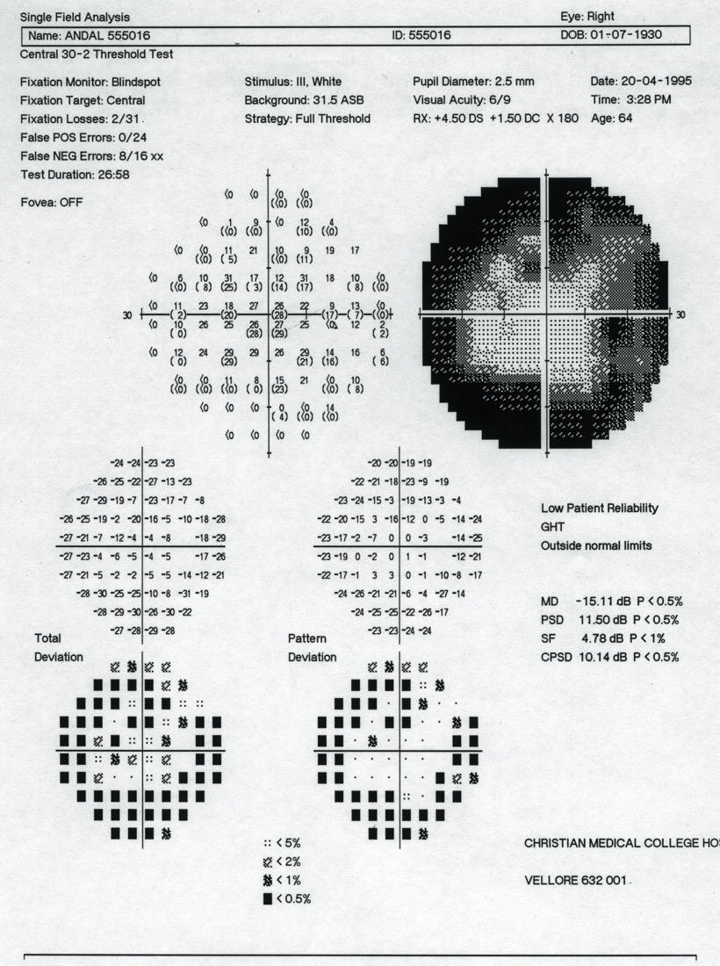
‘Clover leaf’ pattern associated with false negatives
© Thomas R
Notes:
This slide shows a field with a ‘clover leaf’ pattern typical of a fatigued patient. This false-negative pattern occurs when a patient performs well initially but becomes progressively less responsive.
Reference
Thomas R, George R. Interpreting automated perimetry. Indian J Ophthalmol 2001; 49: 125–40.

Slide 22
Using the grey scale
To educate the patient
White scotomas with false positives
Clover leaf pattern with false negatives
Never interpret using the grey scale alone
© Thomas R
Notes:
In summary, the key message is never to use the grey scale alone for interpretation.

Slide 23
Questions
Is there a visual field defect?
Is it due to glaucoma?
Is the defect progressing?
© Thomas R

Slide 24
Is the visual field abnormal?
Without obvious defects, it is difficult to make a decision based on the first field
Repeat examinations provide definitive information
Never make a diagnosis based on the visual field alone
© Thomas R
Notes:
Unless there is an obvious field defect that correlates with clinical features, interpretation may be difficult and the field test should be repeated to provide more reliable information.
Reference
Thomas R, George R. Interpreting automated perimetry. Indian J Ophthalmol 2001; 49: 125–40.

Slide 25
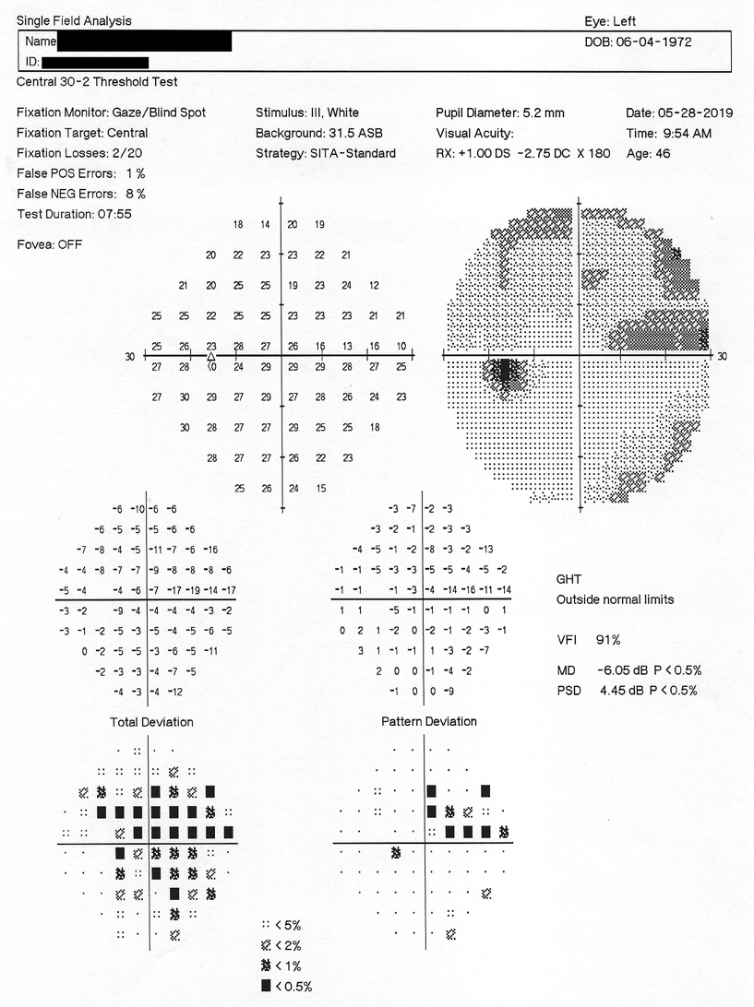
1
8
2
Interpret the field
systematically using zones 1–8
3
7
4
5
6
© Thomas R
Modified by
Tumbocon JA
Notes:
In contrast to traditional kinetic perimetry (i.e. Bjerrum screens, Goldmann perimeters and isopters), interpretation of automated perimetry printouts is focused on the figures and patterns rather than the curves (i.e. the grey scale).
It is recommended that the visual field be interpreted systematically using the eight zones shown in the slide.
Reference
Thomas R, George R. Interpreting automated perimetry. Indian J Ophthalmol 2001; 49: 125–40.

Slide 26
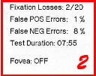
Zone 1
Contains the patient’s details, date of birth, age, test performed (e.g., central 30-2-, 24-2 or 10-2), stimulus size (e.g., size III or V), test strategy (e.g. SITA-standard), fixation monitor and fixation target . It is important to check the following details:
Was the correct test performed?
Has the patient’s date of birth been entered correctly?
Was the appropriate correction used?
Was the pupil diameter at least 2.5–3 mm and
consistent with the patient’s earlier exams?
Zone 2
Displays reliability criteria, including fixation losses and false-positive or false-negative errors. Examinations with low reliability criteria may still provide useful information, but must be interpreted with caution.
Acceptable reliability parameters
Fixation loss < 20%
False positive < 20%
False negative < 20%
- may be high in eyes with significant glaucomatous damage
© Thomas R
Modified by
Tumbocon JA
Notes:
Zone 1
Zone 1 documents the patient’s details, the test performed, the strategy used (e.g. full threshold) and whether the fixation target was central or a large diamond. It is important to check the following details:
Was the correct test performed?
Has the patient’s date of birth been entered correctly? (An error will result in the patient’s threshold being compared to normal individuals of the wrong age)
Was the appropriate correction used? (e.g. contact lens)
Was the pupil diameter at least 2.5–3 mm and consistent with the patient’s earlier fields?
Zone 2
Displays reliability criteria, including fixation losses and false-positive or false-negative errors above a certain percentage. Fields with low reliability criteria may still provide useful information, but must be interpreted with caution.
Reference
Thomas R, George R. Interpreting automated perimetry. Indian J Ophthalmol 2001; 49: 125–40.

Slide 27
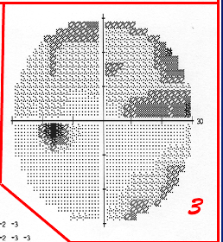
1
8
2
3
7
4
5
6
Just glance at the grey scale and move on to zones 4 & 5
Never interpret using the grey scale alone
© Thomas R
Modified by
Tumbocon JA
Notes:
Zone 3, the grey scale, displays the actual perimetry results. The grey scale draws attention to areas that need detailed examination and is useful when gross false-positive or false-negative errors are present. However, diagnosis should never be based on the grey scale alone.
Small but important scotomas may be missed from the grey scale as the computer extrapolates data from a limited number of points tested. Conversely, in some circumstances the computer may suggest a central scotoma where none exists (e.g. a patient with a cataract producing generalised depression, where the central points fluctuate less than those at the periphery and are marked as abnormal in the pattern deviation plot).
It is best just to glance at zone 3 then move on to zones 4–8, which give the actual threshold values and statistical analysis.
Reference
Thomas R, George R. Interpreting automated perimetry. Indian J Ophthalmol 2001; 49: 125–40.

Slide 28
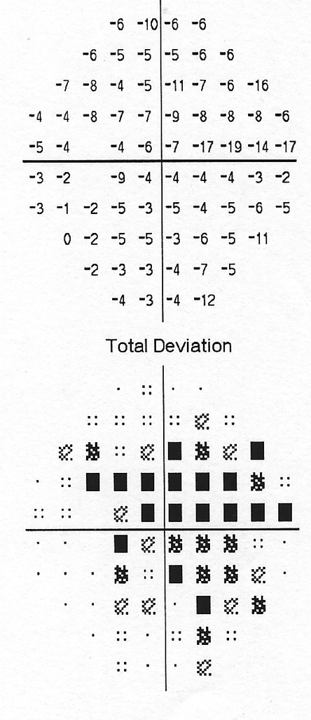
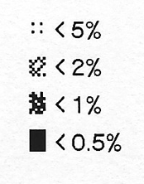
Zone 4: total deviation
Point-by-point difference from the expected value for age-related normal individuals
Cannot confirm a scotoma
Look at the number and pattern of symbols
4
© Thomas R
Modified by
Tumbocon JA
Notes:
Total deviation is depicted using both a numerical plot and a probability plot. The probability plot displays the probability of a visual abnormality occurring in the normal population, where the black squares indicate that < 0.5% of the normal population would be expected to have a similar depression in the same area.
Diagnosis of glaucoma typically depends on identifying localised field loss. While the total deviation plot highlights scotomas involving a large area of the visual field, it will not detect any hidden scotomas present in the depressed field.
Reference
Thomas R, George R. Interpreting automated perimetry. Indian J Ophthalmol 2001; 49: 125–40.

Slide 29
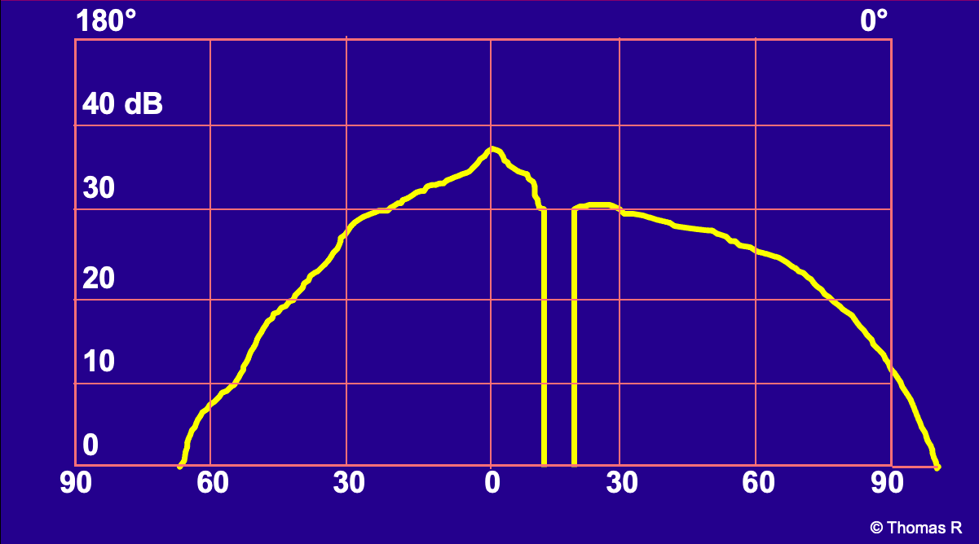
Normal “Hill of vision”
Notes:
The yellow line represents the expected hill of vision for normal individuals of the same age as the patient.
Reference
Thomas R, George R. Interpreting automated perimetry. Indian J Ophthalmol 2001; 49: 125–40.

Slide 30
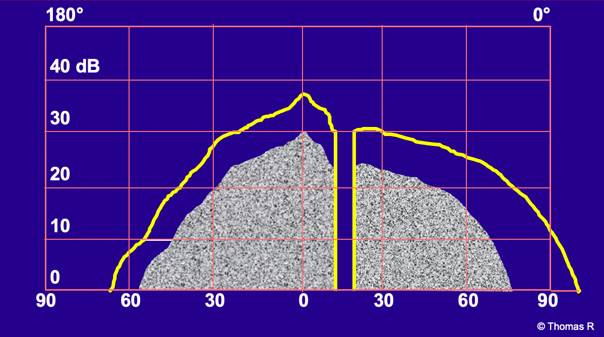
Generalised depression
Notes:
The shaded area shows depression of the patient’s hill of vision relative to the age-adjusted normal hill of vision (yellow line). Deviation from the normal hill of vision is also highlighted by the total deviation plot.
Depression of the hill of vision is usually caused by media opacities (cataracts, corneal opacities, refractive error and miosis).
Reference
Thomas R, George R. Interpreting automated perimetry. Indian J Ophthalmol 2001; 49: 125–40.

Slide 31
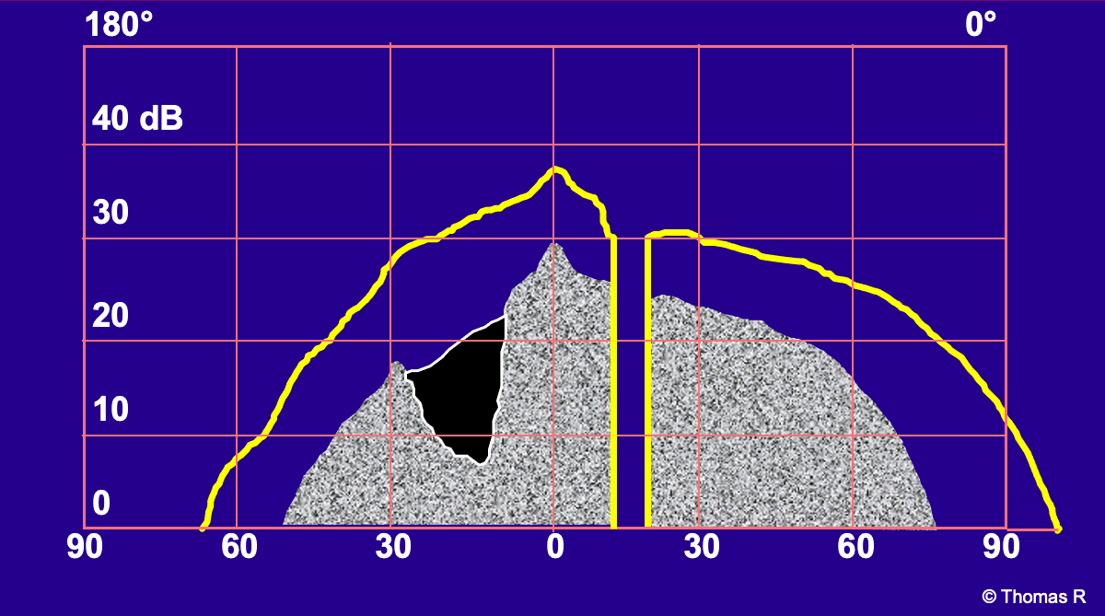
Generalised depression with ‘hidden’ localised scotoma
Notes:
Again, the normal hill of vision is represented by the yellow line and the shading represents the patient’s depressed hill of vision (i.e. the total deviation plot). However, the total deviation plot does not reveal a scotoma (shaded black) hidden within the depressed field.
This type of localised scotoma may occur in glaucoma patients who also have a depressed hill of vision due to cataract, miosis, refractive error, or other causes. Localised scotomas are diagnostic in glaucoma.
Reference
Thomas R, George R. Interpreting automated perimetry. Indian J Ophthalmol 2001; 49: 125–40.

Slide 32
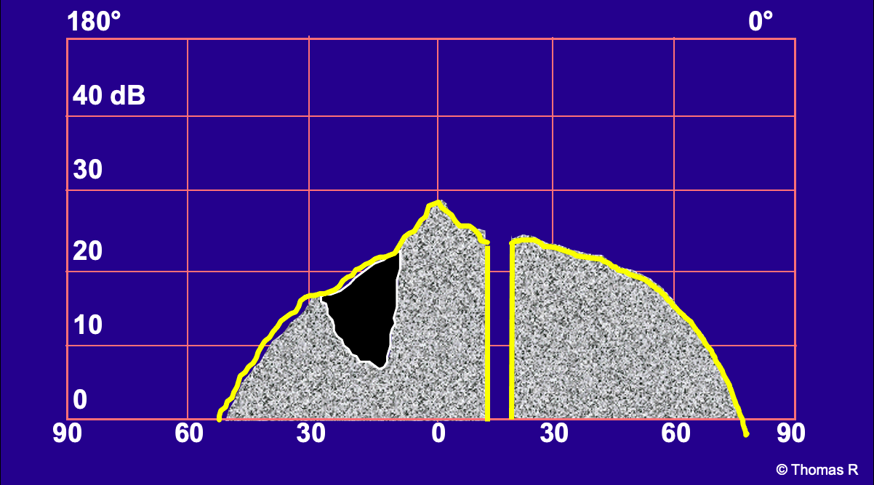
Pattern deviation plot: scotoma revealed after adjusting for generalised depression
Notes:
Zone 5 on the perimetry printout is the pattern deviation plot, in which the perimeter adjusts for overall depression of the visual field in order to reveal any localised scotomas hidden within a depressed field.
Reference
Thomas R, George R. Interpreting automated perimetry. Indian J Ophthalmol 2001; 49: 125–40.

Slide 33
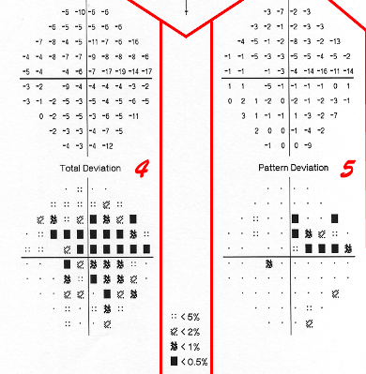
Zone 5: pattern deviation
Reveals focal defects after adjusting for overall depression (or elevation) of the hill of vision
Confirms a scotoma
© Thomas R
Modified by
Tumbocon JA
Notes:
The pattern deviation plot is shown as both a numerical plot and a probability plot. Interpretation should focus on whether the probability plot contains any clusters of abnormal points in an expected area; this is more important than the probability symbols.
Abnormal points in the total deviation plot that remain in the pattern deviation plot represent scotomas.
Reference
Thomas R, George R. Interpreting automated perimetry. Indian J Ophthalmol 2001; 49: 125–40.

Slide 34
Examples of total and pattern deviation plots in different situations
© Thomas R
Notes:
The next four slides show examples of total and pattern deviation plots with corresponding ‘hill of vision’ diagrams to demonstrate the correct interpretation.

Slide 35
Normal ‘hill’ of vision
© Thomas R
Notes:
The total and pattern deviation plots are both clear.

Slide 36
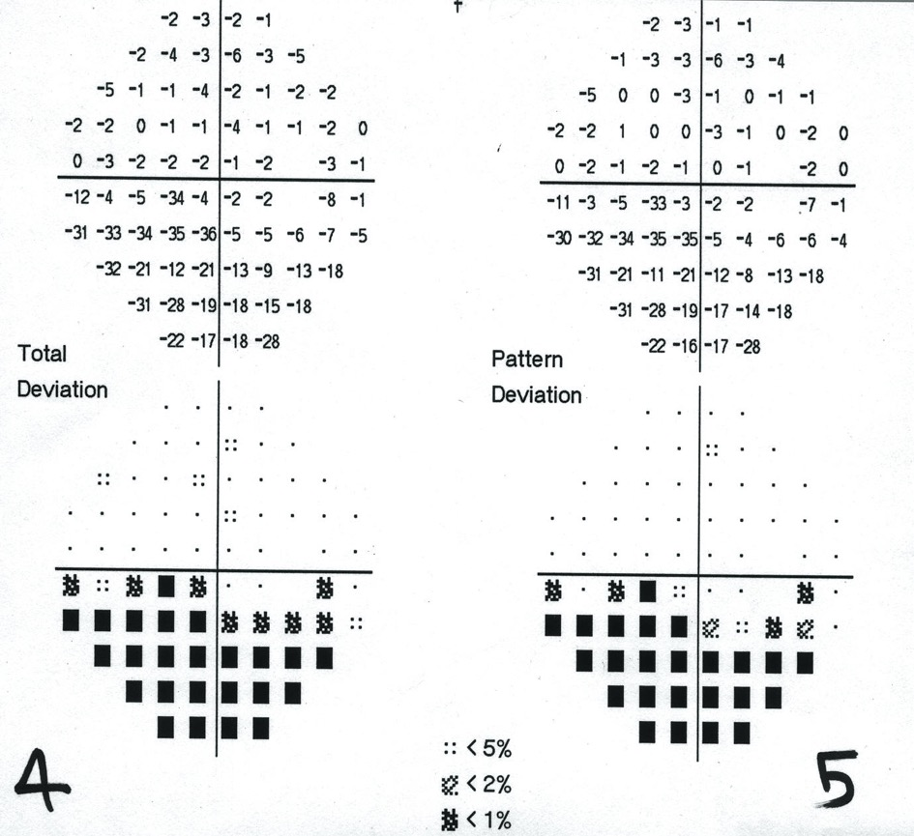
Localised scotoma
© Thomas R
Notes:
Abnormalities on the total deviation plot persist in the pattern deviation plot, revealing a localised scotoma.

Slide 37
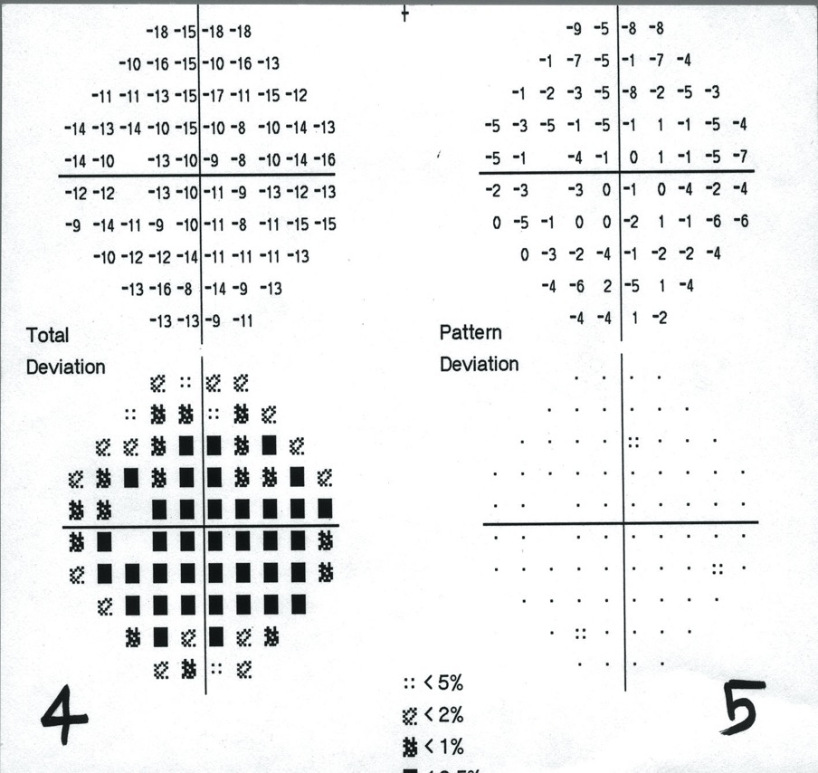
Generalised depression
© Thomas R
Notes:
The total deviation plot shows severe generalised depression, but the pattern deviation plot is clear – there is no localised scotoma.

Slide 38
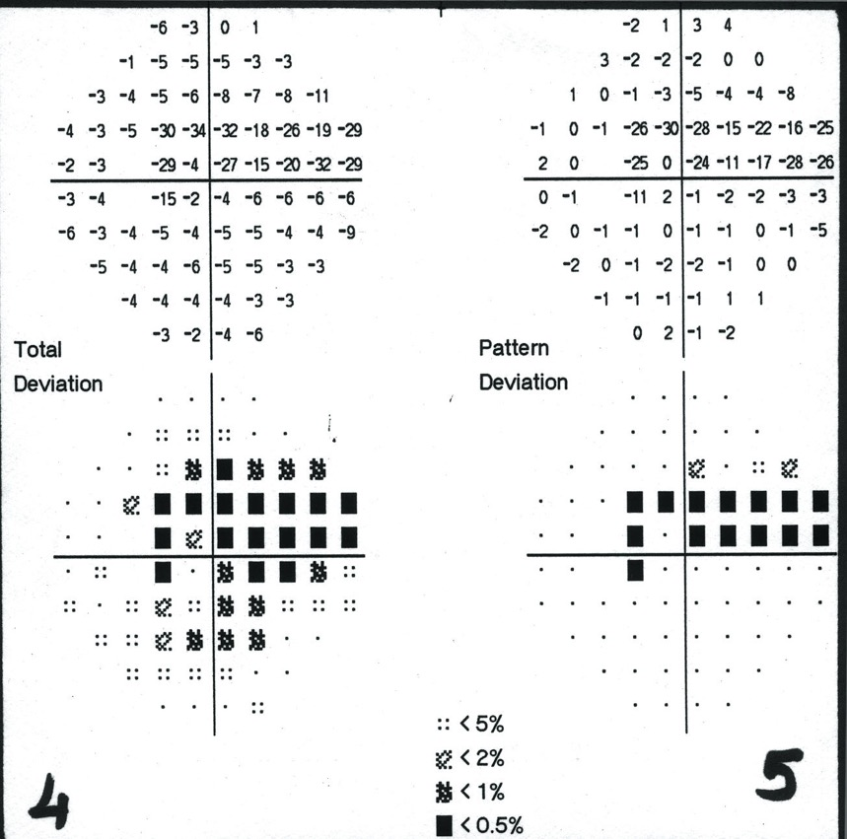
Generalised depression with ‘hidden’ localised scotoma
© Thomas R
Notes:
The total deviation plot shows generalised depression, while a localised scotoma becomes apparent on the pattern deviation plot.

Slide 39
1
8
2
3
7
4
5
6
© Thomas R
Modified by
Tumbocon JA
Notes:
Zone 6 displays the global indices, which are summary values providing information on the patient’s visual field.
Reference
Thomas R, George R. Interpreting automated perimetry. Indian J Ophthalmol 2001; 49: 125–40.

Slide 40
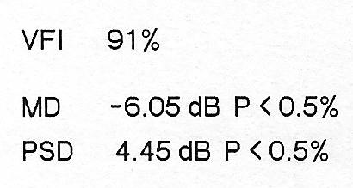
Global indices
All the information from all the points tested is reduced to single numbers
VFI: Visual Field Index
MD: Mean Deviation PSD: Pattern Standard Deviation
© Thomas R
Modified by
Tumbocon JA
Notes:
The following global indices are included in the perimetry printout:
Visual field index
mean deviation (MD)
pattern standard deviation (PSD)
The interpretation of global indices is discussed in the following slides.
Reference
Thomas R, George R. Interpreting automated perimetry. Indian J Ophthalmol 2001; 49: 125–40.

Slide 41
1
8
Both MD and PSD are derived from the total deviation plot
However, they provide different types of information
2
3
7
4
5
6
VFI: Visual Field Index
MD: Mean Deviation PSD: Pattern Standard Deviation
© Thomas R
Modified by
Tumbocon JA
© Thomas R

Slide 42
Global indices: Mean Deviation
Average difference between age-corrected normal sensitivity and measured threshold sensitivity values at all test point locations (e.g., values in the total deviation plot)
Positive value = ‘elevated’ field
Negative value = ‘depressed’ field (Cannot differentiate between diffuse vs. focal defect)
Provides similar information to total deviation
Cannot confirm the presence of a scotoma
VFI: Visual Field Index
MD: Mean Deviation PSD: Pattern Standard Deviation
© Thomas R
Modified by
Tumbocon JA
Notes:
The following global indices are included in the perimetry printout:
Visual field index
mean deviation (MD)
pattern standard deviation (PSD)
A negative MD represents depression of the hill of vision as a result of media opacities or a large scotoma. A positive MD would represent elevation of the hill of vision, i.e. a field that is better than normal.
Reference
Thomas R, George R. Interpreting automated perimetry. Indian J Ophthalmol 2001; 49: 125–40.

Slide 43
Global indices: Pattern Standard Deviation
Also derived from the total deviation plot
Indicates the degree to which the values differ from each other
Highlights ‘roughness’ or ‘pot-holes’ in the hill of vision
Provides similar information to the pattern deviation
Calls attention to scotomas
VFI: Visual Field Index
MD: Mean Deviation PSD: Pattern Standard Deviation
© Thomas R
Modified by
Tumbocon JA
Notes:
Like the pattern deviation plot, the PSD highlights irregularities in the visual field after correcting for any overall depression in the hill of vision and can identify hidden scotomas.
Reference
Thomas R, George R. Interpreting automated perimetry. Indian J Ophthalmol 2001; 49: 125–40.
The clinical role of PSD is questionable. Although PSD increases in the early stages of glaucoma development, it peaks in the moderate stages and subsequently decreases, thus it is not recommended for monitoring the development of a glaucomatous field over time.
Reference
European Glaucoma Society. Terminology and Guidelines for Glaucoma. Savona, Italy: Editrice DOGMA, 2008 (3rd Edn). Available at: www.eugs.org/eng/EGS_guidelines.asp. Accessed: 10 June 2011.

Slide 44
Global indices: Visual Field Index
An enhancement of MD that is less affected by cataract and more sensitive to changes near the center of the field to improve correspondence to retinal ganglion cell loss
Normal visual field is associated with values near 100%, while perimetric blindness has values approaching 0%
VFI or MD are the indices used to determine the rate of progression
VFI: Visual Field Index
MD: Mean Deviation PSD: Pattern Standard Deviation
Heijl A, Patella VM, Bengtson B. Effective perimetry 4th ed. Dublin: Zeiss; 2012; 5-7.
Notes:
An enhancement of MD that is designed to be less affected by cataract and more sensitive to changes near the center of the field to improve correspondence to ganglion cell loss
Normal visual field is associated with VFI values near 100%, while perimetric blindness produces values approaching 0%
VFI and MD are commonly used to monitor the rate of visual field progression due to their linear relationship with the severity of glaucomatous visual field loss.
Heijl A, Patella VM, Bengtson B. Effective perimetry 4th ed. Dublin: Zeiss; 2012; 5-7.

Slide 45
Notes:
Comarison of the global indices in various stages of glaucomatous visual field loss

Slide 46
1
8
2
3
7
4
5
6
© Thomas R
Modified by
Tumbocon JA

Slide 47
Zone 7: Glaucoma Hemifield Test
4
5
2
3
1
© Thomas R
Modified by
Tumbocon JA
Notes:
Zone 7 is the Glaucoma Hemifield Test (GHT), which compares five upper field sectors to five mirror images in the lower field.¹ The paired sectors are based on the anatomy of the retinal nerve fibre layer (RNFL).²
References
1. Thomas R, George R. Interpreting automated perimetry. Indian J Ophthalmol 2001; 49: 125–40.
2. Asman P, Heijl A. Glaucoma Hemifield Test. Automated visual field evaluation. Arch Ophthalmol 1992; 110: 812–9.
The Glaucoma Hemifield Test (GHT) is very important, but not infallible – as shown by the placement of sectors in the slide, the test is not designed to detect a temporal wedge defect. These defects are fortunately rare.
Reference
Thomas R, George R. Interpreting automated perimetry. Indian J Ophthalmol 2001; 49: 125–40.

Slide 48
Zone 7: Glaucoma Hemifield Test
POSSIBLE RESULTS:
Within normal limits
Outside normal limits:
Difference bet. upper & lower hemifield occurs in < 1% of normal
Borderline
Occurs in 1% - 3% of "normal"
General reduction of sensitivity:
Equal reduction in sensitivity found only in < 0.5% of normals
Abnormally high sensitivity:
Uniformly high sensitivity found only in > 99.5% of population
4
5
2
3
1
© Thomas R
Modified by
Tumbocon JA
Notes:
Zone 7 is the Glaucoma Hemifield Test (GHT), which compares five upper field sectors to five mirror images in the lower field.¹ The paired sectors are based on the anatomy of the retinal nerve fibre layer (RNFL).²
References
1. Thomas R, George R. Interpreting automated perimetry. Indian J Ophthalmol 2001; 49: 125–40.
2. Asman P, Heijl A. Glaucoma Hemifield Test. Automated visual field evaluation. Arch Ophthalmol 1992; 110: 812–9.
The GHT is considered to be outside normal limits if:
the values for any sector differ between the upper and lower field to a degree found in < 1% of the population, or
the values for any pair of sectors are depressed to a degree found in < 0.5% of the population.
The test is classed as borderline if neither of the above conditions apply, but the observed difference between the upper and lower fields for a given sector would be expected in < 3% of the population.
If the best part of the visual field is depressed or elevated to a degree expected in < 0.5% of the population, the field is considered to have general reduction of sensitivity or abnormally high sensitivity, respectively.
Reference
Thomas R, George R. Interpreting automated perimetry. Indian J Ophthalmol 2001; 49: 125–40.
The Glaucoma Hemifield Test (GHT) is very important, but not infallible – as shown by the placement of sectors in the slide, the test is not designed to detect a temporal wedge defect. These defects are fortunately rare.
Reference
Thomas R, George R. Interpreting automated perimetry. Indian J Ophthalmol 2001; 49: 125–40.

Slide 49
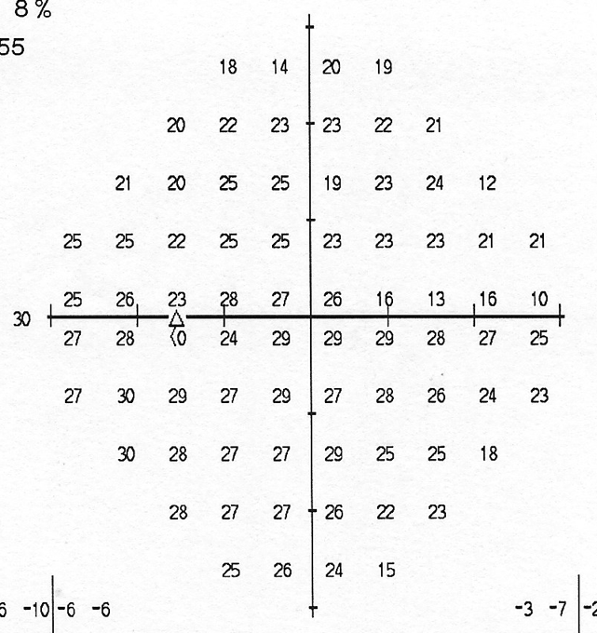
Zone 8: Actual threshold values
1
8
2
8
3
7
4
5
6
© Thomas R
Modified by
Tumbocon JA
Notes:
Zone 8 shows the actual threshold values. These should be examined for any pattern or scotoma if all zones are normal but the clinical features are very suspicious. The threshold values may suggest a scotoma, which is defined by comparison with the surrounding regions rather than the normal values. It is also valuable to compare the thresholds in the upper and lower arcuate areas and look for any clinical correlation.
If a defect is repeatable and correlates with the clinical features, treatment can be initiated.
Reference
Thomas R, George R. Interpreting automated perimetry. Indian J Ophthalmol 2001; 49: 125–40.

Slide 50
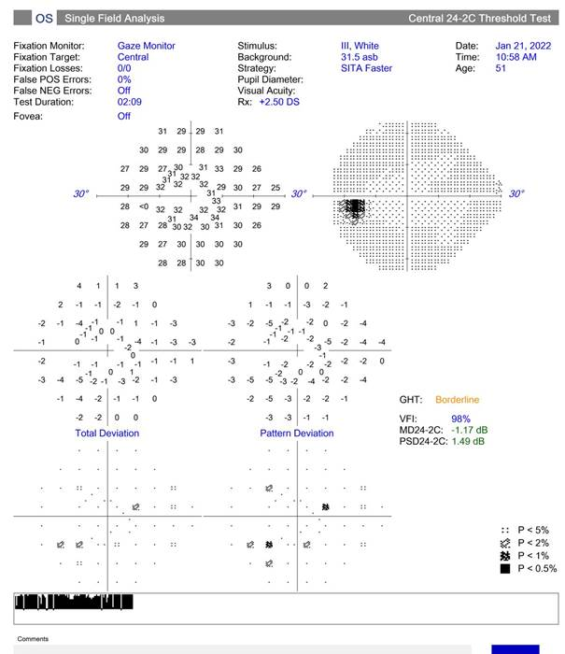
24-2C : 10 additional central test points
In early 2019, the 24-2C was commercially available for the Humphrey Field Analyzer. It combines the speed of a SITA-Faster with an extra 10 points integrated into a 24-2 grid.
Ten additional points were described as selected from common areas affected by glaucoma.
Although 24-2C adds little time, there is no apparent difference between 24-2 and 24-2C in the ability to stage or identify cases of glaucomatous field loss. Indeed, the presence of a central fault is often indicated by a current 24-2 loss anyway.

Slide 51
Reminders:
Never rely on the grey scale alone to make a diagnosis
Never rely on the visual field alone to make a diagnosis
Always correlate with anatomic/ structural and clinical findings
© Thomas R
Modified by
Tumbocon JA
Notes:
In summary, the clinician should remember never to rely on the grey scale or the visual field alone when making a diagnosis; perimetry results must always be correlated with clinical findings.

Slide 52
Questions
Is there a visual field defect?
Is it due to glaucoma?
Is the defect progressing?
© Thomas R

Slide 53
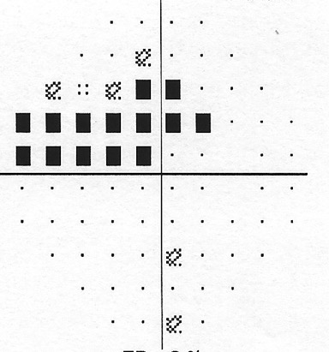
Glaucomatous defects
Characteristics of glaucomatous defects:
Follows a retinal nerve fiber layer pattern
Clustered in neighbouring test points (localisied)
Defect(s) should correlate with the appearance of the optic disc and retinal nerve fiber layer
Rarely crosses the horizontal midline/ rarely extends across the horizontal midline
Located in the mid-periphery* (5º to 25º from fixation)
Not attributable to other pathology
Reproducible
© Thomas R
Modified by
Tumbocon JA
* Applicable to early/moderate cases.
Asia Pacific Glaucoma Guidelines 3rd ed. 2016.
Notes:
This slide lists some typical characteristics of glaucomatous visual defects, while the following slides describe the criteria used to identify a glaucomatous visual field defect on an automated perimetry printout.
Reference
South East Asia Glaucoma Interest Group. Asia Pacific Glaucoma Guidelines, 2nd Edition. Sydney: SEAGIG, 2008. Available at: www.seagig.org/toc/APGGuidelinesNMview.pdf.

Slide 54
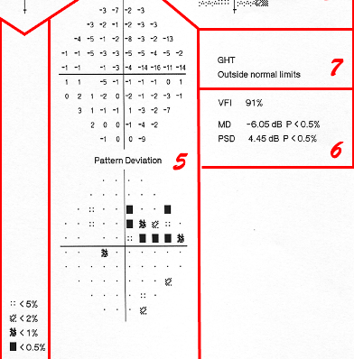
Criteria for glaucomatous defects (1)
Pattern deviation plot
≥ 3 non-edge points with p < 5% and one point with p < 1%
Disregarding edge points not necessary in 24-2 test
Cluster in arcuate area
© Thomas R
Modified by
Tumbocon JA
Notes:
Anderson and Patella proposed three criteria for a glaucomatous field defect.¹
[1] Pattern deviation plot²
The outside edge points in the pattern deviation plot must be ignored if a 30–2 program (testing out to 30 degrees) is used, but this is not necessary for a 24–2 program.
The field defect may be labelled as early glaucoma if the pattern deviation plot contains a cluster of ≥ 3 non-edge points in the arcuate area, all of which are depressed to a degree that would be found in < 5% of the population and one of which is depressed to a degree found in < 1% of the population.
The pattern deviation plot reproduced on the slide meets the first criterion for a glaucomatous defect.
References
1. Anderson DR, Patella VM. Automated Static Perimetry. 2nd Edn. St Louis: Mosby, 1999.
2. Thomas R, George R. Interpreting automated perimetry. Indian J Ophthalmol 2001; 49: 125–40.

Slide 55
Criteria for glaucomatous defects (2)
PSD or CPSD depressed with p < 5%
© Thomas R
Modified by
Tumbocon JA
Notes:
[2] CPSD or PSD depressed
For a defect to be labelled glaucomatous, either the CPSD or the PSD should be depressed to a degree expected in < 5% of the population. This is the case in the example shown on this slide.
Reference
Thomas R, George R. Interpreting automated perimetry. Indian J Ophthalmol 2001; 49: 125–40.

Slide 56
Criteria for glaucomatous defects (3)
Glaucoma hemifield test (GHT): Outside normal limits
© Thomas R
Modified by
Tumbocon JA
Notes:
[3] Abnormal GHT
The third criteria for a glaucomatous defect is a GHT outside normal limits, as shown on this slide.
Reference
Thomas R, George R. Interpreting automated perimetry. Indian J Ophthalmol 2001; 49: 125–40.

Slide 57
Three criteria for glaucomatous defects*
Pattern deviation plot
– ≥ 3 non-edge points p < 5% with one point with p < 1%
– Cluster in arcuate area
PSD or CPSD p < 5%
Abnormal GHT
© Thomas R
Modified by
Tumbocon JA
*Anderson DR, Patella VM. Automated Static Perimetry. 2nd Edn. St Louis: Mosby, 1999.
Notes:
The example shown meets all three criteria for establishing a diagnosis of glaucoma.
Whether all three criteria are required for diagnosis depends on the context: if the clinical features strongly suggest glaucoma, one criterion is sufficient to make a diagnosis, whereas if the clinical features are not at all suspicious, all three criteria must be positive and both the field and clinical examinations should be repeated. In general, requiring the fulfilment of all three criteria will minimise false positives, but potentially miss very early glaucomas, whereas the opposite is true if only one criterion is required.
Reference
Thomas R, George R. Interpreting automated perimetry. Indian J Ophthalmol 2001; 49: 125–40.

Slide 58
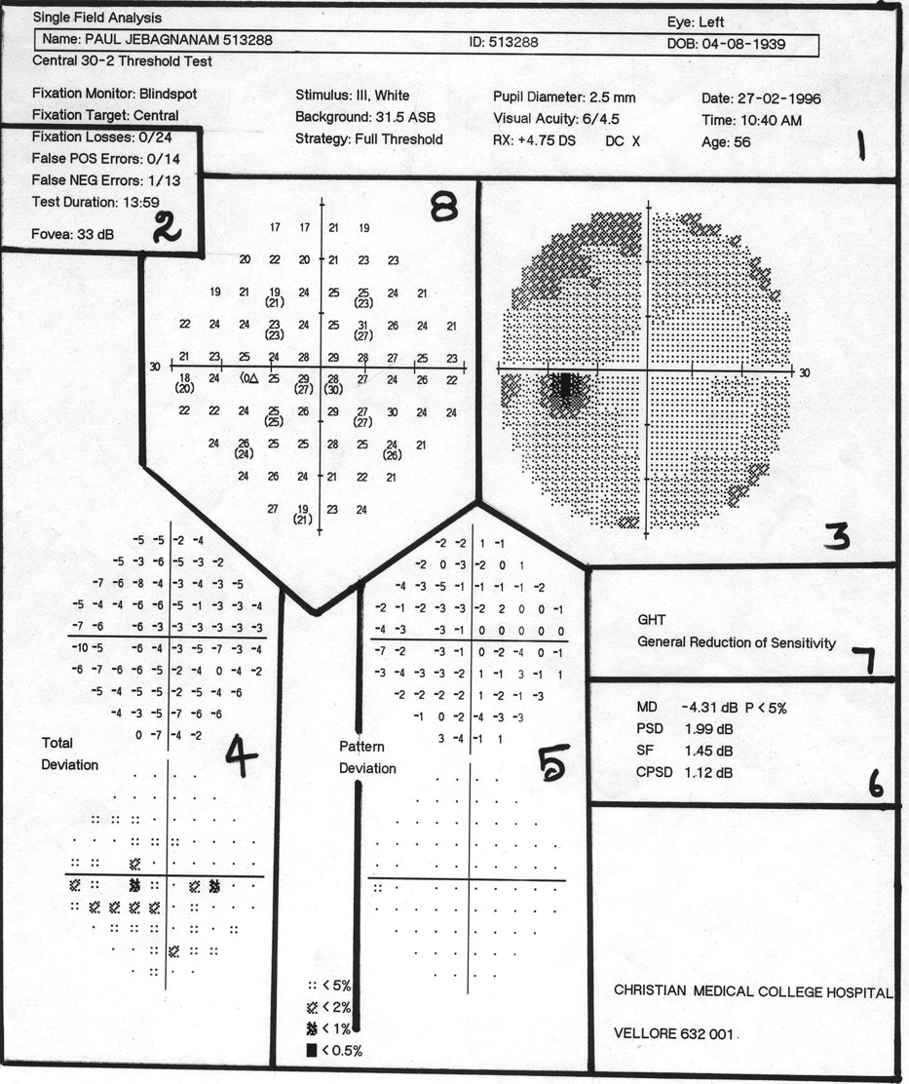
Try interpreting this visual field, going from zones 1–8
© Thomas R

Slide 59
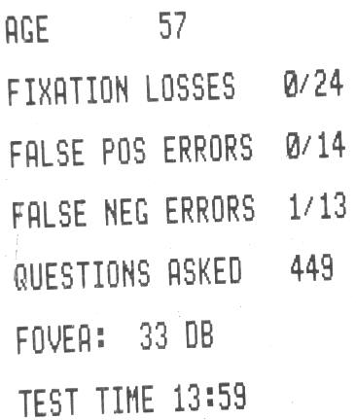
2
2
© Thomas R
Notes:
Zones 1 and 2:
confirm that the patient details are correct and that the appropriate correction was used
a 30–2 program was employed with a routine fixation target
the pupil diameter is 2.5 mm
reliability criteria are acceptable.
Reference
Thomas R, George R. Interpreting automated perimetry. Indian J Ophthalmol 2001; 49: 125–40.

Slide 60
Continue interpreting this visual field: zones 3–8
Remember: no more than a glance at the grey scale
© Thomas R
Notes:
The total deviation plot (zone 4) shows a number of points that are depressed to a degree found in < 5% of the population; however, no localised scotomas are apparent on the pattern deviation plot (zone 5). This overall depression of the visual field could be caused by cataract, miosis or the patient having a bad (testing) day.
The global indices (zone 6) are normal exept for the MD, which reflects an overall depression of the hill of vision.
The GHT (zone 7) shows `general reduction of sensitivity’.
All of the above findings are consistent with a generalised depression of the hill of vision.
The patient was in fact a glaucoma suspect. Although examination of the actual threshold (zone 8) showed depression of several points in the upper half of the visual field relative to the lower half, the patient was considered to be reliable and compliant and was subsequently followed without treatment.
Reference
Thomas R, George R. Interpreting automated perimetry. Indian J Ophthalmol 2001; 49: 125–40.

Slide 61
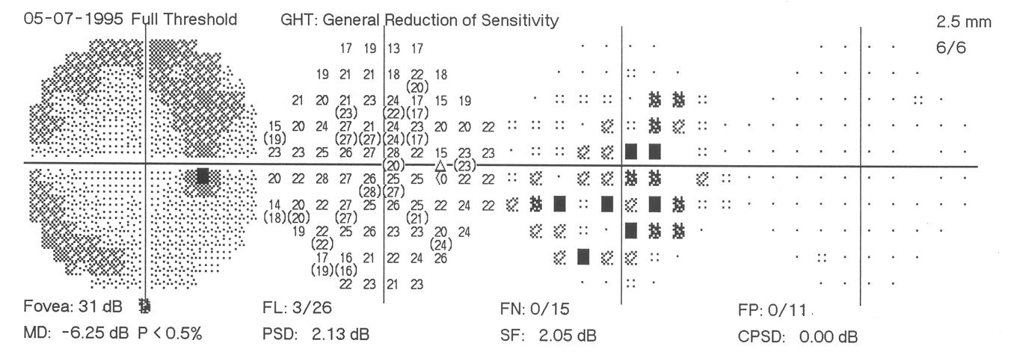
Typical cataract
© Thomas R
Notes:
This slide shows a typical visual field for a patient with a cataract, featuring overall depression with no abnormality on the pattern deviation plot.

Slide 62
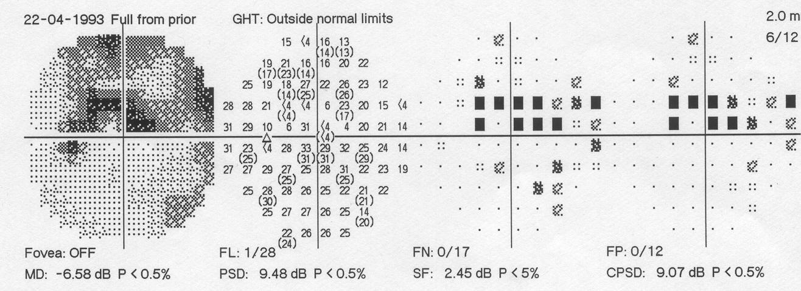
Typical glaucoma
© Thomas R
Notes:
This typical glaucomatous visual field shows several depressed points on the total deviation plot that persist in the pattern deviation plot. The GHT is outside normal limits and the CPSD is highly abnormal. All three criteria for a glaucomatous defect are met.

Slide 63
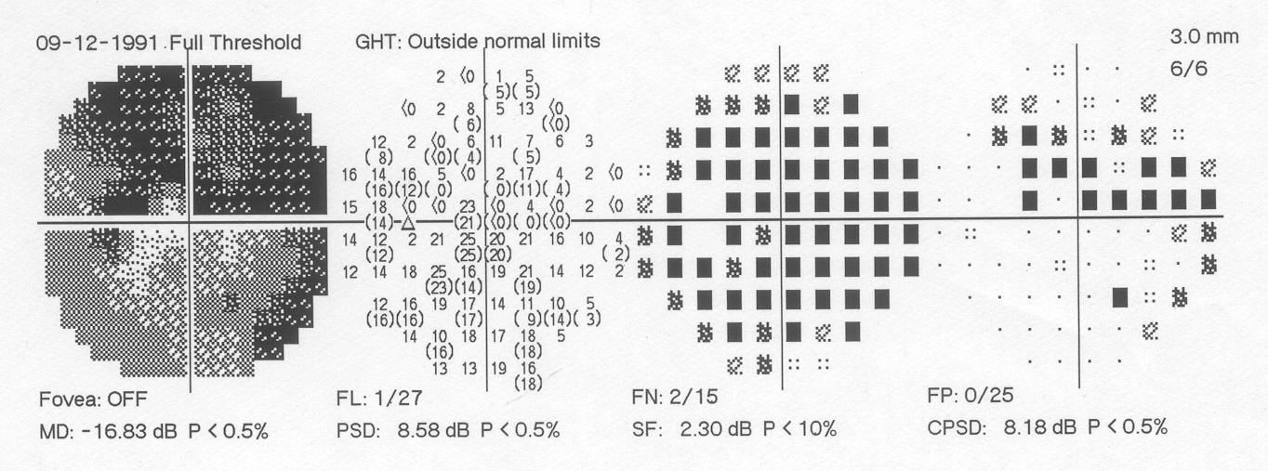
Glaucoma and cataract
© Thomas R
Notes:
The visual field shows typical features of both cataract and glaucoma:
the total deviation plot and MD indicate significant generalised depression of the visual field
the pattern deviation plot confirms the presence of a localised scotoma
the CPSD is highly abnormal and the GHT is outside normal limits.

Slide 64
Does this patient have glaucoma? (1)
© Thomas R
Notes:
Both the MD (p < 1%) and GHT indicate an overall depression of the visual field. The persistence of several depressed points in the pattern deviation plot hints at a scotoma, but the specific criteria for a glaucomatous defect are not met. The PSD also suggests a possible defect, but statistical significance is not reached (p < 10%). In this case, the optic disc examination and clinical findings are essential to confirm the diagnosis.

Slide 65
Does this patient have glaucoma? (2)
Only if the defects are repeatable and correlate with disc and clinical findings
© Thomas R
Notes:
This field shows overall depression (total deviation plot and MD with p < 2%). Several depressed points persist in the pattern deviation plot, but the PSD is not abnormal. The GHT is borderline. The clinical findings are again of paramount importance.

Slide 66
Questions
Is there a field defect?
Is it due to glaucoma?
Is the defect progressing?

Slide 67
Visual field progression
Field progression is characterised by:
widening or deepening of an existing scotoma
development of a new glaucomatous scotoma
occasionally, generalised field depression
Fluctuation in sensitivity is common and is not usually due to GON progression
GON, glaucomatous optic neuropathy.
Asia Pacific Glaucoma Guidelines 3rd ed. 2016.
Notes:
Visual field progression is characterised by expansion of an existing scotoma or development of a new glaucomatous scotoma. Generalised field depression can indicate field progression, but it is necessary to consider other possibilities such as cataract, miosis, or poor reliability.
Fluctuations in the visual field sensitivity are common, but only a small proportion of apparent changes are due to glaucoma progression.
Reference
South East Asia Glaucoma Interest Group. Asia Pacific Glaucoma Guidelines, 2nd Edition. Sydney: SEAGIG, 2008. Available at: www.seagig.org/toc/APGGuidelinesNMview.pdf.

Slide 68
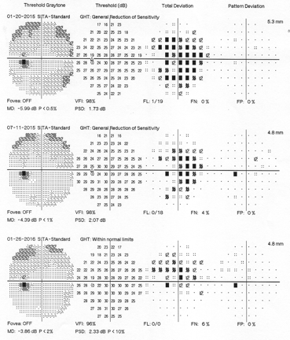
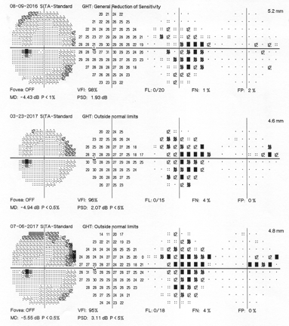
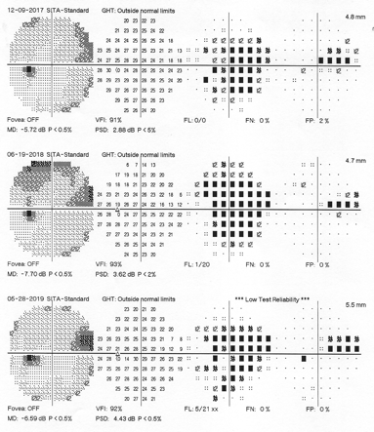
Detecting progression
Is the defect progressing?
Compare to selected baseline
Discard learning fields from baseline
Recognise ‘false’ progression
© Thomas R
Modified by
Tumbocon JA
For more information, see Module 9: Monitoring for progression
Notes:
Determining whether a glaucomatous defect is progressing requires a comparison with baseline visual fields, which should be obtained after the patient has become familiar with automated perimetry. The typical learning curve is 2–3 fields.
Module 9: Monitoring for progression covers visual field progression in more detail.
Reference
Thomas R, George R. Interpreting automated perimetry. Indian J Ophthalmol 2001; 49: 125–40.

Slide 69
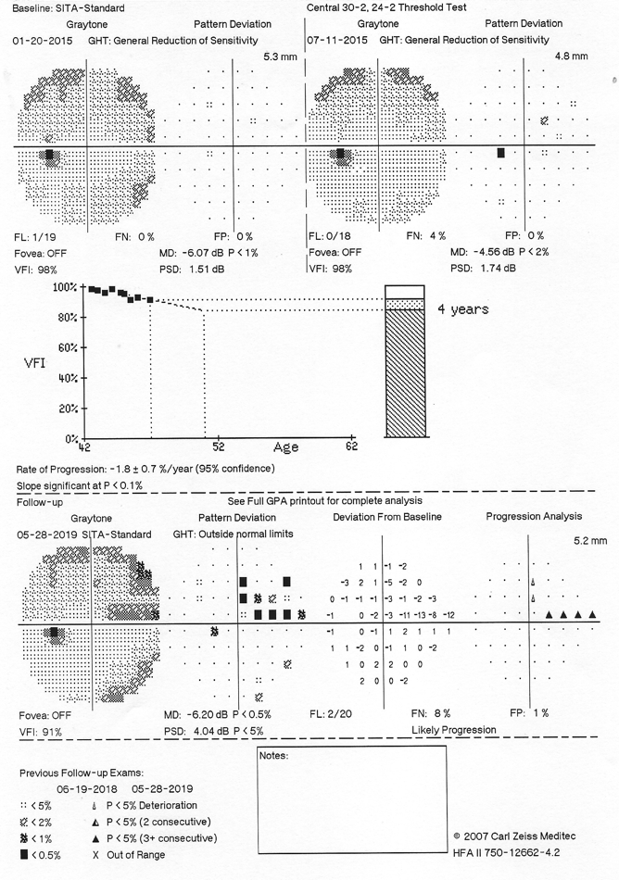
Detecting progression:
Humphrey Guided Progression Analysis (GPA)
Baseline exams
Rate of progression: trend analysis of patient’s overall visual field history (Trend analysis)
Current VF summary including GPA alert (Event analysis)
© Tumbocon JA

Slide 70
© Tumbocon JA

Slide 71
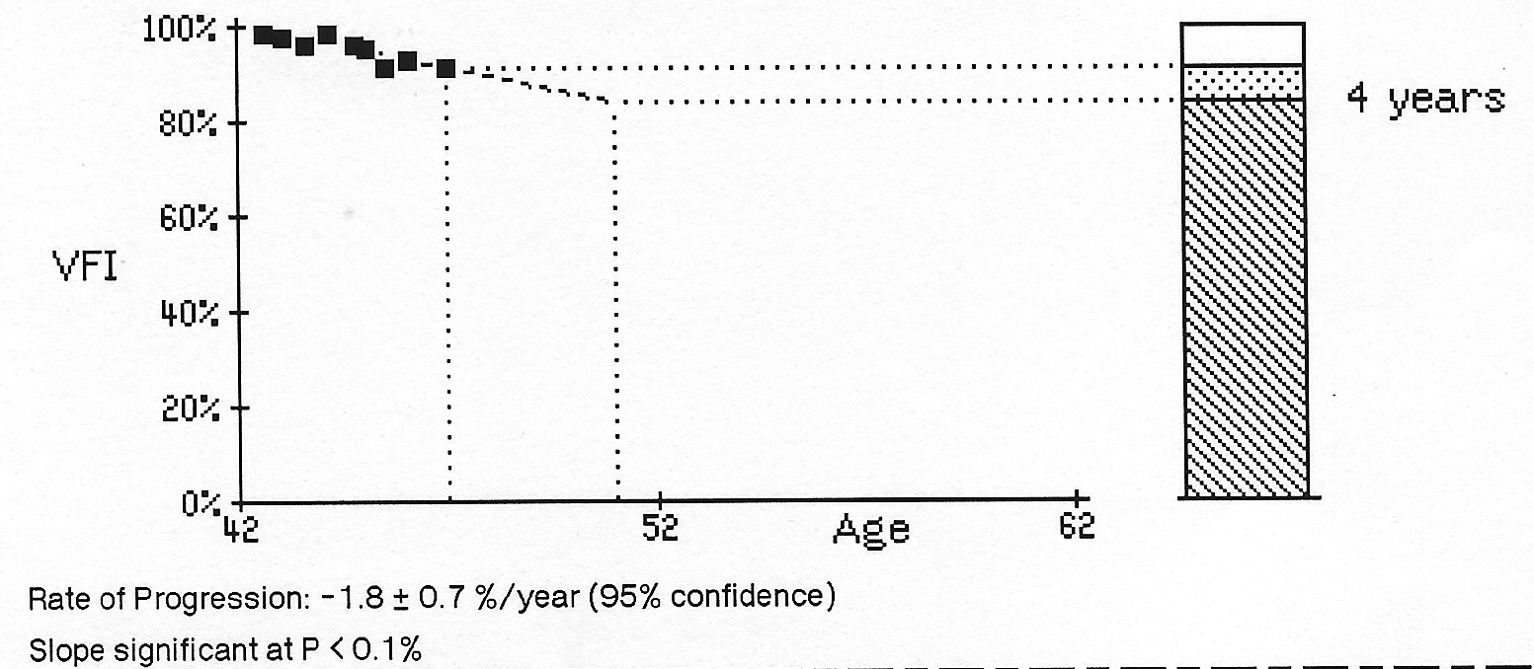
Detecting progression:
Humphrey Guided Progression Analysis (GPA)
Trend Analysis
Current amount of
visual function
VFI of series of tests & current slope of change
Extrapolation of current trend
Loss to date
Projected future loss with current level of treatment
Linear regression analysis of VFI / rate of progression & if the slope is significant
© Tumbocon JA

Slide 72
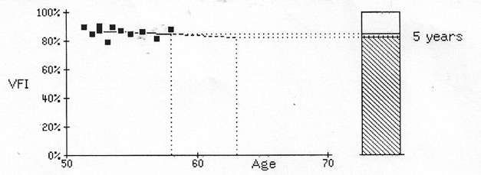
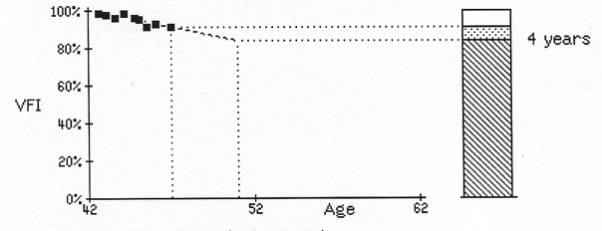
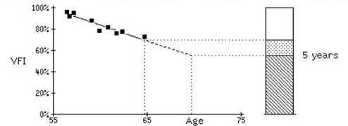
Detecting progression:
Humphrey Guided Progression Analysis (GPA)
Trend Analysis
Stable visual field with inter-test fluctuation
Significant rate of progression
Faster rate of progression
© Tumbocon JA

Slide 73
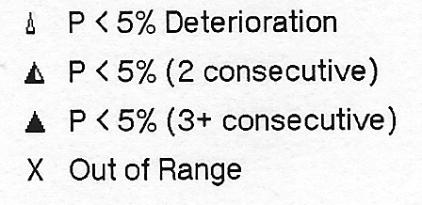
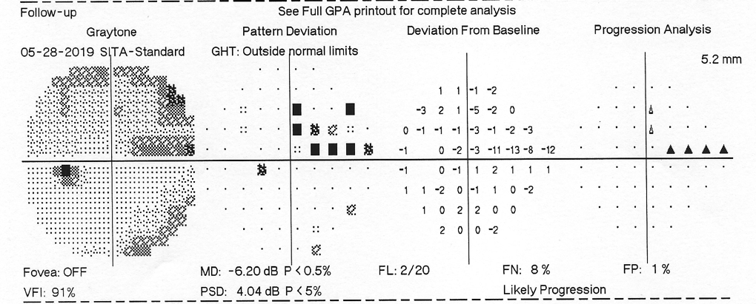
Detecting progression:
Humphrey Guided Progression Analysis (GPA)
Event Analysis
GPA alert - possible results
Likely progression
Possible progression
No progression detected
© Tumbocon JA

Slide 74
For more information, see Module 9: Monitoring for progression

Slide 75
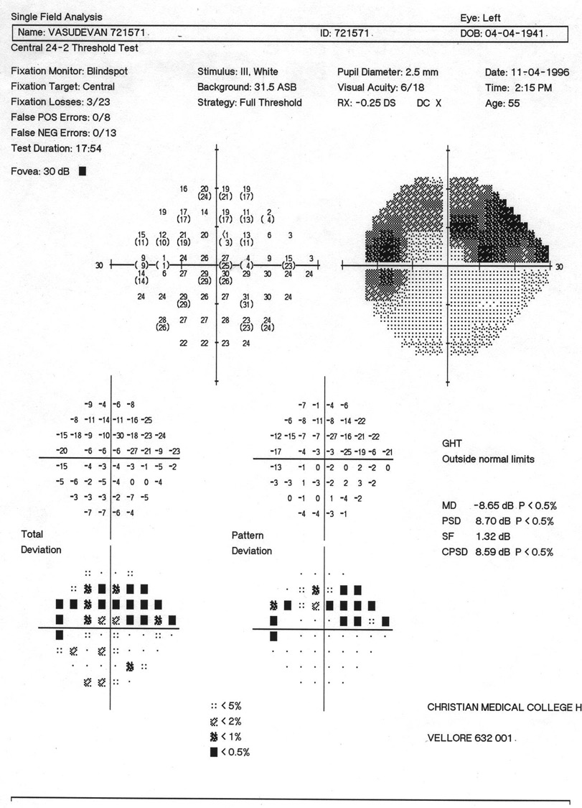
Applying the skills
Does this field fulfill the criteria for a glaucomatous defect?
Does this patient have glaucoma?
© Thomas R
© Thomas R
Notes:
The field fulfils all the criteria for a glaucomatous defect:
zones 1 and 2 are normal
zone 3 shows an arcuate defect
the total deviation plot contains several points that are significantly depressed, including ≥ 3 depressed non-edge points
the pattern deviation plot shows an arcuate scotoma
the global indices, including both PSD and CPSD, are significantly abnormal, with levels found in < 0.5% of the normal population
the GHT is outside normal limits.
Reference
Thomas R, George R. Interpreting automated perimetry. Indian J Ophthalmol 2001; 49: 125–40.

Slide 76
Not unless the field defect correlates with clinical findings
Never diagnose based on the visual field ALONE
© Thomas R
© Thomas R
Notes:
The optic disc photograph for this patient shows an inferior coloboma that explains the field defect, once again highlighting the importance of correlating field defects with the clinical findings.
Reference
Thomas R, George R. Interpreting automated perimetry. Indian J Ophthalmol 2001; 49: 125–40.

Slide 77
Automated perimetry: warning
Sophisticated techniques and elaborate data printouts should not seduce us into a false sense of security or a misplaced belief in the validity or reliability of automated perimetry*
* Zalta AH. Ophthalmology 1989; 96: 1302–11.
Notes:
Zalta reported the presence of lens rim artefacts in 10.4% of 704 visual fields examined retrospectively and in 6.2% of 276 fields examined prospectively using the HFA 30–2 program with a corrective lens. The temporal quadrant was commonly involved.
Interpretational errors related to lens rim artefacts resulted in overdiagnosis more often than underdiagnosis. Risk factors for lens rim artefacts included older age, high hyperopic correction and location-specific involvement.
Reference
Zalta AH. Lens rim artifact in automated threshold perimetry. Ophthalmology 1989; 96: 1302–11.

Slide 78
INTERPRETATION OF OCTOPUS VISUAL FIELD EXAMINATION
Notes:
This section of the presentation provides a brief overview of the interpretation of visual fields obtained using the Octopus perimeter.

Slide 79
Humphrey vs. Octopus perimetry
Parameter | Octopus 300 | HFA 700 series
Bowl type | Direct projection | Aspherical bowl
Background luminance | 10 cd/m² (31.4 asb) | 10 cd/m² (31.5 asb)
Stimulus size Stimulus duration Luminance for 0 dB | Goldmann III and V 100 ms 4800 asb | Goldmann I–V 200 ms 10,000 asb
Measuring range | 0–40 dB | 0–40 dB
Test strategies | 4–2–1 dB bracketing strategy Dynamic Tendency oriented perimetry (TOP) | 4–2 dB bracketing strategy SITA Standard SITA Fast
Weijland A et al. Automated Perimetry: Visual Field Digest. 5th Edn. Köniz: Haag-Streit AG, 2004.
Notes:
This slide compares the main test parameters and strategies used with the Octopus 300 and HFA 700 series.¹ Note the difference in the luminance at 0 dB (the brightest stimulus the perimeter can produce) between the Octopus 300 and HFA 700 series. As a consequence of this and other differences, normal values are 3–4 dB higher for HFA 700 compared with Octopus perimeters.¹ However, defects (local loss values) are virtually identical between different perimeters (e.g. a 6 dB defect always means an increase of 0.6 log units in the individual threshold luminance compared to the normal threshold).¹
Octopus testing typically takes 8–12 min to complete using the normal bracketing strategy, 5–8 min with the Dynamic strategy and 2–3 min using tendency-oriented perimetry (TOP), an accelerated thresholding strategy that assesses sensitivity at each location only once and determines the threshold of neighbouring points by interpolation.^{2,3} Using the TOP strategy, small localised scotomas may appear somewhat wider, but more shallow, compared with traditional threshold algorithms.³
Commonly used test point patterns used with Octopus perimeters include Program 32 (identical to the Humphrey 30-2 test pattern), G1 and G2, which cover the central 30° field.⁴
References
1. Weijland A, Fankhauser F, Bebie H, Flammer J. Automated perimetry: visual field digest. 5th Edn. Köniz: Haag-Streit AG, 2004–2006. Available at: www.haag-streit.com/fileadmin/haagstreit_international/schulung/monhart/octopus_various/AutomatedPerimetry_2006.pdf. Accessed 13 April 2011.
2. Haag-Streit International. Octopus 300 & 900 perimeters. Available at: www.haag-streit.com/fileadmin/haagstreit_international/Documents/Publicity/ Brochure_Octopus_300_900_e_A4.pdf. Accessed 13 April 2011.
3. Morales J, Weitzman ML, Gonzalez de la Rosa M. Comparison between Tendency-Oriented Perimetry (TOP) and Octopus threshold perimetry. Ophthalmology 2000; 107: 134–42.
4. European Glaucoma Society. Terminology and Guidelines for Glaucoma. Savona, Italy: Editrice DOGMA, 2008 (3rd Edn). Available at: www.eugs.org/eng/EGS_guidelines.asp. Accessed: 10 June 2011.

Slide 80
Octopus global indices
MS Mean sensitivity
MD Mean defect
Average of all values corrected for age
LV Loss variance
Equivalent to PSD. The square root (sLV) is useful for following fields over time
SF Short-term fluctuation
CLV ‘Corrected’ loss variance
Equivalent to corrected PSD
RF Reliability factor
Weijland A et al. Automated Perimetry: Visual Field Digest. 5th Edn. Köniz: Haag-Streit AG, 2004.
Notes:
This slide shows the global indices included on earlier Octopus 7-in-1 reports.¹
Mean defect (MD), like the HFA mean deviation index, enables a rapid assessment of the overall depression or elevation of the field. The normal tolerance range is from –2 to +2 dB.^{1,2} Note that in the Octopus system, a more positive MD value indicates an increasing defect, in contrast to the HFA system, where field worsening is associated with negative MD values.³
The loss variance (LV) increases dramatically as glaucoma progresses, so the square root of LV (sLV) is used to follow fields over time.¹
Short-term fluctuation (SF) is obtained by testing the patient twice in one session, to ensure an accurate diagnosis in borderline situations.¹
Corrected loss variance (CLV) measures localised loss independent of SF,¹ and is equivalent to corrected PSD in the Humphrey system. Like PSD, CLV increases in the early stages of the disease but decreases in advanced field loss, limiting its clinical value.³
The reliability factor (RF) is the percentage of missed catch trials (i.e. false positive and false negative answers) and should be under 15%.^{1,2}
Slide 83 shows an updated Octopus 7-in-1 report using EyeSuite software.
References
1. Weijland A, Fankhauser F, Bebie H, Flammer J. Automated perimetry: visual field digest. 5th Edn. Köniz: Haag-Streit AG, 2004–2006. Available at: www.haag-streit.com/fileadmin/haagstreit_international/schulung/monhart/octopus_various/AutomatedPerimetry_2006.pdf. Accessed 13 April 2011.
2. Haag-Streit AG. OCTOPUS Seven-in-One Report. www.octopus.ch/products/fr6_seven_in_one.htm. Accessed: 12 October 2006.
3. European Glaucoma Society. Terminology and Guidelines for Glaucoma. Savona, Italy: Editrice DOGMA, 2008 (3rd Edn). Available at: www.eugs.org/eng/EGS_guidelines.asp. Accessed: 10 June 2011.

Slide 81
Humphrey vs. Octopus perimetry
Humphrey
Octopus
Patient Information
Patient Information
Reliability Indices
Reliability Indices
Threshold Printout
Threshold Printout
Total Deviation Plot
Comparisons Plot
Pattern Deviation Plot
Corrected Comparisons Plot
Probability Symbols
Probability Symbols
Global Indices
Global Indices
Glaucoma Hemifield Test
Bebie Curve

Slide 82
Humphrey vs. Octopus perimetry:
Humphrey
Octopus
Mean Sensitivity
Mean Deviation (MD)
Mean Defect (MD)
Pattern Standard Deviation (PSD)
Loss Variance (LV)
Visual Field Index (VFI)

Slide 83
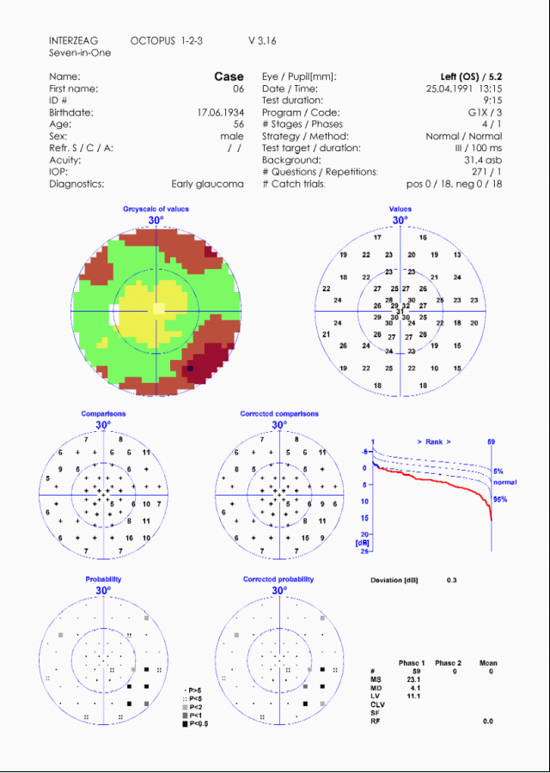
Patient data and refraction
Strategy and test parameters
Grey scale
Actual values
Comparison tables
Bebie (defect) curve
Deviation
Probability plots
Global indices
Notes:
This slide shows an Octopus 7-in-1 visual field printout from a patient with early glaucoma. [A more recent 7-in-1 format is shown on slide 83]
Patient data – the date of birth is included to enable calculations from the age-matched normal database.
Strategy and test parameters – this area lists the test parameters, together with data such as the pupil size and false positive and negative responses.
Grey scale – the grey scale shows the depth and location of visual field defects (in colour or black and white, where darker areas indicate depression).
Actual values – the actual measured thresholds in decibels. These values must be related to age.
Comparison tables – these show the difference between the patient's test results and age-matched normal individuals. A '+' symbol indicates normal sensitivity with a tolerance range of 4 dB. Any uniform field depression (deviation, see below) is subtracted to highlight ‘hidden’ focal loss.
Bebie (defect) curve – the Bebie curve is a cumulative defect curve that distinguishes between uniform field depression (curve parallel to age-adjusted normal values) and focal defects typical of glaucoma (steep decline).
Deviation – documents the degree of uniform loss (dB).
Probability plots – these show the probability of a real defect. A full black square indicates a 99.5% probability of a defect.
Global indices – statistical information that facilitates rapid and easy assessment of the field. Global indices are discussed further in the following slide.
Reference
Haag-Streit AG. OCTOPUS Seven-in-One Report. www.octopus.ch/products/fr6_seven_in_one.htm. Accessed: 12 October 2006.

Slide 84
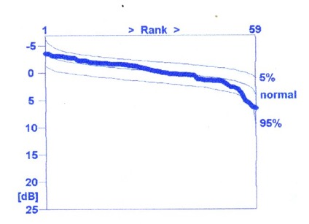
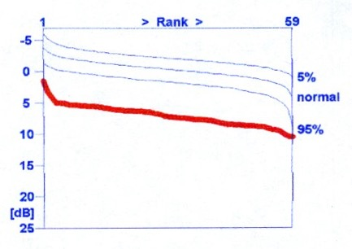
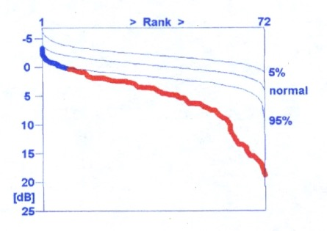
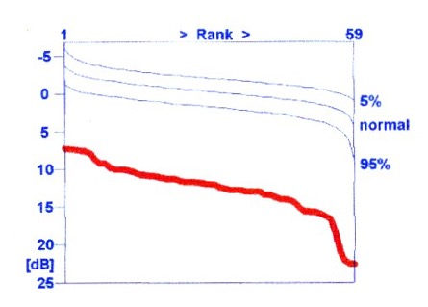
Octopus perimetry
Defect (Bebie) curve
No visual field defect
Generalised depression /
Diffuse defect
Focal defects
(scotoma)
Combined diffuse and
focal defects
Ranking all defects values from left to right, the defect curve shows the actual field results together with the normal bandwidth. It clearly differentiates uniform depression (parallel to the band of normality) from focal defects (steep decline).
Lat-Luna MM. Automated visual field examination. In: Aquino MV, Tumbocon JA, De Guzman MHP eds. Glaucoma Handbook. Quezon City: St. Luke’s Medical Center; 2012
© Tumbocon JA

Slide 85
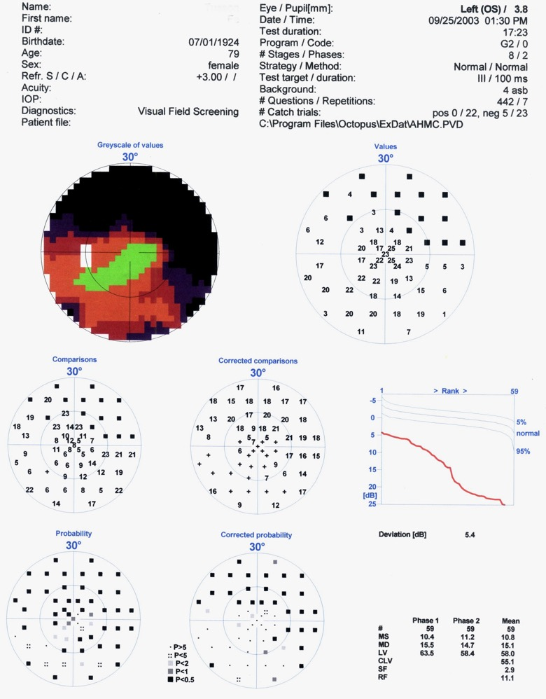
Octopus Print out
© Thomas R
Modified by
Tumbocon JA

Slide 86
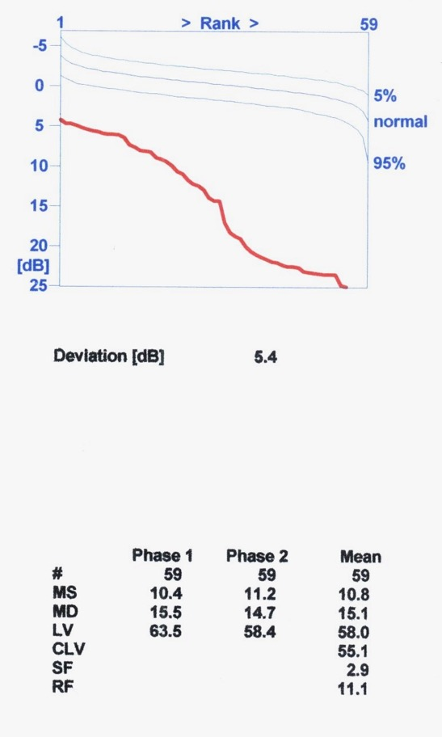
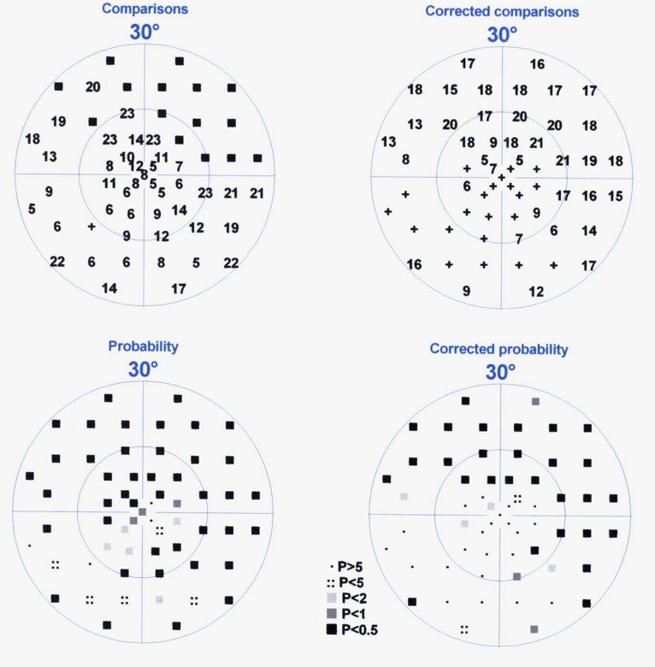
Octopus Print out
Comparison table: difference between patient test results and age-matched normal. The “+” symbols indicate normal sensitivity with a tolerance ranges of 4 dB. Test points with values indicate decreased sensitivity
Corrected comparison table: removes diffuse loss/ generalised depression to reveal “hidden” focal loss.
Probability Plots: The full black box indicates that fewer than 0.5% of reliable normal fields in the data base has a sensitivity value that low
© Thomas R
Modified by
Tumbocon JA

Slide 87
Octopus Print out
Octopus criteria for a visual field defect
MD greater than 2 dB
LV greater than 6 dB
At least 7 points with sensitivity decreased by ≥ 5 dB, three of them being contiguous
© Thomas R
Modified by
Tumbocon JA
Morales J et al. Ophthalmology 2000; 107: 134–42.

Slide 88
Octopus trend analysis
© Tumbocon JA

Slide 89
Comparison of Octopus and Humphrey fields from a single patient
© Sihota R
Notes:
The following four slides compare Octopus and HFA fields for the same patient, a 34-year-old female.* The tests were performed approximately 1 week apart.
*Fields supplied by Dr Ramanjit Sihota (Dr Rajendra Prasad Center for Ophthalmic Sciences, All India Institute of Medical Sciences [AIIMS], New Delhi).

Slide 90
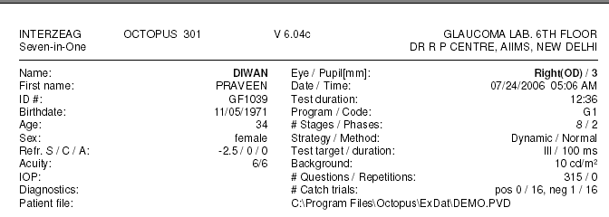
Patient data, strategy and test parameters
© Sihota R
Notes:
The test parameters are shown for an Octopus test using the G1 program (8 stages, 2 phases) with the dynamic strategy, and an HFA 30–2 full threshold test. The pupil diameter is 3 mm in both tests and there are 1–2 false-negative errors in each test. Features you may wish to comment on include the effect of refractive error and the significance of fixation losses.

Slide 91
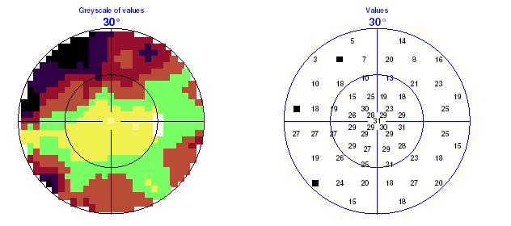
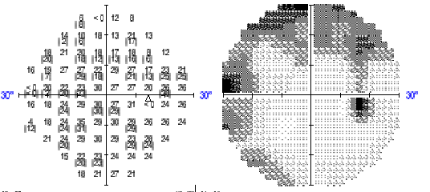
Grey scale
© Sihota R
Notes:
Light regions on the HFA grey scale correspond to bright colours on its Octopus equivalent.

Slide 92
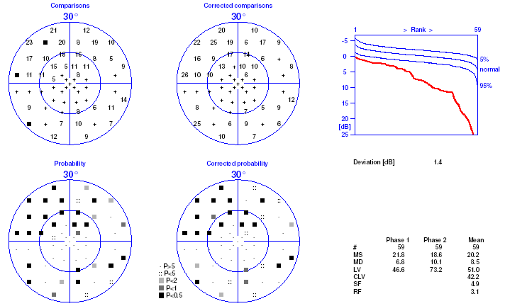
Octopus: comparison tables
Phase I Phase 2 Mean # 59 59 59 MS 21.8 18.6 20.2 MD 6.8 10.1 8.5 LV 46.6 73.2 51.0 CLV 42.2 SF 4.9 RF 3.1
© Sihota R
Notes:
This slide shows the Octopus comparison tables, Bebie curve and global indices, while the corresponding HFA results are displayed on the following slide. Discuss the interpretation of each field.

Slide 93
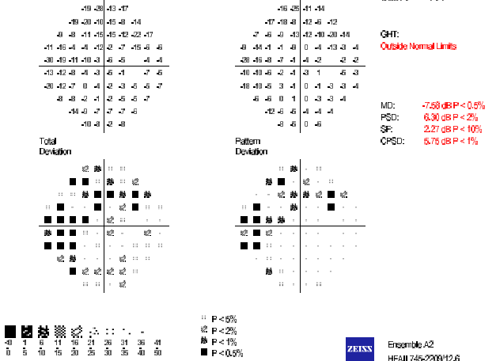
Humphrey : Total and Pattern deviation
GHT Outside normal limits MD –7.58 dB; p < 0.5% PSD 6.30 dB; p < 2% SF 2.27 dB; p < 10% CPSD 5.75 dB; p < 1%
© Sihota R

Slide 94
Guidelines
Clinical decisions should not be based on a single visual field examination
Correlate the visual field examination with anatomic findings (e.g. optic nerve head and RNFL)
The visual field examination results must be reproducible
All available clinical information about a patient must be taken into account before treatment decisions are made

