Slide 1
MONITORING FOR PROGRESSION
Notes:
This module is intended to aid clinicians in the long-term management of patients with glaucoma. The strategies outlined in this module are not intended as a guide for care immediately following a surgical or laser procedure; this is covered in more detail in previous modules.

Slide 2
Follow-up
Why follow up?
Assessing the effects of treatment
on the patient’s life
Detecting changes in the patient’s risk profile
Detecting changes in disease status
When to follow up
Key points
SEAGIG. Asia Pacific Glaucoma Guidelines. 2008.
Notes:
Upon completion of this module, clinicians should have a good understanding of when and how to monitor for progression in glaucoma, and be able to assess the effects of both the disease and its treatment on a patient’s overall well-being.

Slide 3
Follow-up: why?
To implement a glaucoma management plan, or revise it if necessary
To detect progression and the rate
of change
To monitor the effectiveness and any side effects of treatment
SEAGIG. Asia Pacific Glaucoma Guidelines. 2008.
Notes:
The follow-up process starts with the management plan made at the initiation of therapy.
Reference
South East Asia Glaucoma Interest Group. Asia Pacific Glaucoma Guidelines, 2nd Edition. Sydney: SEAGIG, 2008. Available at: www.seagig.org/toc/APGGuidelinesNMview.pdf.

Slide 4
Follow-up: why?
To identify any changes in health or systemic medication use that may affect the glaucoma management plan
To monitor or treat ocular comorbidity, such as cataract or diabetic retinopathy
To detect any change in the risk profile
SEAGIG. Asia Pacific Glaucoma Guidelines. 2008.

Slide 5
Follow-up: what?
Assess patient well-being, visual function
and quality of life
Reassess risk factors
  Especially IOP and gonioscopic changes
Reassess optic nerve structure and function
Estimate the rate of progression (if any)
  Consider its significance in relation to age and
  the status of the other eye
SEAGIG. Asia Pacific Glaucoma Guidelines. 2008.

Slide 6
Follow-up: what?
Identify any adverse effects of treatment
Assess adherence to, and persistence with, the treatment plan
Identify changes in medical and ophthalmological problems
Reinforce appropriate patient information
  Revise management if necessary
  Plan follow-up
SEAGIG. Asia Pacific Glaucoma Guidelines. 2008.

Slide 7
Follow up: when?
Initial follow-up: relatively frequent so as to reliably detect the rate of progression
The more severe the damage,
the more the risk factors,
the faster the rate of progression,
the more frequent should be the follow-up
SEAGIG. Asia Pacific Glaucoma Guidelines. 2008.

Slide 8
Well-being and visual function
Assess patient’s subjective well-being and visual function
  How do they feel their condition has changed or not changed?
Helps to build the doctor–patient relationship and therapeutic alliance
Self-reported visual function shows some association with visual field
status and progression
SEAGIG. Asia Pacific Glaucoma Guidelines. 2008.
Notes:
Patients frequently wish to discuss any perceived changes in their condition and this helps to build a good doctor–patient relationship and establish a therapeutic alliance against the disease. Patient education is a central component of glaucoma management and an ongoing process; patients should always be informed participants in the treatment programme. For further information, see Module 10: Patient-centred management.
Reference
South East Asia Glaucoma Interest Group. Asia Pacific Glaucoma Guidelines, 2nd Edition. Sydney: SEAGIG, 2008. Available at: www.seagig.org/toc/APGGuidelinesNMview.pdf.

Slide 9
Detecting qualitative progression
Subjective changes in the following may indicate a deterioration of GON
  night vision
  dark adaptation
  glare
  loss of stereopsis
  acuity (high and low contrast)
  symptomatic scotoma or scotoma enlargement
GON: glaucomatous optic neuropathy
SEAGIG. Asia Pacific Glaucoma Guidelines. 2008.
Notes:
While subjective vision changes are rare in glaucoma, altered vision in advanced disease may indicate a deterioration in GON. Patients may report difficulties with night driving (e.g. vehicles ‘jumping’ into their vision and glare from oncoming headlights) or dark adaptation (i.e. difficulty when walking into a dark environment). Problems with acuity may include reading small print (especially in dim light), identifying faces, problems with contrast sensitivity, and poor judgement of distance.
Patients with mild-to-moderate glaucoma are unlikely to report subjective vision changes, but may still experience problems with bumping into objects, climbing stairs and finding things that have been dropped.
Reference
South East Asia Glaucoma Interest Group. Asia Pacific Glaucoma Guidelines, 2nd Edition. Sydney: SEAGIG, 2008. Available at: www.seagig.org/toc/APGGuidelinesNMview.pdf.

Slide 10
Adverse effects of treatment
Ask the patient about side effects
  General effects
    Self-rated health
    Feelings about / attitude towards treatment
  Systemic effects
    Cardiovascular, respiratory, neurological, impotence, digestive
  Local effects
    Stinging / burning, blurring, redness, itching
SEAGIG. Asia Pacific Glaucoma Guidelines. 2008.
Notes:
The adverse effects of treatment should be actively identified using both general and specific questioning.
Reference
South East Asia Glaucoma Interest Group. Asia Pacific Glaucoma Guidelines, 2nd Edition. Sydney: SEAGIG, 2008. Available at: www.seagig.org/toc/APGGuidelinesNMview.pdf.

Slide 11
Quality-of-life issues
Assess the impact of glaucoma and its treatment on QOL
  GQL-15 questionnaire
Management should be individualised with
the aim of improving QOL
Consider community health referral
For more on assessing QOL, see
Module 10: Patient-centred management
GQL-15, Glaucoma Quality of Life-15 questionnaire.
SEAGIG. Asia Pacific Glaucoma Guidelines. 2008.

Slide 12
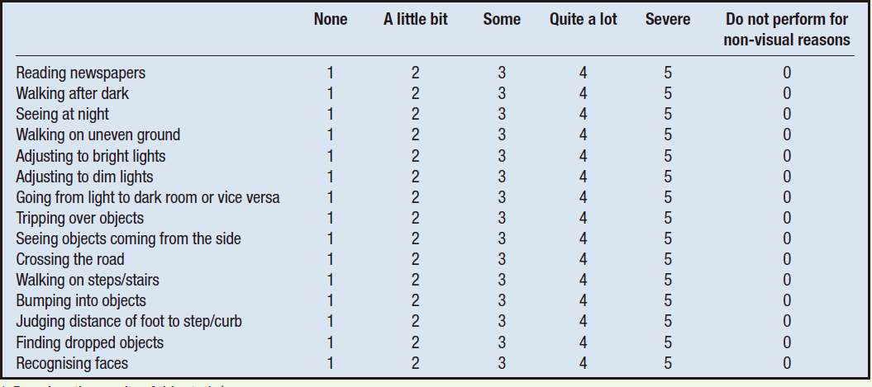
QQL-15 questionnaire^{1,2}
1. Nelson P et al. J Glaucoma 2003; 12: 139–50;
2. Goldberg I et al. J Glaucoma 2009; 18: 6–12.
Notes:
The Glaucoma Quality of Life-15 (GQL-15) questionnaire asks patients with glaucoma to rate their level of difficulty in performing a list of daily activities that showed the strongest relationship with visual field loss in glaucoma.¹ In a validation study, the GQL-15 was found to discriminate between quality of life in patients with glaucoma and healthy controls. The GQL-15 score correlated with objective measures of visual function such as visual acuity, disease severity and visual field measurements.²
References
1. Nelson P, Aspinall P, Papasouliotis O, Worton B, O'Brien C. Quality of life in glaucoma and its relationship with visual function. J Glaucoma 2003; 12: 139–50.
2. Goldberg I, Clement CI, Chiang TH et al. Assessing quality of life in patients with glaucoma using the Glaucoma Quality of Life-15 (GQL-15) questionnaire. J Glaucoma 2009; 18: 6–12.

Slide 13
Reassess risk factors: IOP
Assess IOP at every visit
  Has target IOP been achieved?
  Measure at different times of the day to detect diurnal variation
  Repeat unexpected readings at the same visit and again soon after
Review the target, especially if progression is detected
SEAGIG. Asia Pacific Glaucoma Guidelines. 2008.
Notes:
As IOP is currently the only major modifiable risk factor for glaucoma, assessment at every visit is vital.
For information on setting IOP targets, see Module 5: IOP targets (part 1).
Reference
South East Asia Glaucoma Interest Group. Asia Pacific Glaucoma Guidelines, 2nd Edition. Sydney: SEAGIG, 2008. Available at: www.seagig.org/toc/APGGuidelinesNMview.pdf.

Slide 14
IOP changes: possible causes
Increased IOP | Reduced outflow Tachyphylaxis (gradual loss of drug efficacy) Poor adherence
Reduced IOP | Therapeutic effect Corneal refractive surgery Resolving pathology
Reduced or increased IOP | Regression to the mean Variation during the day and between days Changes in systemic medications Poor instrument calibration/function
SEAGIG. Asia Pacific Glaucoma Guidelines. 2008.
Notes:
LASIK/corneal refractive surgery may cause unexpected changes in measured IOP that do not reflect actual IOP. Resolving pathology, such as regression of pigment dispersion, may also cause a reduction in IOP.
Reference
South East Asia Glaucoma Interest Group. Asia Pacific Glaucoma Guidelines, 2nd Edition. Sydney: SEAGIG, 2008. Available at: www.seagig.org/toc/APGGuidelinesNMview.pdf.

Slide 15
Reassess risk factors: gonioscopic changes
What to look for
  Increased appositional and/or synechial closure
  Change in angle width, synechiae and pigmentation
    Changes in pupil size have a dynamic effect on the angle
When and how?
  At least every 3 years in all patients
  More frequently in patients with angle closure
  (or at high risk of angle closure)
  Maintain baseline examination conditions
  Consider gonioscopic photography or AS imaging
AS, anterior segment.
SEAGIG. Asia Pacific Glaucoma Guidelines. 2008.
Notes:
Appositional angle closure and the presence of new or increased peripheral anterior synechiae (PAS) are associated with a high risk of vision loss. If available, gonioscopic photography or anterior segment imaging enables a more objective comparison between visits.
Reference
South East Asia Glaucoma Interest Group. Asia Pacific Glaucoma Guidelines, 2nd Edition. Sydney: SEAGIG, 2008. Available at: www.seagig.org/toc/APGGuidelinesNMview.pdf.

Slide 16
Optic disc changes
Detecting change is difficult, as progression generally occurs over a long period
In angle closure patients, examine the disc:
  Every visit until opening of the angle is achieved
  At least every 3 years thereafter
Baseline and serial disc imaging is useful
  If imaging is not available, perform a dilated examination (if the angle permits)
Consider imaging of the RNFL if available
RNFL, retinal nerve fibre layer.
SEAGIG. Asia Pacific Glaucoma Guidelines. 2008.
Notes:
Detection of optic nerve changes is substantially enhanced when baseline and serial optic disc images are available.¹ Indeed, optic disc photography is probably the best method to detect progression at an early stage.¹ If such photographs are not available, the pupil should be dilated to obtain an adequate view of the disc; if this cannot be done safely, prophylactic iridotomy or iridoplasty should be considered.¹ Pharmacological mydriasis significantly improves the reproducibility of optic disc measurement compared to examination without mydriasis.²
References
1. South East Asia Glaucoma Interest Group. Asia Pacific Glaucoma Guidelines, 2nd Edition. Sydney: SEAGIG, 2008. Available at: www.seagig.org/toc/APGGuidelinesNMview.pdf.
2. Kirwan JF, Gouws P, Linnell AE, Crowston J, Bunce C. Pharmacological mydriasis and optic disc examination. Br J Ophthalmol 2000; 84: 894–8.

Slide 17
Optic disc changes
Features of GON progression:
  disc haemorrhage
  focal rim notching*
  change in vessel position
  generalised rim thinning (increased CDR)
  wedge-type nerve fibre layer defects*
* Incidence or enlargement.
CDR, cup-to-disc ratio.
SEAGIG. Asia Pacific Glaucoma Guidelines. 2008.

Slide 18
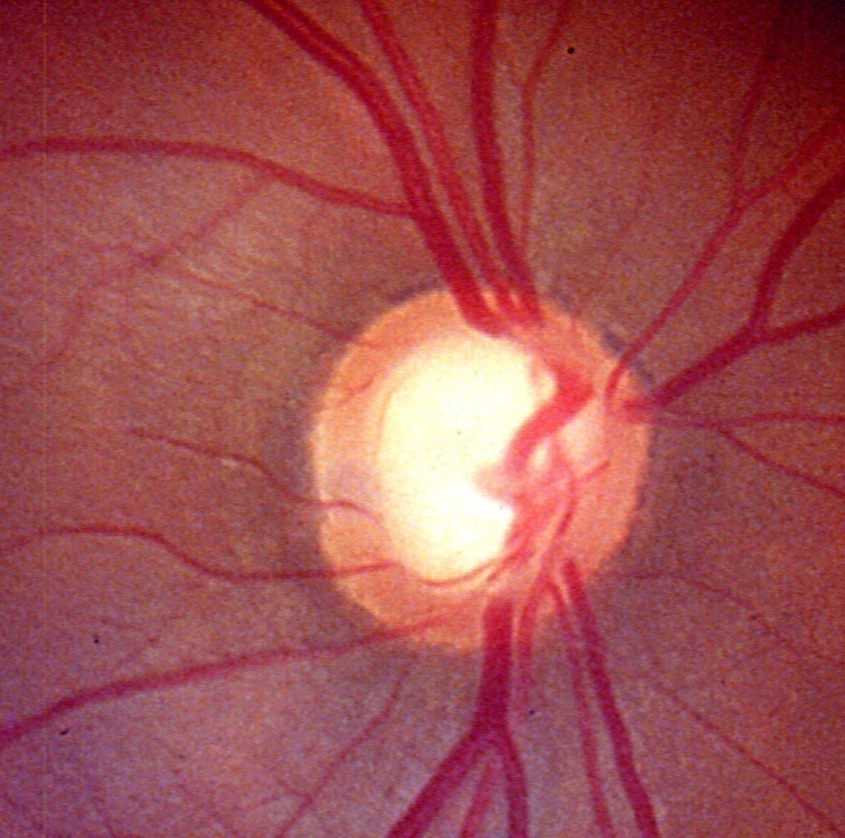
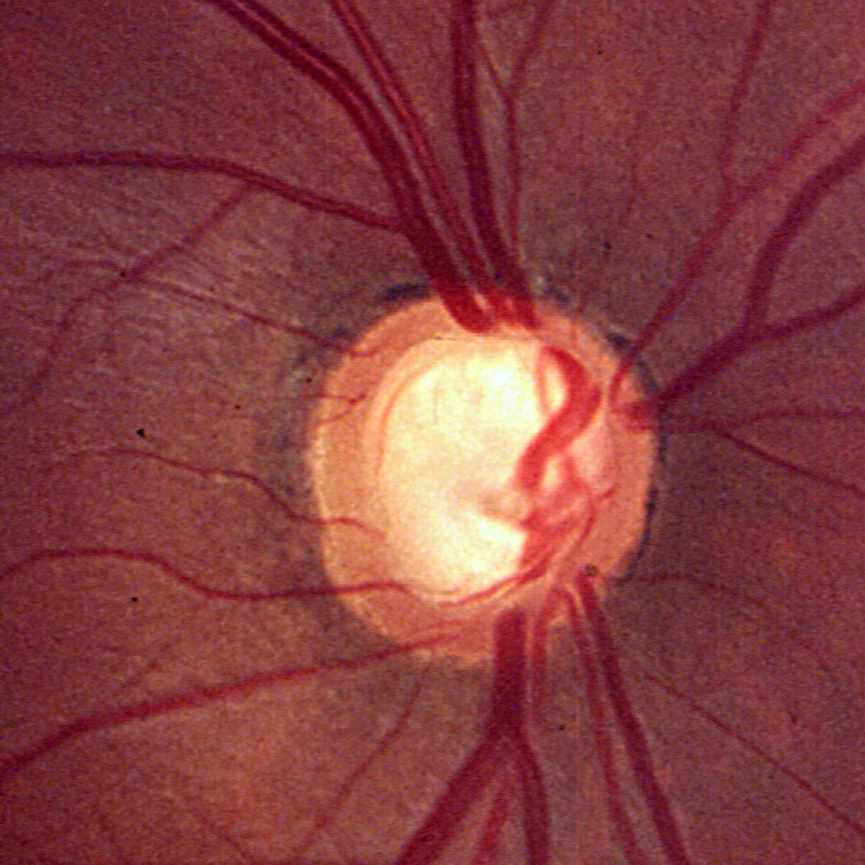
Generalised rim thinning
10 years
©2004 Remo Susanna Jr
Notes:
Observing the rim width may provide an important indication of progression. In this eye, diffuse enlargement of the cup size is evident at a 10-year follow-up.
For each enlargement of 0.1 in the cup–disc ratio, or decrease of 0.1 in the neuroretinal rim–disc area ratio, there is a loss of approximately 10% of the optic nerve fibres. This data was obtained from a study in cynomolgus monkeys with an initial cup–disc ratio of 0.2–0.3 and an initial neuroretinal rim–disc area ratio of 0.9.
Reference
Varma R, Quigley HA, Pease ME. Changes in optic disk characteristics and number of nerve fibers in experimental glaucoma. Am J Ophthalmol 1992; 114: 554–9.

Slide 19
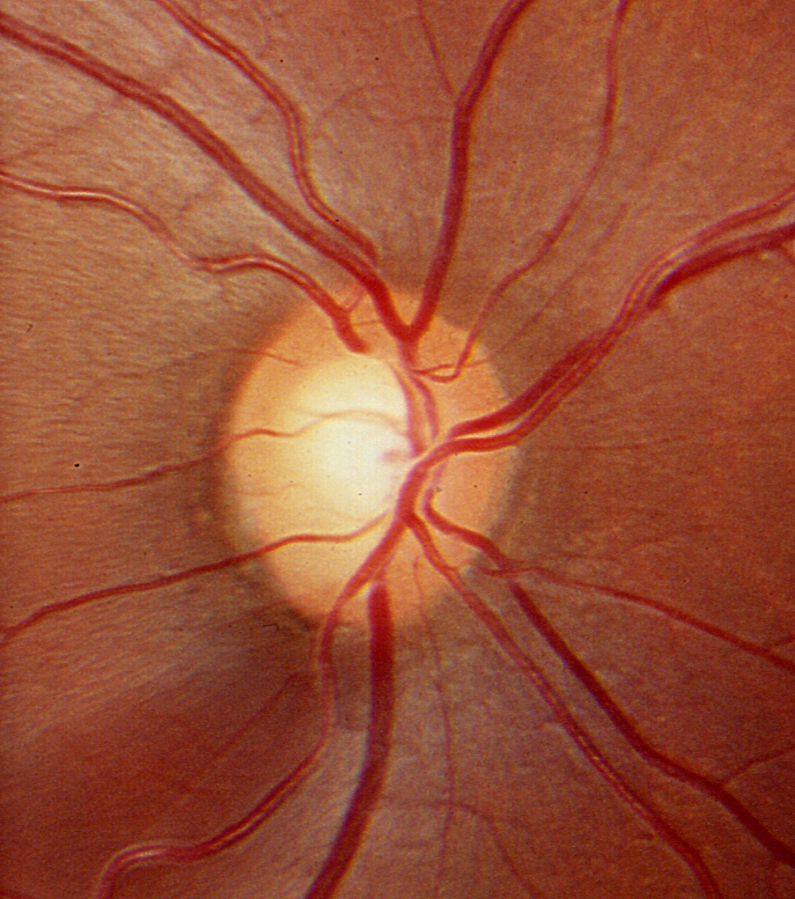
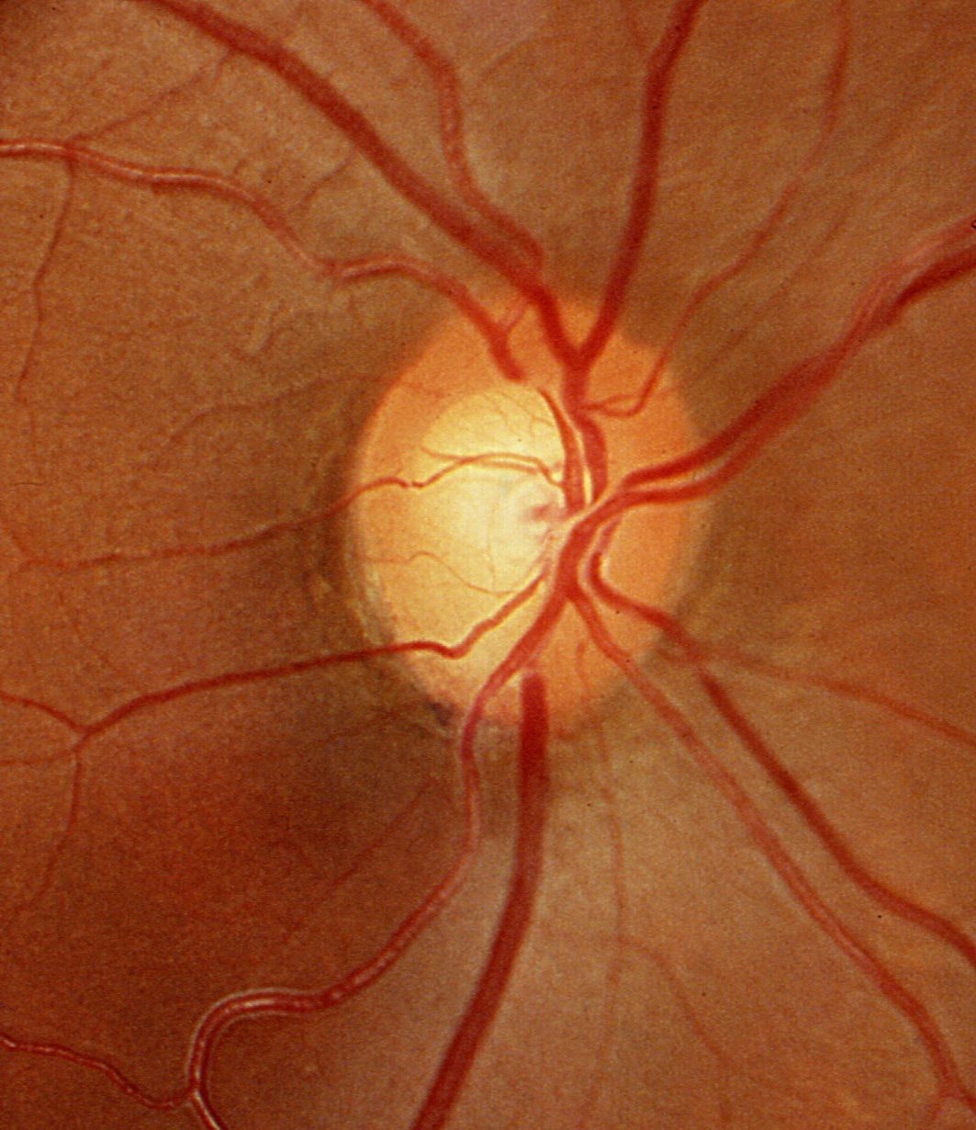
Progressive rim thinning (1)
Enlargement of localised RNFL defect
4 years
©2004 Remo Susanna Jr
Notes:
The black arrow shows increased bending of the blood vessel and the white arrows show enlargement of the RNFL defect over 4 years.

Slide 20
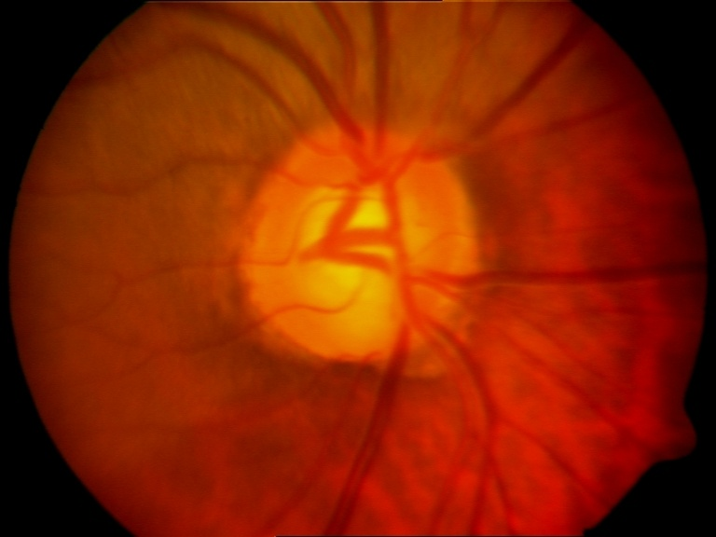
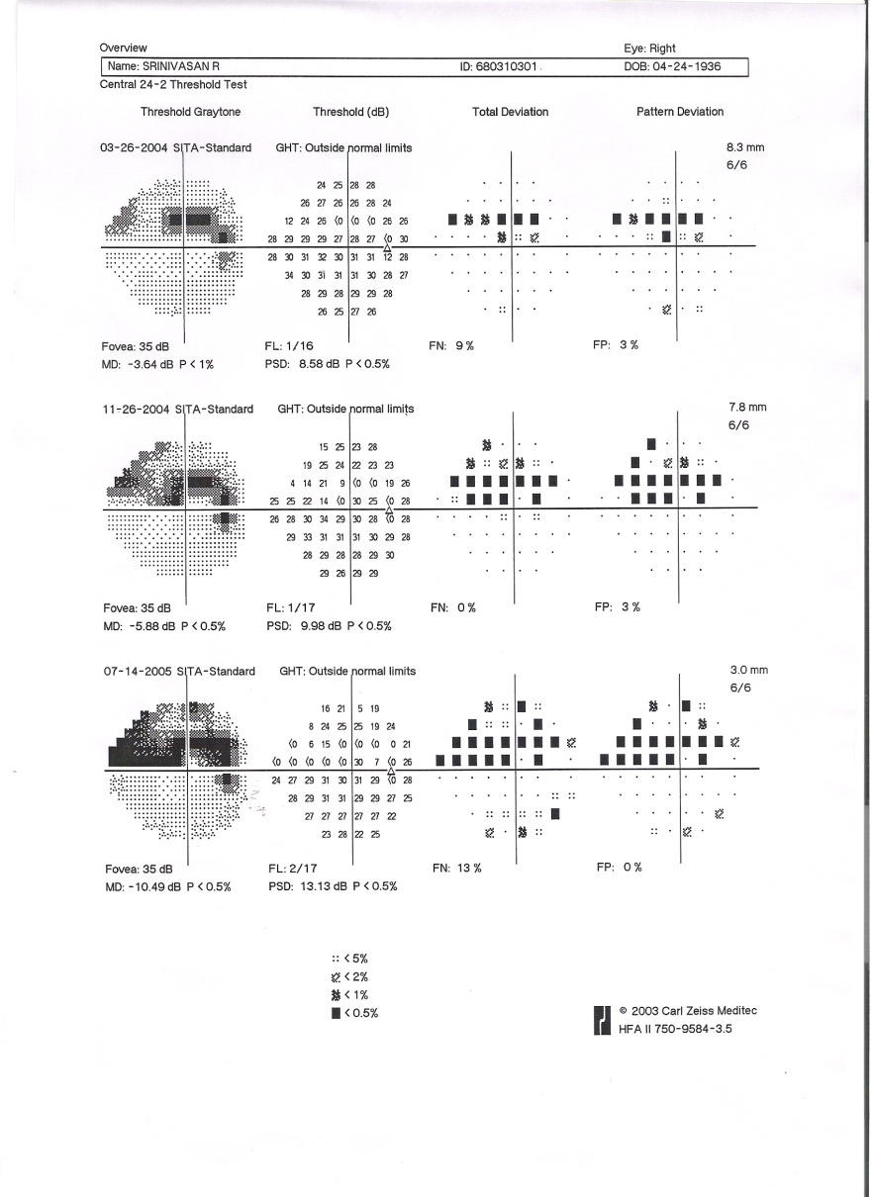
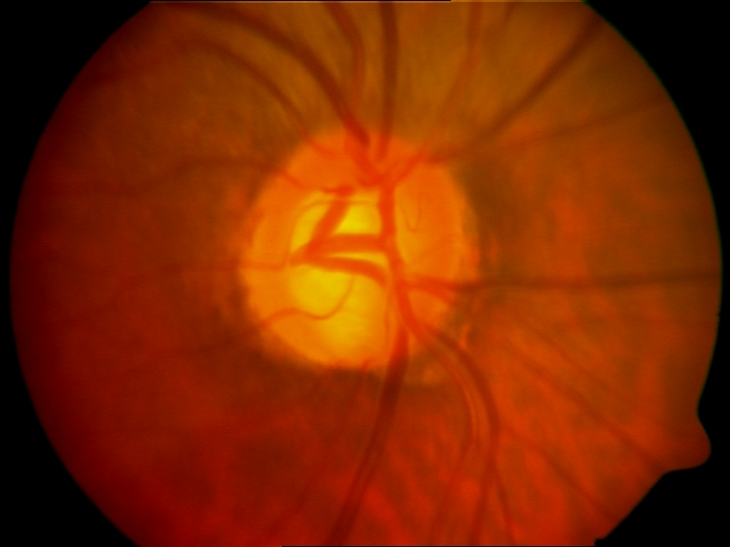
Progressive rim thinning (2)
A
B
Images courtesy of GT Sunil and L Vijaya
Notes:
The initial photograph (A) shows GON in the right eye associated with thinning of the inferior neuroretinal rim. The follow-up photograph (B) shows progressive thinning of the neuroretinal rim as evidenced by baring of the lamina cribrosa, increased deflection of the circumlinear vessel and increased inferior cupping. Standard automated perimetry shows corresponding defects in the visual field.

Slide 21
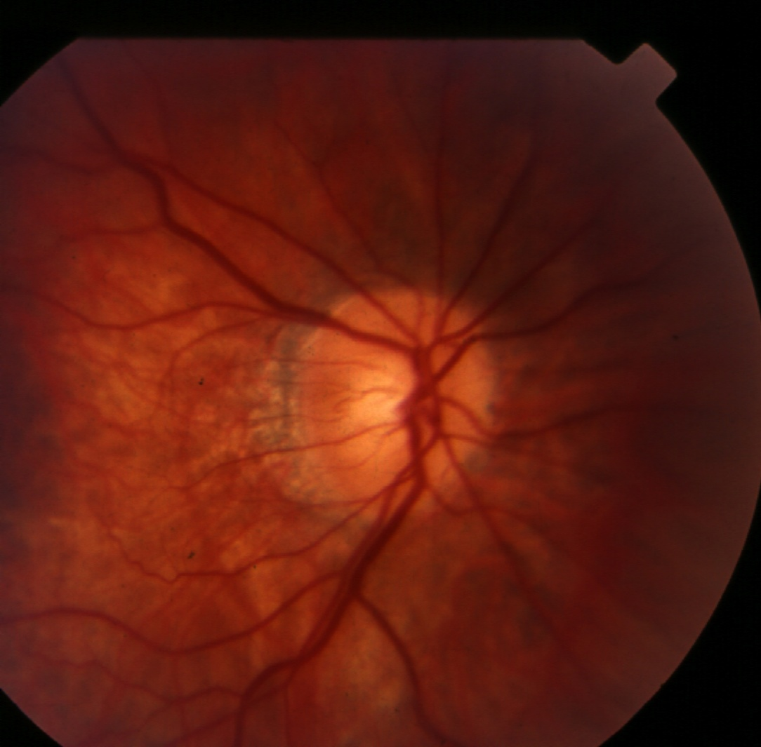
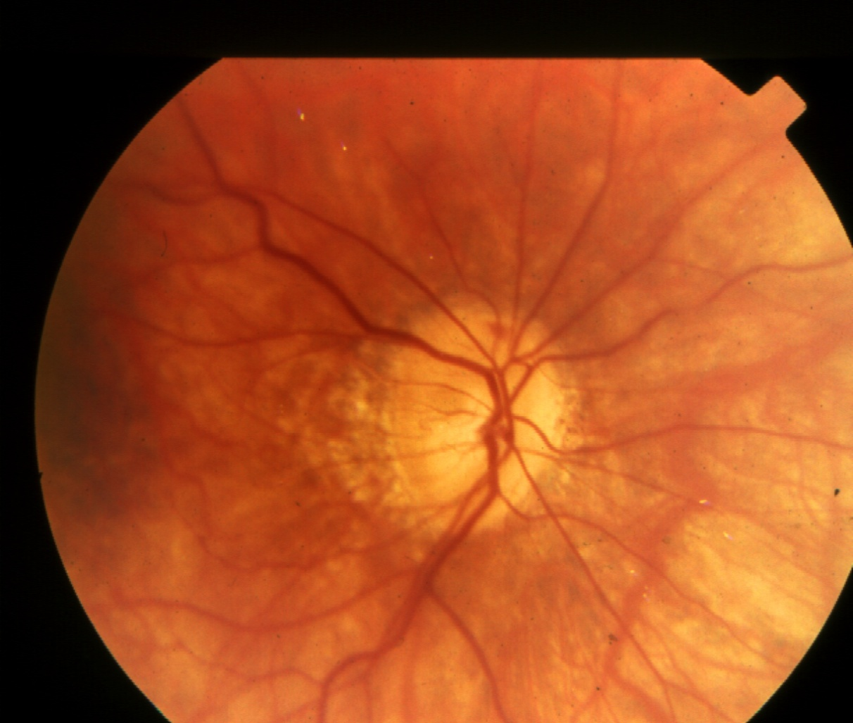
Disc haemorrhage
5 years
©2004 Remo Susanna Jr
Notes:
In this slide, note the enlargement of the beta zone after 5 years. A fresh superior optic disc haemorrhage may also be seen in the later photograph. These signs definitely indicate glaucomatous progression.

Slide 22
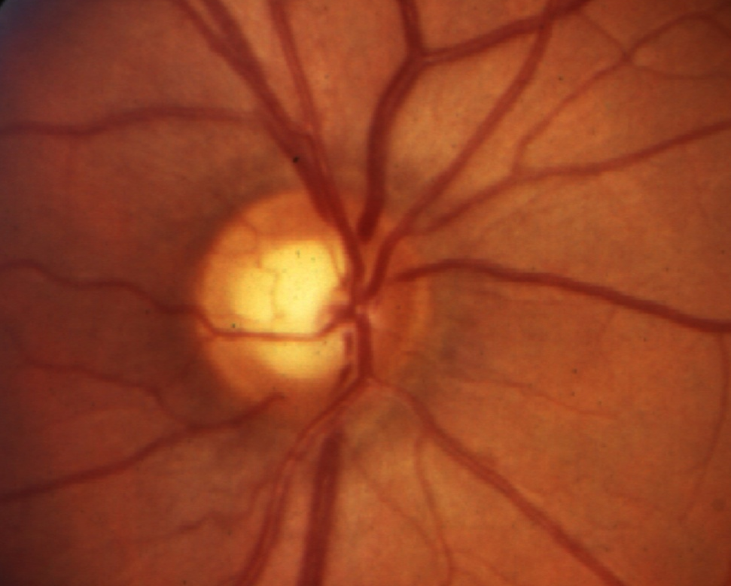
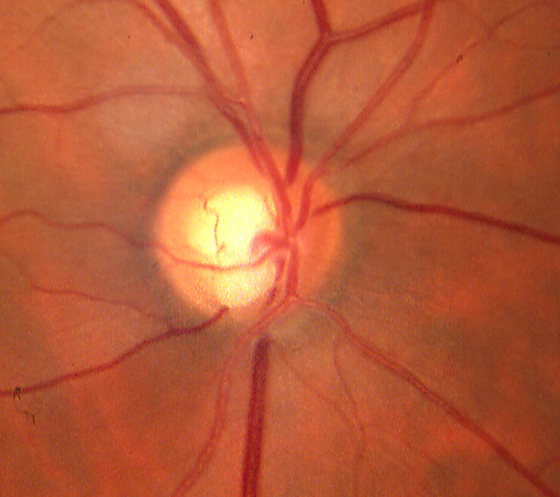
RNFL loss with notching
5 months
©2004 Remo Susanna Jr
Notes:
On follow-up after 5 months, this patient has developed localised RNFL loss associated with notching.

Slide 23
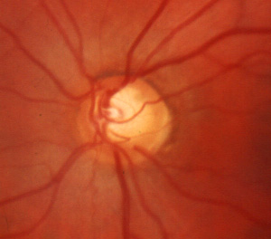
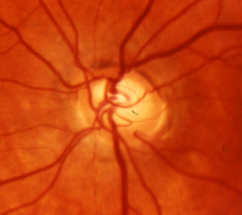
Enlargement of the cup
10 years
©2004 Remo Susanna Jr
Notes:
Here, nasal cupping and diffuse rim thinning has resulted in enlargement of the cup, easily appreciated nasally.

Slide 24
Visual field changes
Visual field changes on perimetry have many causes other than GON progression
  Learning effect
  Poor concentration
  Cataracts
  Changes in pupil size (minimum 3 mm recommended)
  Retinal disease and retinal laser treatment
  Changes in measurement strategy
  Decline in general health
  Artefacts – lens rim, ptosis, deep-set eyes
SEAGIG. Asia Pacific Glaucoma Guidelines. 2008.
Notes:
Progression is only one of many potential causes of visual field changes on perimetry. Performance generally improves over the first few attempts, and reliability may vary. Poor concentration may cause general depression, and false positive errors may indicate poor reliability. Cataracts and miosis also cause generalised depression. Other factors to be aware of include retinal disease (e.g. vein occlusion, macular degeneration, diabetic retinopathy), retinal laser treatment, changes in the perimetry strategy, and miscellaneous artefacts.
Reference
South East Asia Glaucoma Interest Group. Asia Pacific Glaucoma Guidelines, 2nd Edition. Sydney: SEAGIG, 2008. Available at: www.seagig.org/toc/APGGuidelinesNMview.pdf.

Slide 25
Visual field progression
Field progression is characterised by:
  Widening or deepening of an existing scotoma
  Development of a new glaucomatous scotoma
  Generalised field depression
    Consider cataract, miosis or poor reliability
Correlate with structural features*
* Visual field changes may not correlate with structural features if disc damage is advanced.
SEAGIG. Asia Pacific Glaucoma Guidelines. 2008.
Notes:
Glaucomatous changes in the optic disc structure are closely correlated with consequent visual field loss. However, both the morphology of a ‘normal’ disc and a patient’s ability to perform visual field tests may vary considerably.
Reference
South East Asia Glaucoma Interest Group. Asia Pacific Glaucoma Guidelines, 2nd Edition. Sydney: SEAGIG, 2008. Available at: www.seagig.org/toc/APGGuidelinesNMview.pdf.

Slide 26
Detecting visual field progression
Confirm changes with at least one repeat test
  Although 5–6 fields are required to confirm progression in a research setting, this may be impractical in the clinic
  With corroborative clinical signs, a single repeat field may confirm progression
Change is best detected using software
that highlights areas of possible change
See Appendix: visual field progression
SEAGIG. Asia Pacific Glaucoma Guidelines. 2008.
Notes:
Visual field changes should be regarded sceptically until the deviation exceeds the standard deviation of serial measurements.
Reference
South East Asia Glaucoma Interest Group. Asia Pacific Glaucoma Guidelines, 2nd Edition. Sydney: SEAGIG, 2008. Available at: www.seagig.org/toc/APGGuidelinesNMview.pdf.

Slide 27
SEAGIG decision square for GON
Risk | Disease status
 | Stable | Uncertain | Progressing
Increased | + | ++ | +++
Uncertain | Reassess risk | Reassess both | ++
Stable | – | Reassess disease | +
Add a ‘+’ for every additional risk factor
Add a ‘+’ if the rate of progression appears rapid
SEAGIG. Asia Pacific Glaucoma Guidelines. 2008.
Notes:
The SEAGIG decision square for GON illustrates how various combinations of risk factor profiles and levels of disease stability or progression would influence the aggressiveness of medical, surgical or laser intervention.
A grade of ‘+++’ may be associated with a rapid, stepwise progression through medical to surgical management. A grade of ‘–’ indicates no addition to therapy.
Reference
South East Asia Glaucoma Interest Group. Asia Pacific Glaucoma Guidelines, 2nd Edition. Sydney: SEAGIG, 2008. Available at: www.seagig.org/toc/APGGuidelinesNMview.pdf.

Slide 28
Risk factors
Factors conferring an increased risk of
vision loss from glaucoma:
  high or rising IOP
  any appositional angle closure
  any PAS, or an increase in PAS if previously seen
  longer life expectancy
  ethnicity, e.g. African descent
  pseudoexfoliation glaucoma
  advanced glaucoma at diagnosis
  non-IOP dependent factors, e.g. sleep apnoea (uncertain), ischaemic heart disease
More risk factors equals higher risk
PAS, peripheral anterior synechiae.
SEAGIG. Asia Pacific Glaucoma Guidelines. 2008.

Slide 29
Defining progression
Stable disease
  No change in optic disc or visual field status
Uncertain disease
  Change in visual field that is not consistent with the status of the optic disc, or vice versa
  Check for artefacts
Progressing disease
  Changes consistent with glaucoma in the
  optic disc and/or visual field
SEAGIG. Asia Pacific Glaucoma Guidelines. 2008.

Slide 30
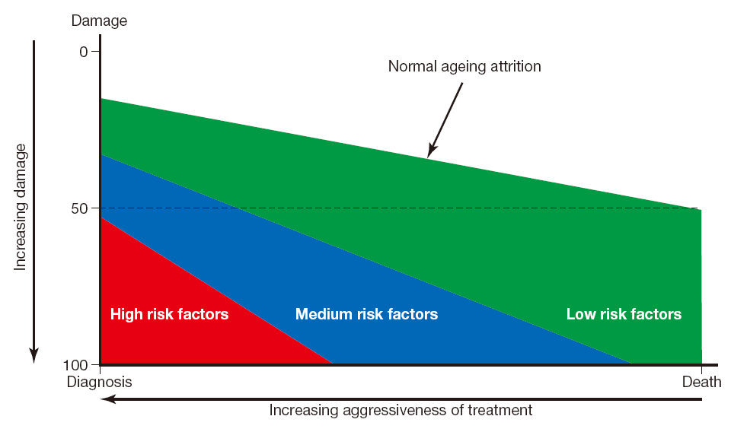
The glaucoma life story
SEAGIG. Asia Pacific Glaucoma Guidelines. 2008.
Notes:
Determinants of the glaucoma life story include the state of damage, the rate of progression, and life expectancy. The graph plots life expectancy against the extent of glaucomatous damage at diagnosis. The colours in the graph represent the risk of blindness from glaucoma; green represents low risk and red, high risk. The slope of the line is the rate of progression, which is determined by risk factors. The minimum slope is the rate of normal ageing of the nerve. Although the progression rate is the key factor in determining the success of treatment, it is very difficult to measure accurately or reliably. Generally, risk factors are used to estimate the likely rate of progression, in order to guide treatment decisions, but knowledge of risk factors remains incomplete.
POAG: primary open-angle glaucoma
Reference
South East Asia Glaucoma Interest Group. Asia Pacific Glaucoma Guidelines, 2nd Edition. Sydney: SEAGIG, 2008. Available at: www.seagig.org/toc/APGGuidelinesNMview.pdf.

Slide 31
Timing of follow-up
Follow-up timing is determined by the treatment regimen, if this has changed
If the patient is stable, the timing is determined mainly by the extent of damage
Extent of damage | Follow-up interval
Glaucoma suspects | 6–24 months
Mild damage | 6–12 months
Moderate damage | 4–6 months
Severe damage | 1–4 months
SEAGIG. Asia Pacific Glaucoma Guidelines. 2008.
Notes:
Patients with secondary glaucoma often present with higher IOP and may require closer follow-up, but this should be determined on an individual basis. Close follow-up is required for juvenile-onset POAG, which also tends to present with higher IOP and frequently has a worse response to medical therapy than adult-onset disease.
Reference
South East Asia Glaucoma Interest Group. Asia Pacific Glaucoma Guidelines, 2nd Edition. Sydney: SEAGIG, 2008. Available at: www.seagig.org/toc/APGGuidelinesNMview.pdf.

Slide 32
Key points
Monitor effects of treatment and involve the patient in treatment decisions to maximise adherence and improve QOL
Visual field fluctuations may not be due to GON progression
Analyse risk factors and progression to determine the follow-up interval
SEAGIG. Asia Pacific Glaucoma Guidelines. 2008.
Notes:
Educating patients about the benefits and risks of medication, as well the seriousness of glaucoma and the importance of adhering to the treatment regimen, is a key part of effective long-term management.
Optic disc changes generally occur over a long period of time and therefore may be difficult to detect. However, not all visual field changes are due to GON. Changes should be confirmed with at least one repeat test.
While a clear definition of disease progression in glaucoma has not been established, certain risk factors confer a higher risk of vision loss, and patients who are at increased risk should be followed up more frequently.

Slide 33
APPENDIX
VISUAL FIELD PROGRESSION

Slide 34
Detecting progression
Is the defect progressing?
  Compare to selected baseline
  Discard learning fields from baseline
  Recognise ‘false’ progression
© Thomas R
Notes:
Determining whether a glaucomatous defect is progressing requires a comparison with baseline visual fields, which should be obtained after the patient has become familiar with automated perimetry. The typical learning curve is 2–3 fields.
Reference
Thomas R, George R. Interpreting automated perimetry. Indian J Ophthalmol 2001; 49: 125–40.

Slide 35
False progression
Learning curve
Long-term fluctuation
Artefacts
Patient factors
Pupil size
© Thomas R
Notes:
As noted previously, numerous factors may lead to visual field changes. Factors that may interfere with the ability to determine progression include the learning curve with perimetry, long-term fluctuation, artefacts that may mimic progression, patient factors (e.g. poor performance on a particular day), and pupil size.
Reference
Thomas R, George R. Interpreting automated perimetry. Indian J Ophthalmol 2001; 49: 125–40.

Slide 36
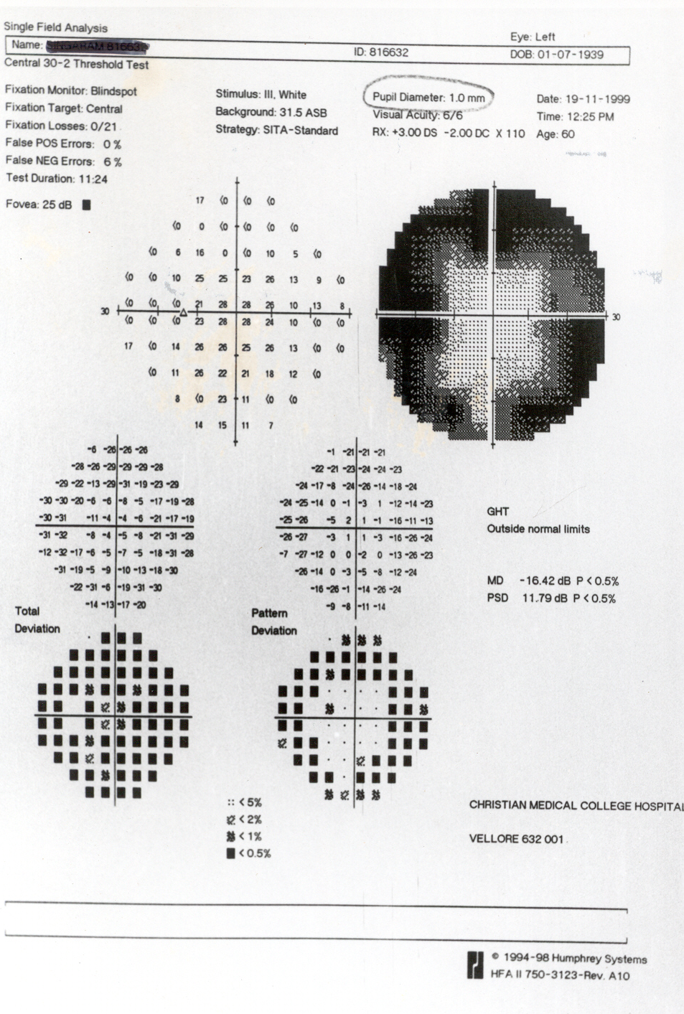
Pupil: 1 mm
© Thomas R
Notes:
The field shown in this slide had a significant field defect and was initially considered to have progressed. However, the pupil size was small (1 mm) and the patient had recently begun treatment with pilocarpine.
Reference
Thomas R, George R. Interpreting automated perimetry. Indian J Ophthalmol 2001; 49: 125–40.

Slide 37
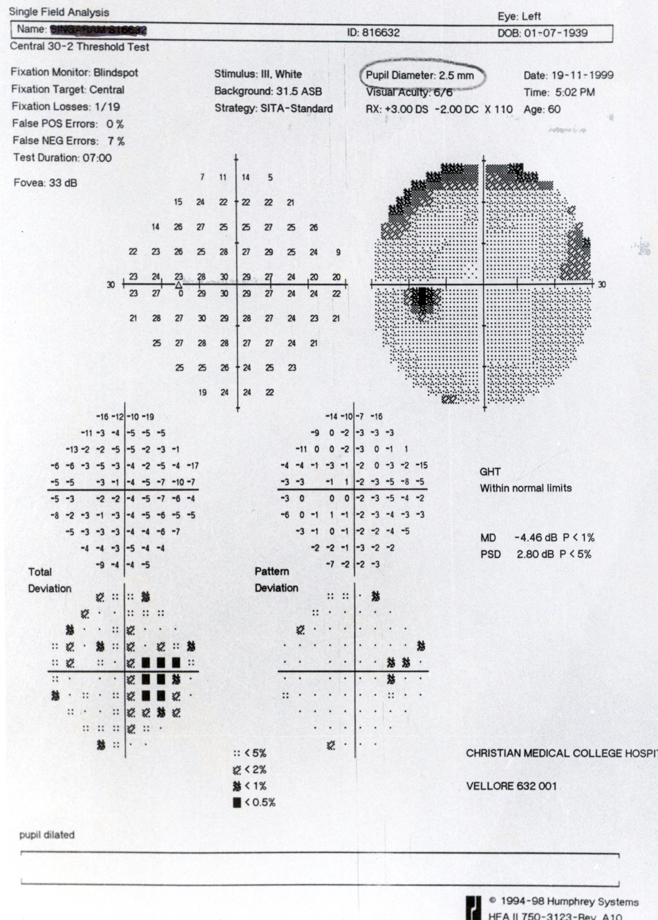
Pupil: 2.5 mm
© Thomas R
Notes:
When the field was repeated after dilating the pupil, it resembled the patient’s earlier field and no further intervention was necessary.
Reference
Thomas R, George R. Interpreting automated perimetry. Indian J Ophthalmol 2001; 49: 125–40.

Slide 38
Detecting change
Change analysis – box plot
Overview programme
Glaucoma Progression Analysis (GPA)
Select appropriate baseline
Discard learning fields from baseline
© Thomas R
Notes:
The perimeter offers several statistical programmes for determining changes in the size or depth of the scotoma. These include Change Analysis, Overview and Glaucoma Progression Analysis; the latter two are discussed in the following slides.
Reference
Thomas R, George R. Interpreting automated perimetry. Indian J Ophthalmol 2001; 49: 125–40.

Slide 39
Overview programme
Sequential series of fields for the same patient over a period of time
Has all the single field information, including total and pattern deviation plots
Tells us at a glance what is happening and allows us to deduce WHY it is happening
© Thomas R
Notes:
The Overview programme prints up to 16 sequential fields for the same patient, assisting identification of any trends and their underlying cause.
Reference
Thomas R, George R. Interpreting automated perimetry. Indian J Ophthalmol 2001; 49: 125–40.

Slide 40
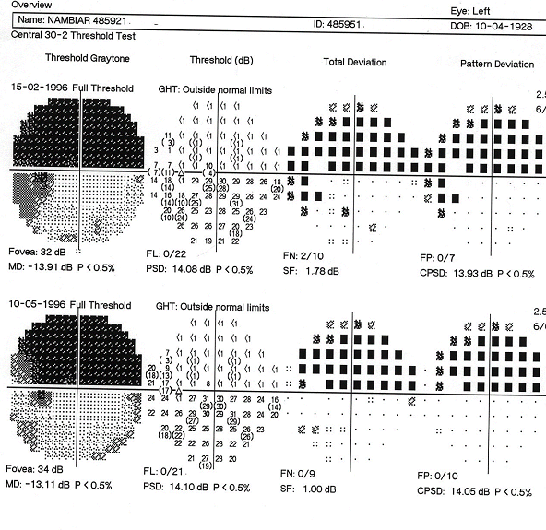
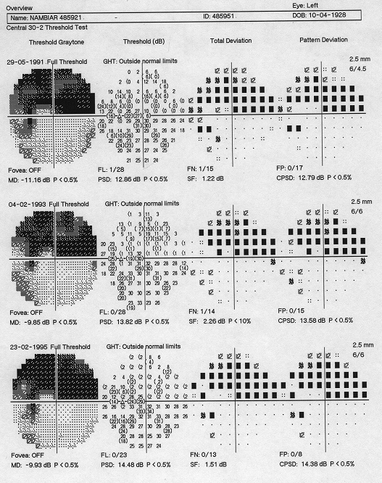
Fluctuation over time
© Thomas R
Notes:
Both the total and pattern deviation plots in this series show fluctuations over time, with some points worsening and others improving, and reversal of changes at individual points.

Slide 41
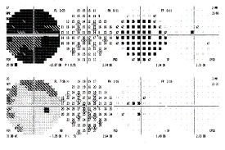
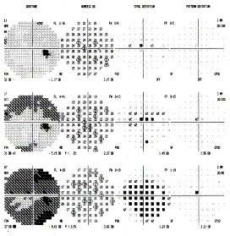
Overview: the patient developed a cataract, which was extracted.
Note that the pattern deviation plot remains clear.
© Thomas R
Notes:
The total deviation plot in the series shown continues to worsen until cataract surgery is performed. There is little change in the pattern deviation plot. Surgery results in a marked improvement in the total deviation plot (last field) with no effect on the pattern deviation plot.

Slide 42
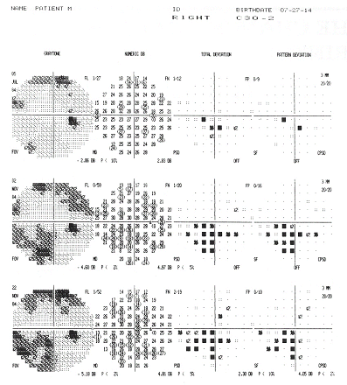
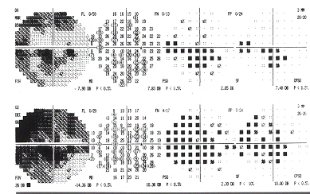
Overview: glaucoma is progressing.
Both the total and pattern deviation plots show worsening.
© Thomas R
Notes:
Both the total and pattern deviation plots show progressive worsening, indicating glaucomatous progression.

Slide 43
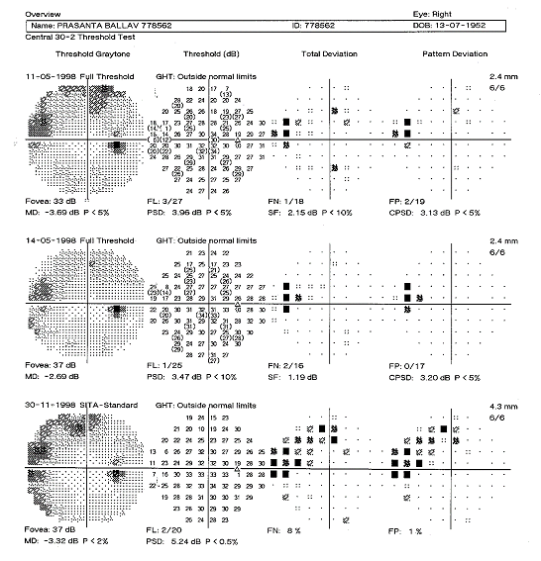
Overview
programme shows progression
Full threshold
SITA standard
SITA, Swedish Interactive Threshold Algorithm.
© Thomas R
Notes:
As the Swedish Interactive Threshold Algorithm (SITA) is different from full threshold, the printouts cannot be directly compared. In addition, fields can fluctuate substantially.
SITA is discussed in more detail towards the end of this presentation.
Reference
Thomas R, George R. Interpreting automated perimetry. Indian J Ophthalmol 2001; 49: 125–40.

Slide 44
Overview
programme shows progression
SITA is different
from full threshold
Can't compare apples to oranges
Fields may fluctuate
© Thomas R

Slide 45
Glaucoma Progression Analysis
GPA™* incorporates the Early Manifest Glaucoma Trial progression criteria
Change is based on the pattern deviation plot
Compatible with both SITA and full threshold (baseline only)
* Carl Zeiss Meditec.
© Thomas R
Notes:
The Humphrey® Glaucoma Progression Analysis™ (GPA™) software [Carl Zeiss Meditec] is designed to simplify the identification of progressive visual field loss in glaucoma patients. It analyses a series of visual fields (white size III stimulus) obtained using the full threshold or SITA testing strategies and corrects for ocular media effects. The analysis is based on variability data from clinical trials in North America, Europe and Asia, and uses the Early Manifest Glaucoma Trial progression criteria.
The GPA software selects two baseline tests, although the operator can over-rule the automated choice (e.g. to exclude initial learning fields).
Full threshold fields can be used as baseline fields but not for follow-up, therefore it is best to switch the baseline to SITA once three fields are available.
Reference
Carl Zeiss Meditec Inc. Humphrey® Glaucoma Progression Analysis™ (GPA™) Software. An advanced approach to monitoring disease progression. Company white paper. Dublin, CA: Zeiss, 2003. Available at: www.zeiss.de/C125679E00525939/EmbedTitelIntern/OFS_White_Paper16_eng/$File/OFS_whitepaper16_eng.pdf. Accessed: 1 March 2012.

Slide 46
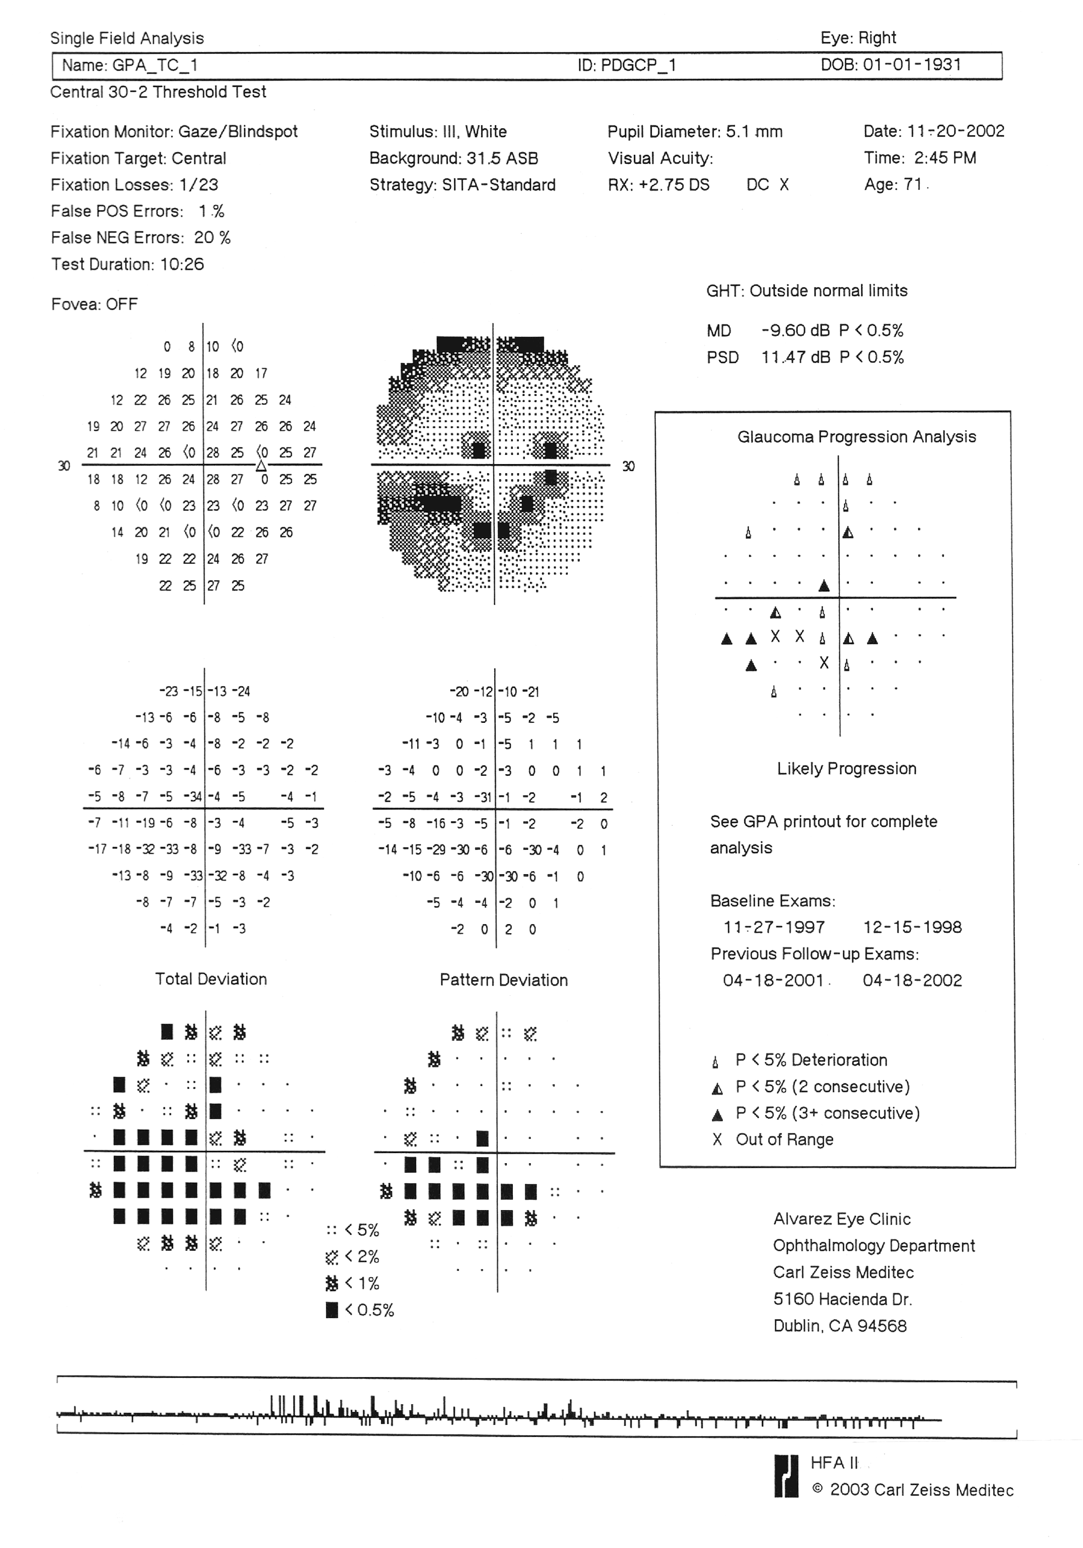

© Thomas R
Notes:
At least four examinations are required for confirmation of progression (two baseline and two follow-up fields). Triangles indicate statistically significant change (p < 0.05) as follows:
Open triangles indicate points that have deteriorated on at least one test compared with baseline. Although these points should be followed closely, any given field is likely to contain two or three open triangles based on chance alone.
Half triangles indicate deterioration on two consecutive fields.
Full triangles indicate deterioration on three consecutive fields.
The programme alerts the user to possible or likely progression, where progression refers to statistically significant change that is also clinically repeatable and consistent. Progression is considered possible or likely if the same three or more points show significant deterioration on two or three consecutive follow-up tests, respectively.
Reference
Carl Zeiss Meditec Inc. Humphrey® Glaucoma Progression Analysis™ (GPA™) Software. An advanced approach to monitoring disease progression. Company white paper. Dublin, CA: Zeiss, 2003. Available at: www.zeiss.de/C125679E00525939/EmbedTitelIntern/OFS_White_Paper16_eng/$File/OFS_whitepaper16_eng.pdf. Accessed: 1 March 2012.

Slide 47
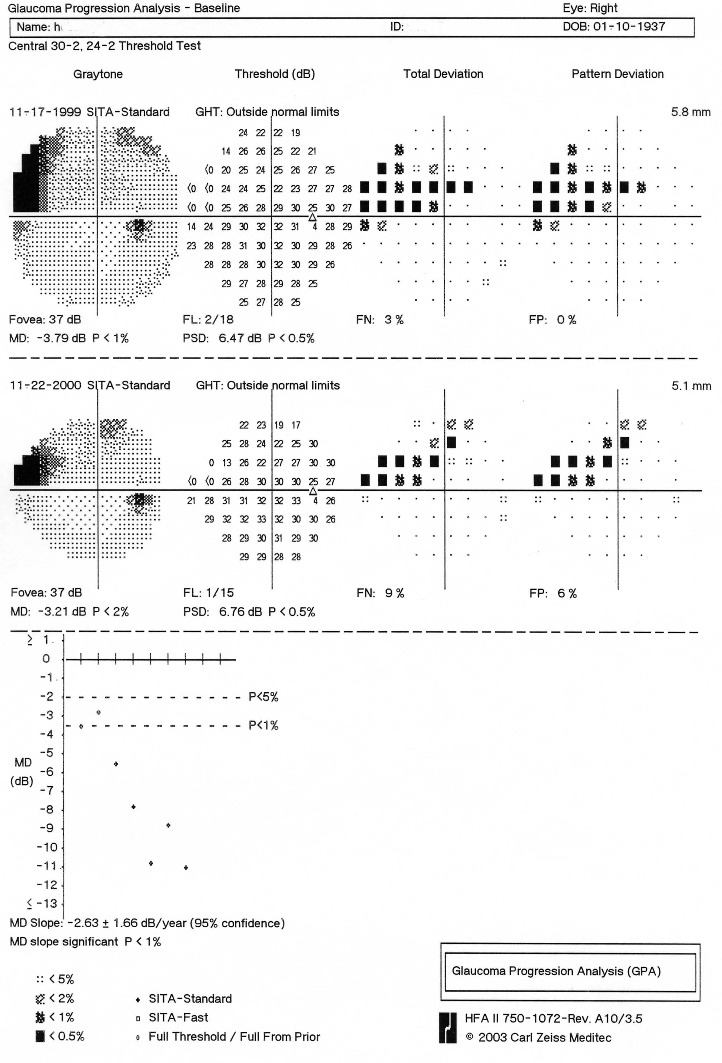
GPA
Right eye: baseline
© Thomas R
Notes:
The rate of glaucoma progression varies considerably from patient to patient. The GPA programme estimates the progression rate by performing a regression analysis of the MD. A plot of the MD is displayed at the bottom of the baseline printout (see slide) and the MD slope given below the plot indicates how rapidly field damage is progressing. However, it should be noted that patients with significant damage at baseline (MD < –15 dB) may appear to be progressing slowly.
Reference
Carl Zeiss Meditec Inc. Humphrey® Glaucoma Progression Analysis™ (GPA™) Software. An advanced approach to monitoring disease progression. Company white paper. Dublin, CA: Zeiss, 2003. Available at: www.zeiss.de/C125679E00525939/EmbedTitelIntern/OFS_White_Paper16_eng/$File/OFS_whitepaper16_eng.pdf. Accessed: 1 March 2012.

Slide 48
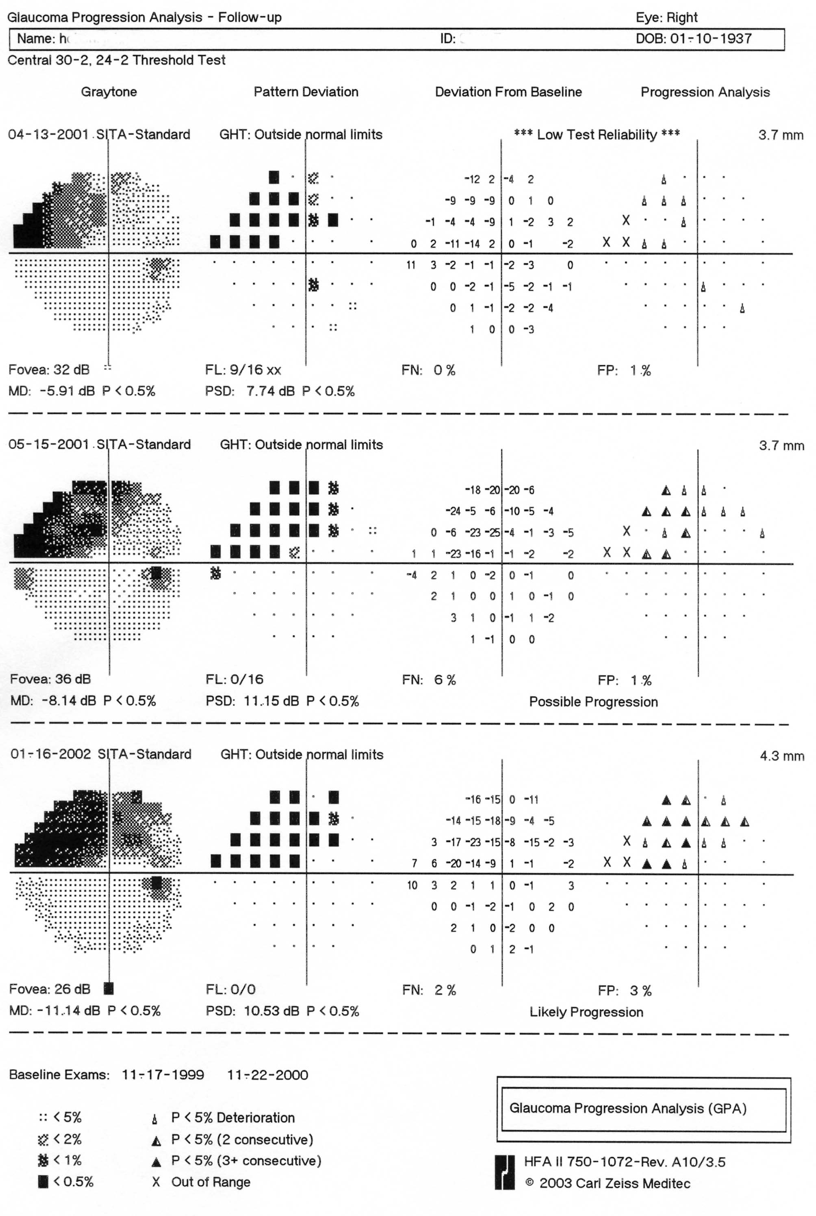
GPA
Right eye: follow-up
© Thomas R
Notes:
Follow-up examinations show progressive deterioration compared with baseline.

Slide 49
3 or more points deteriorate in at least 2 consecutive tests
© Thomas R
Notes:
This printout shows deterioration in more than three points in at least two consecutive visits, indicating possible glaucomatous progression.

Slide 50
3 or more points deteriorate in at least 3 consecutive tests
© Thomas R
Notes:
This printout shows deterioration in more than three points in at least three consecutive visits, indicating likely glaucomatous progression.

Slide 51
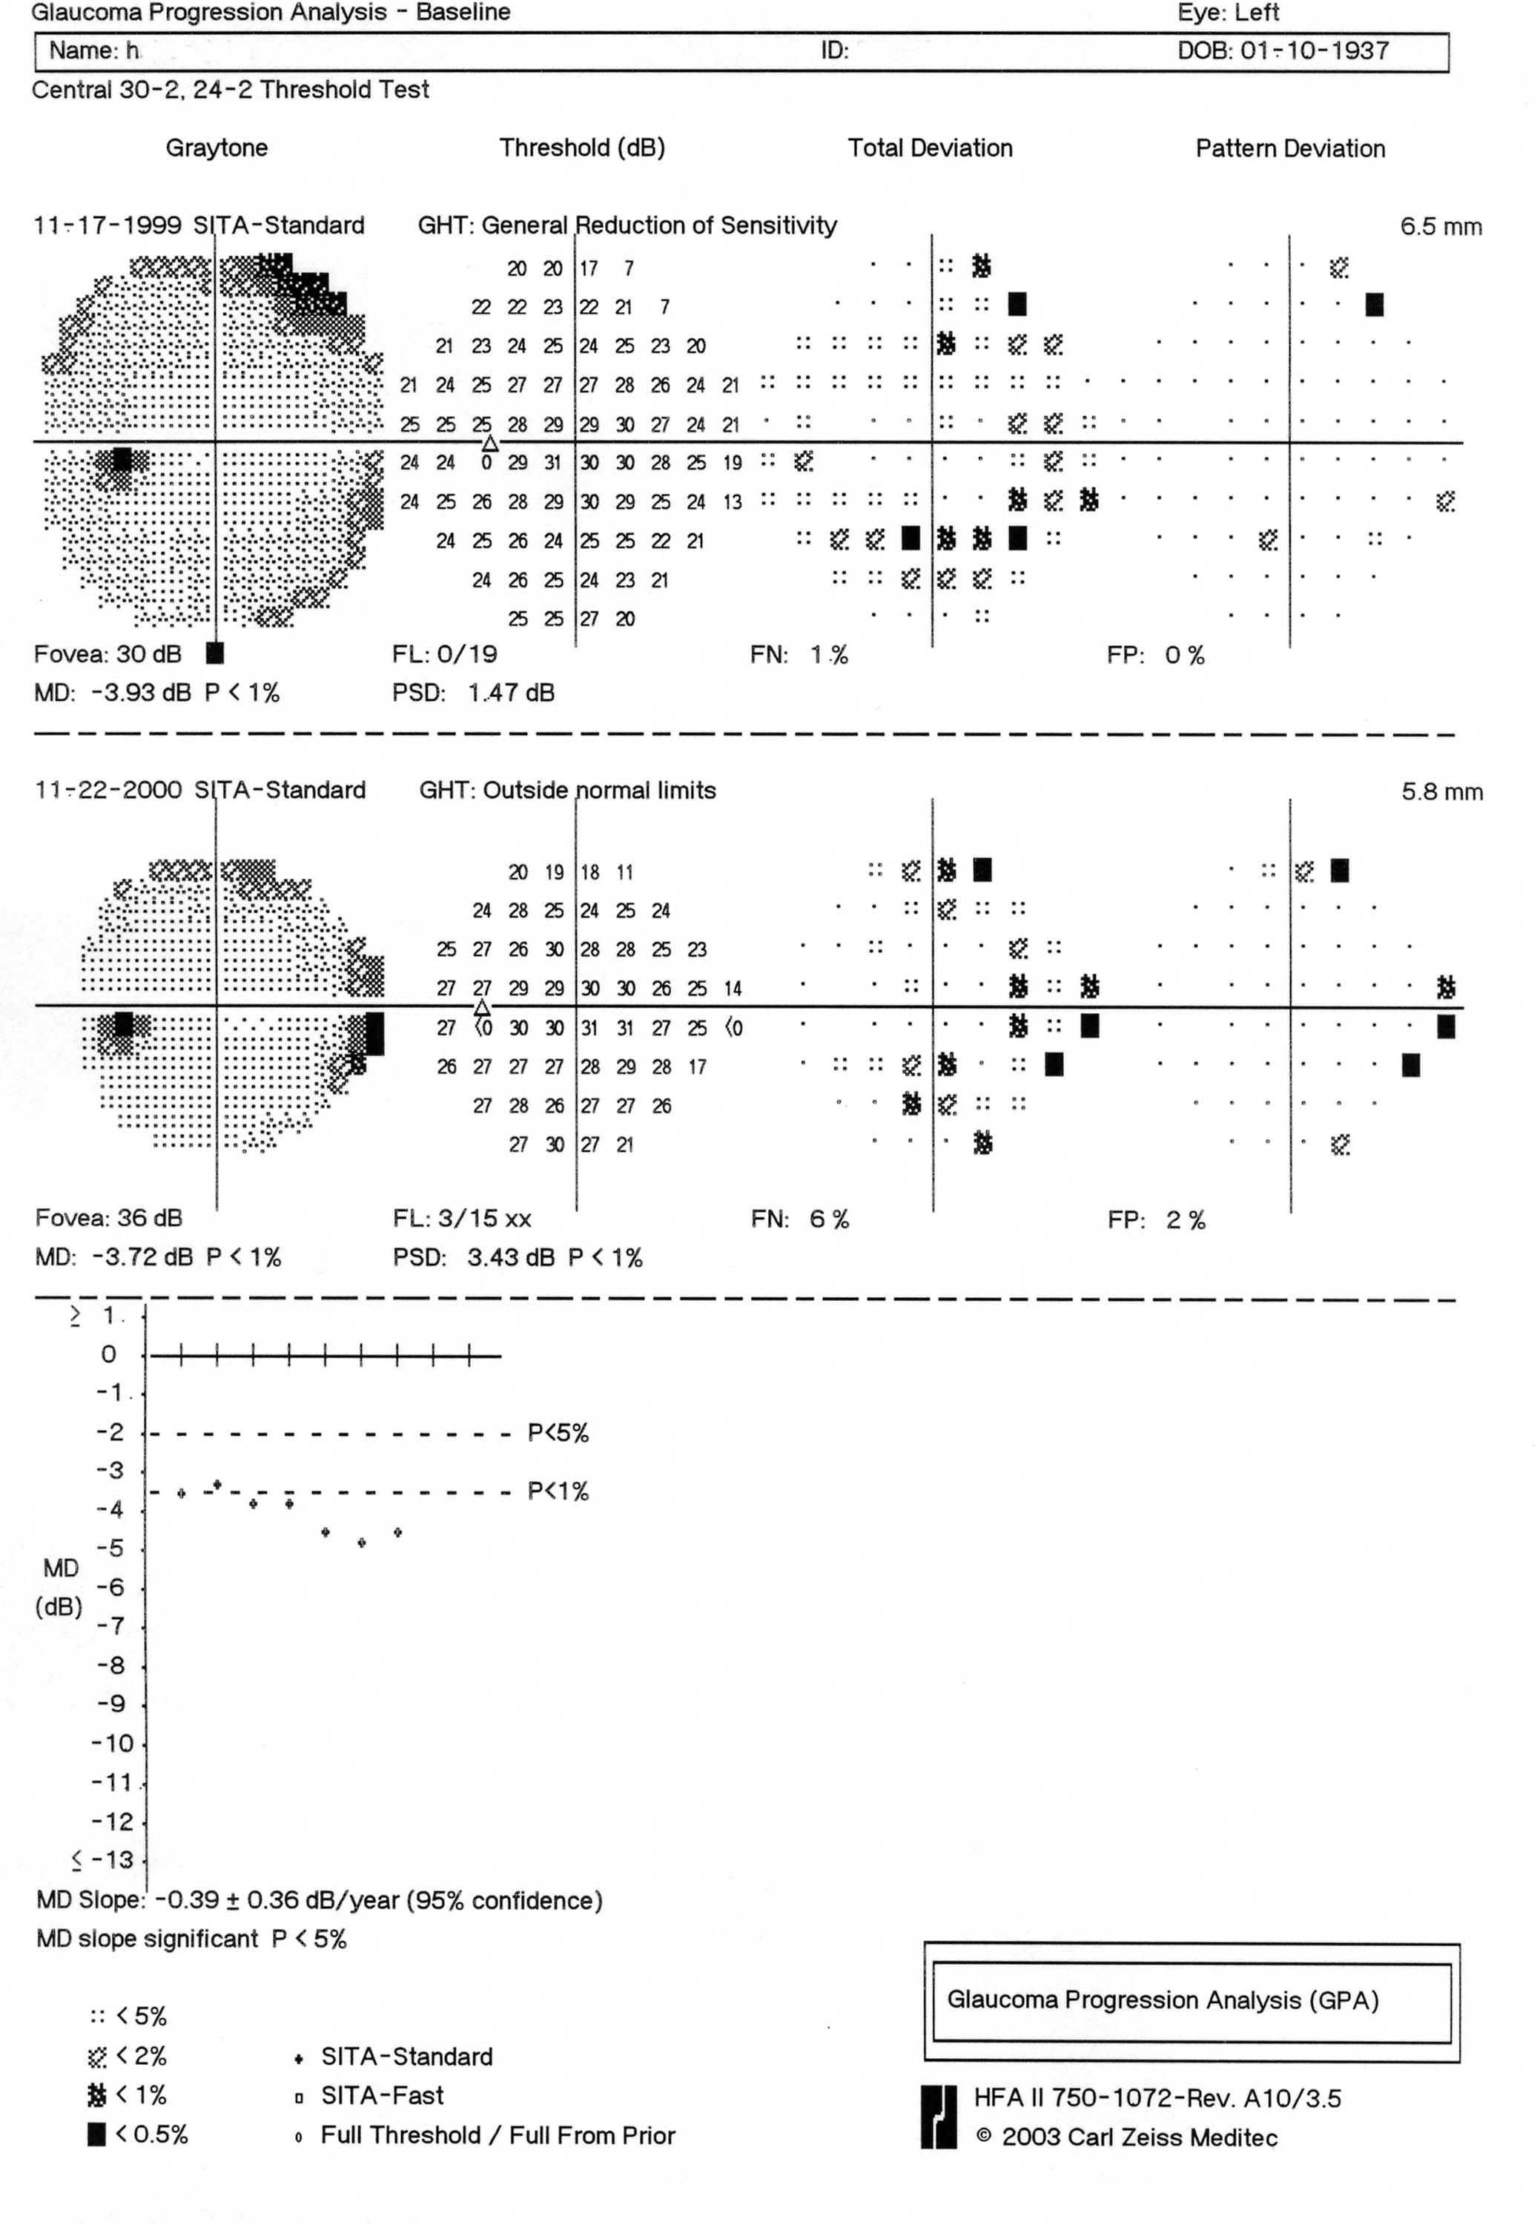
GPA
Left eye: baseline
© Thomas R

Slide 52
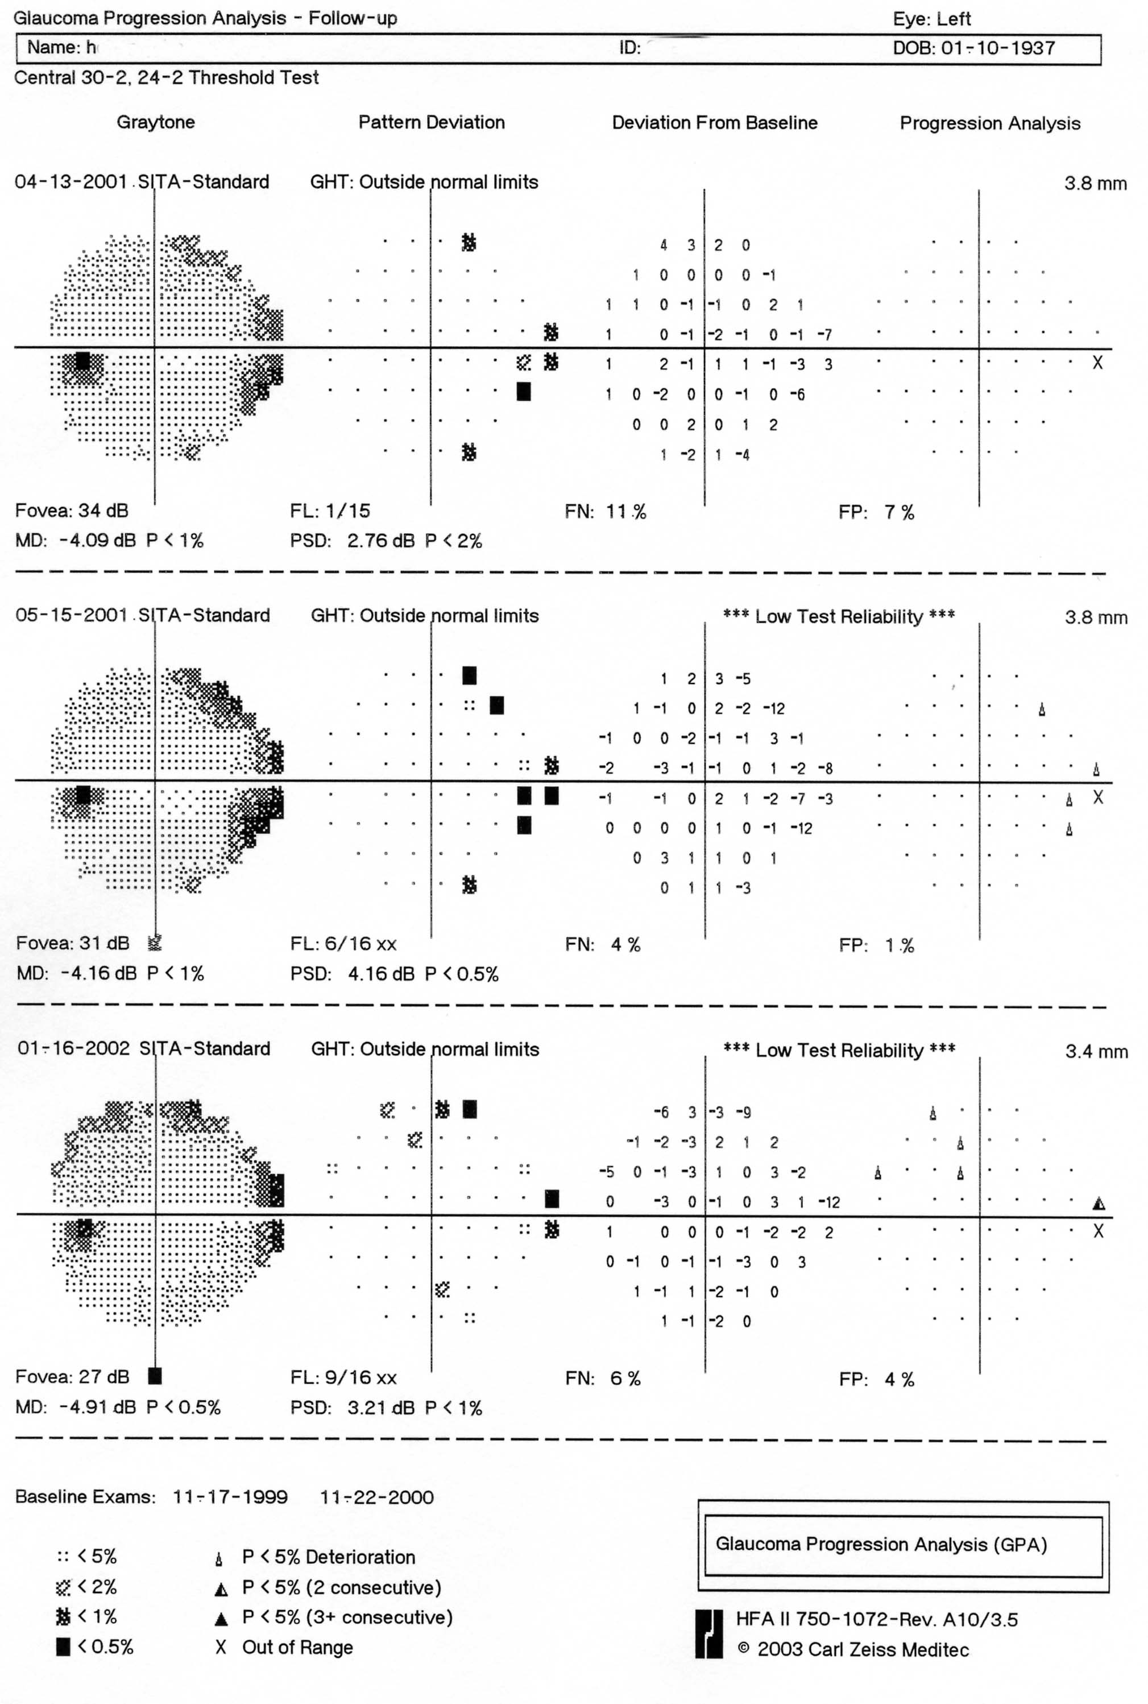
GPA
Left eye: follow-up
© Thomas R
Notes:
These follow-up examinations do not show statistically significant change from baseline.
However, note the ‘Low Test Reliability’ warning on two of these follow-up exams.

Slide 53
© Thomas R

Slide 54
Visual Field Index for calculating the progression rate
Visual Field Index (VFI)
  Improved metric of visual field loss
  New graphical trend display
  Plotted against age
  Single page printout
Bengtsson B, Heijl A. Am J Ophthalmol 2008; 145: 343–53.
Notes:
54
The Visual Field Index (VFI) developed by Boel Bengtsson is an age-corrected perimetric index for quantifying the rate of glaucomatous progression.¹ Designed for the Humphrey 30-2 and 24-2 test patterns, the VFI is included in the one-page GPA Summary Report for the Humphrey perimeter.^{1,2} The VFI plot graphs the rate of vision loss relative to age, and projects the current progression rate out over the next 3 to 5 years.²
References
1. Bengtsson B, Heijl A. A visual field index for calculation of glaucoma rate of progression. Am J Ophthalmol 2008; 145: 343–53.
2. Carl Zeiss Meditec, Inc. HFA II-i Guided Progression Analysis (GPA): Summary Report. Dublin, CA: Zeiss, 2008. Available at: www.meditec.zeiss.com/C125679E00525939/EmbedTitelIntern/hfa-summary-report/$File/hfa-summary-report.pdf. Accessed: 1 March 2012.

Slide 55
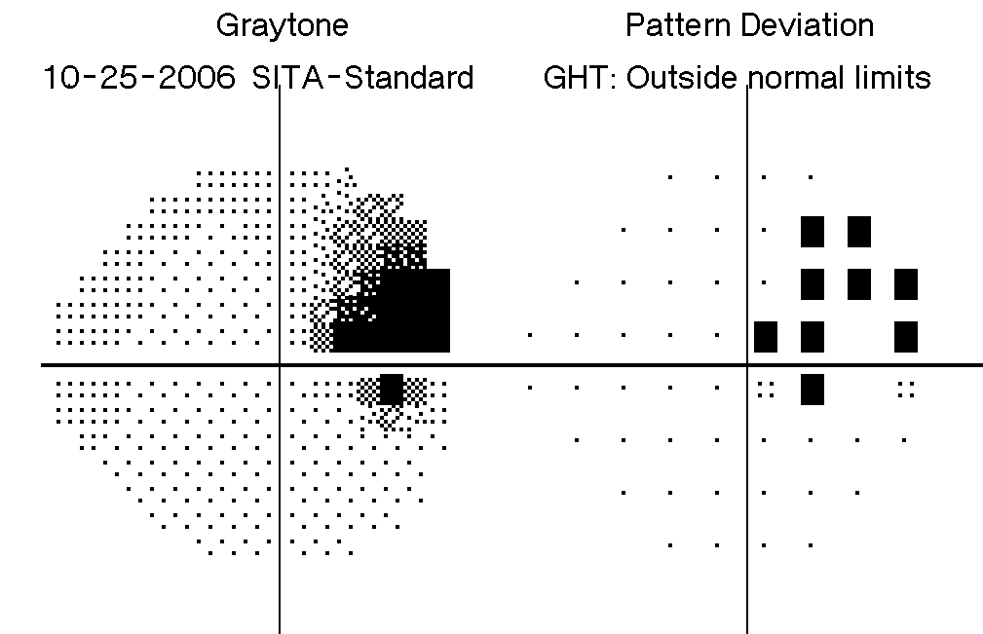
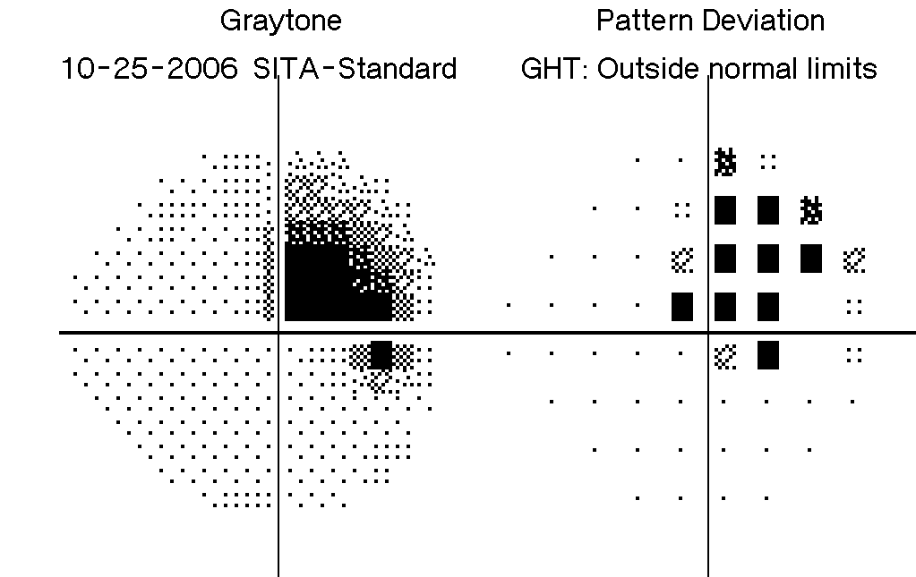
Visual Field Index for calculating the progression rate
Central points are weighted more heavily
Reduces contribution of cataract to the measurement of VF loss
A
B
VFI = 90%
VFI = 81%
Bengtsson B, Heijl A. Am J Ophthalmol 2008; 145: 343–53.
Notes:
55
The VFI is centrally weighted to reflect the greater importance of central and paracentral vision relative to peripheral vision. Central weighting of the index is based on cortical magnification, which is assumed to reflect ganglion cell density.
The VFI was designed to be less influenced by cataracts than the Humphrey® mean deviation index (MDI). Cataracts can interfere with the accurate evaluation of glaucoma progression using MDI – a worsening cataract can falsely suggest a high progression rate, whereas MDI values will improve after cataract surgery. The VFI uses the Humphrey pattern deviation map to overcome the effect of cataracts (except for fields with an MDI worse than –20 dB, for which total deviation probability maps are used).
A pilot evaluation retrospectively compared the MDI and VFI in a series of fields from three patient groups: eyes with developing cataract (n = 45), eyes without cataract (n = 42), and eyes in which cataract surgery was performed in the middle of the series (n = 44). The apparent progression rate in eyes with cataract was significantly higher when measured with the MDI compared with the VFI (mean loss of 3.6% versus 2.1% per year; p < 0.0001). In contrast, there was no significant difference between the MDI and VFI in eyes with no cataract. For eyes undergoing cataract surgery, the MDI showed a lower rate of progression than the VFI, with wider confidence intervals. Overall, the study indicated that glaucoma progression rates determined using the VFI were less affected by cataract or cataract surgery than rates based on the MDI.
Reference
Bengtsson B, Heijl A. A visual field index for calculation of glaucoma rate of progression. Am J Ophthalmol 2008; 145: 343–53.

Slide 56
Visual Field Index for calculating the progression rate
Regression graph
VFI Bar
Notes:
56
The VFI Plot graphs the VFI value as a function of age for all the exams included in the GPA analysis. Provided at least 5 exams over 3 years are included in the GPA, the VFI Plot displays a linear regression analysis of the VFI over time and a 3 to 5 year projection if this trend continues. The projection time is equal to the number of years of data available, to a maximum of 5 years.
The VFI Bar is a histogram that visually displays the information in the VFI Plot.
Reference
Carl Zeiss Meditec, Inc. HFA II-i with Guided Progression Analysis™ (GPA): Sample Cases. Dublin, CA: Zeiss, 2008. Available at: www.meditec.zeiss.com/C125679E00525939/EmbedTitelIntern/HFA_GPA_sample_cases/$File/HFA_GPA_sample_cases.pdf. Accessed: 1 March 2012.

Slide 57
Visual Field Index for calculating the progression rate
The VFI shows vision loss in percentage terms
The VFI value is expressed as a percentage of
a normal, age-adjusted VF
Notes:
57
The VFI value is a summary measure of the patient’s VF status, expressed as a percentage of a normal, age-adjusted VF.
Reference
Carl Zeiss Meditec, Inc. HFA II-i Guided Progression Analysis (GPA): Summary Report. Dublin, CA: Zeiss, 2008. Available at: www.meditec.zeiss.com/C125679E00525939/EmbedTitelIntern/hfa-summary-report/$File/hfa-summary-report.pdf. Accessed: 1 March 2012.

Slide 58
Visual Field Index for calculating the progression rate
% loss to date
% loss in next 5 years
100%
  The VFI Bar presents the percentage vision loss
  in an intuitive visual format:
    vision lost to date
    projected loss if the current trend continues
Notes:
58
The VFI Bar is a graphical representation of the patient’s vision at the current VFI value. The top segment of the bar represents the percentage vision loss to date when compared with a normal visual field adjusted for age. The middle segment of the bar depicts the projected vision loss over the next 3 to 5 years, assuming the current rate of progression continues. The bottom segment of the bar represents the patient’s remaining useful vision.
Reference
Carl Zeiss Meditec, Inc. HFA II-i Guided Progression Analysis (GPA): Summary Report. Dublin, CA: Zeiss, 2008. Available at: www.meditec.zeiss.com/C125679E00525939/EmbedTitelIntern/hfa-summary-report/$File/hfa-summary-report.pdf. Accessed: 1 March 2012.

Slide 59
Visual Field Index for calculating the progression rate
The VFI is plotted against age:
characterises trend significance over next 5 years
aids in interpretation and patient education
helps formulate individualised treatment decisions.
Notes:
59
The VFI is plotted relative to patient age to determine the rate of functional loss. The risk of visual impairment depends on the progression rate and the patient’s expected lifetime – a progression rate may be acceptable in an 85-year-old patient but not at age 65 years. The VFI projection of visual loss over the next 3 to 5 years may help guide individualised treatment decisions and may also aid in patient education.
Reference
Carl Zeiss Meditec, Inc. HFA II-i with Guided Progression Analysis™ (GPA): Sample Cases. Dublin, CA: Zeiss, 2008. Available at: www.meditec.zeiss.com/C125679E00525939/EmbedTitelIntern/HFA_GPA_sample_cases/$File/HFA_GPA_sample_cases.pdf. Accessed: 1 March 2012.

Slide 60
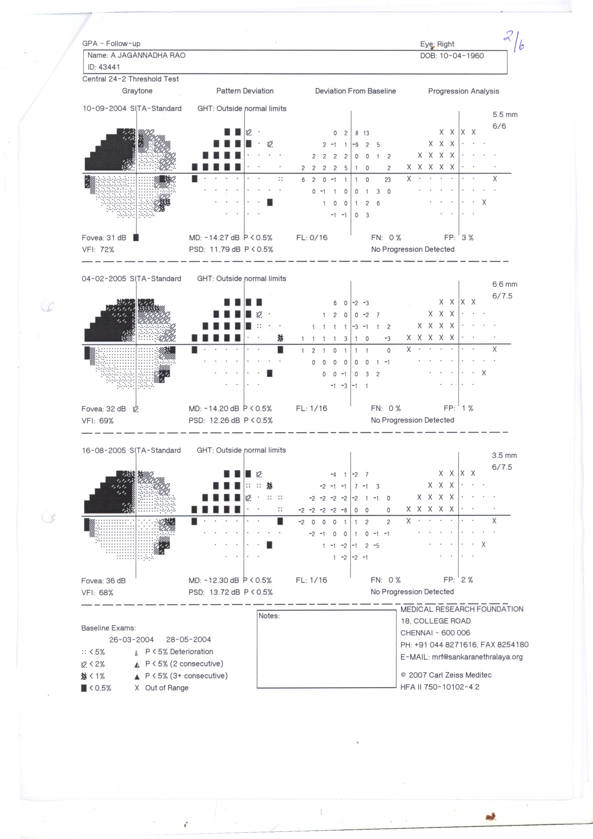
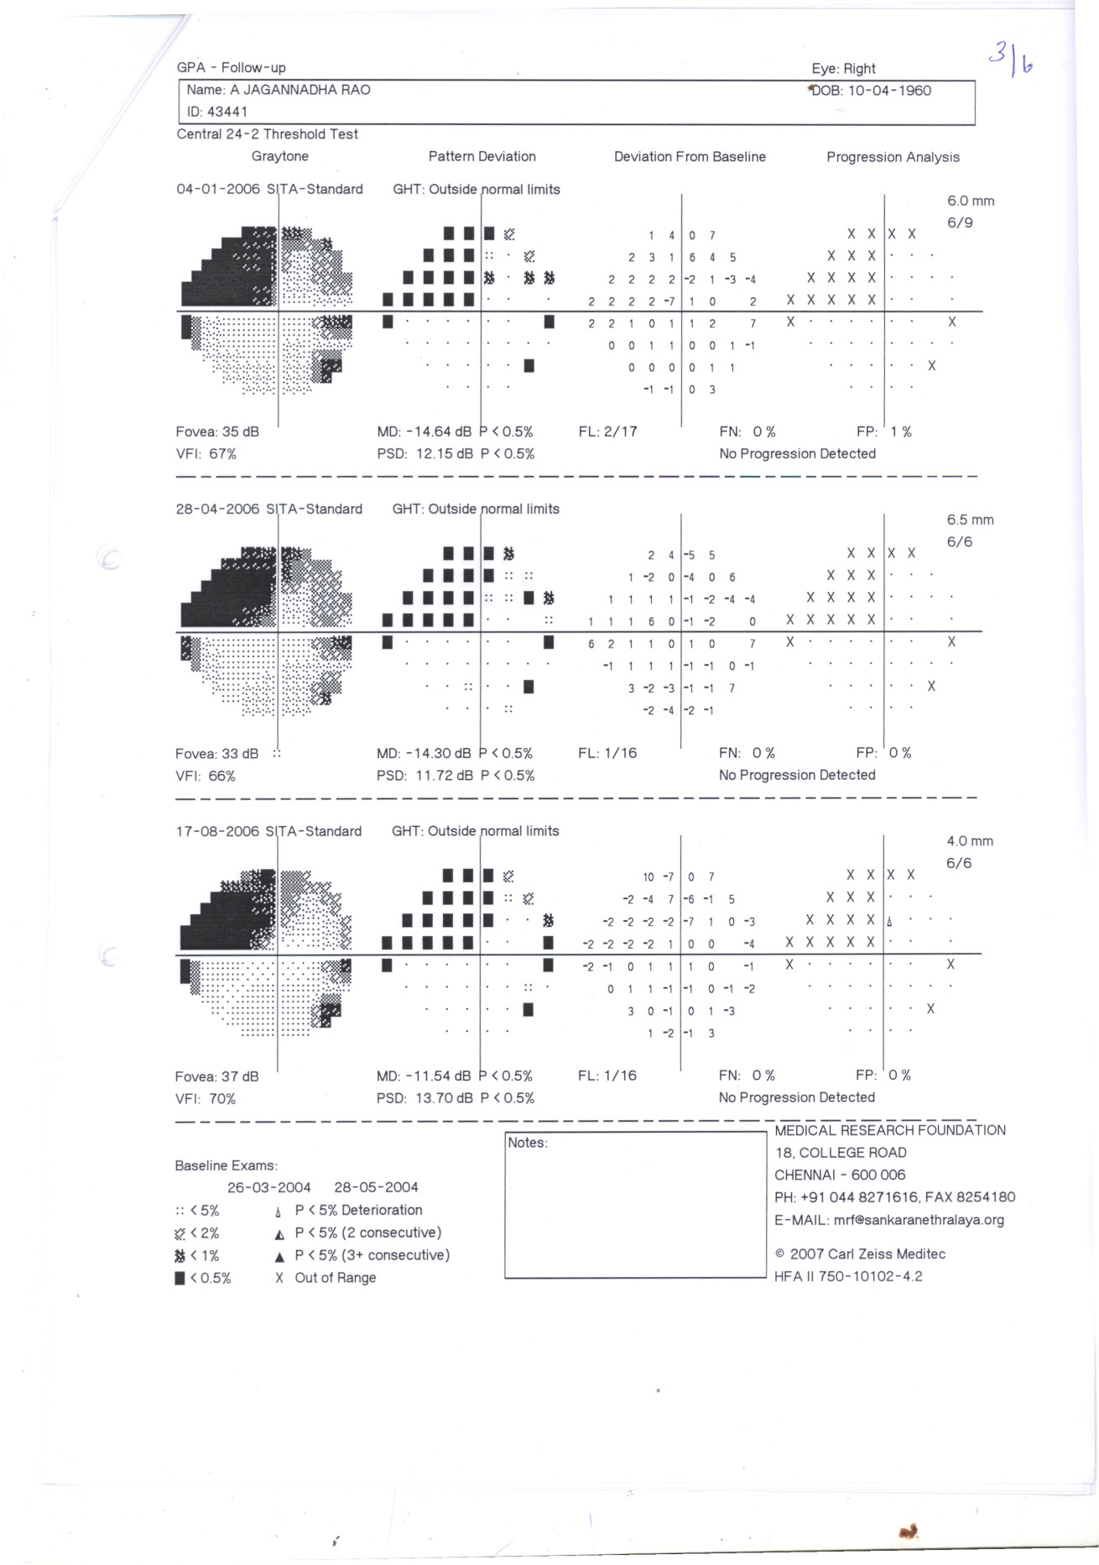
Notes:
This slide and the following two slides show follow-up fields from a young patient over a 4-year period.

Slide 61
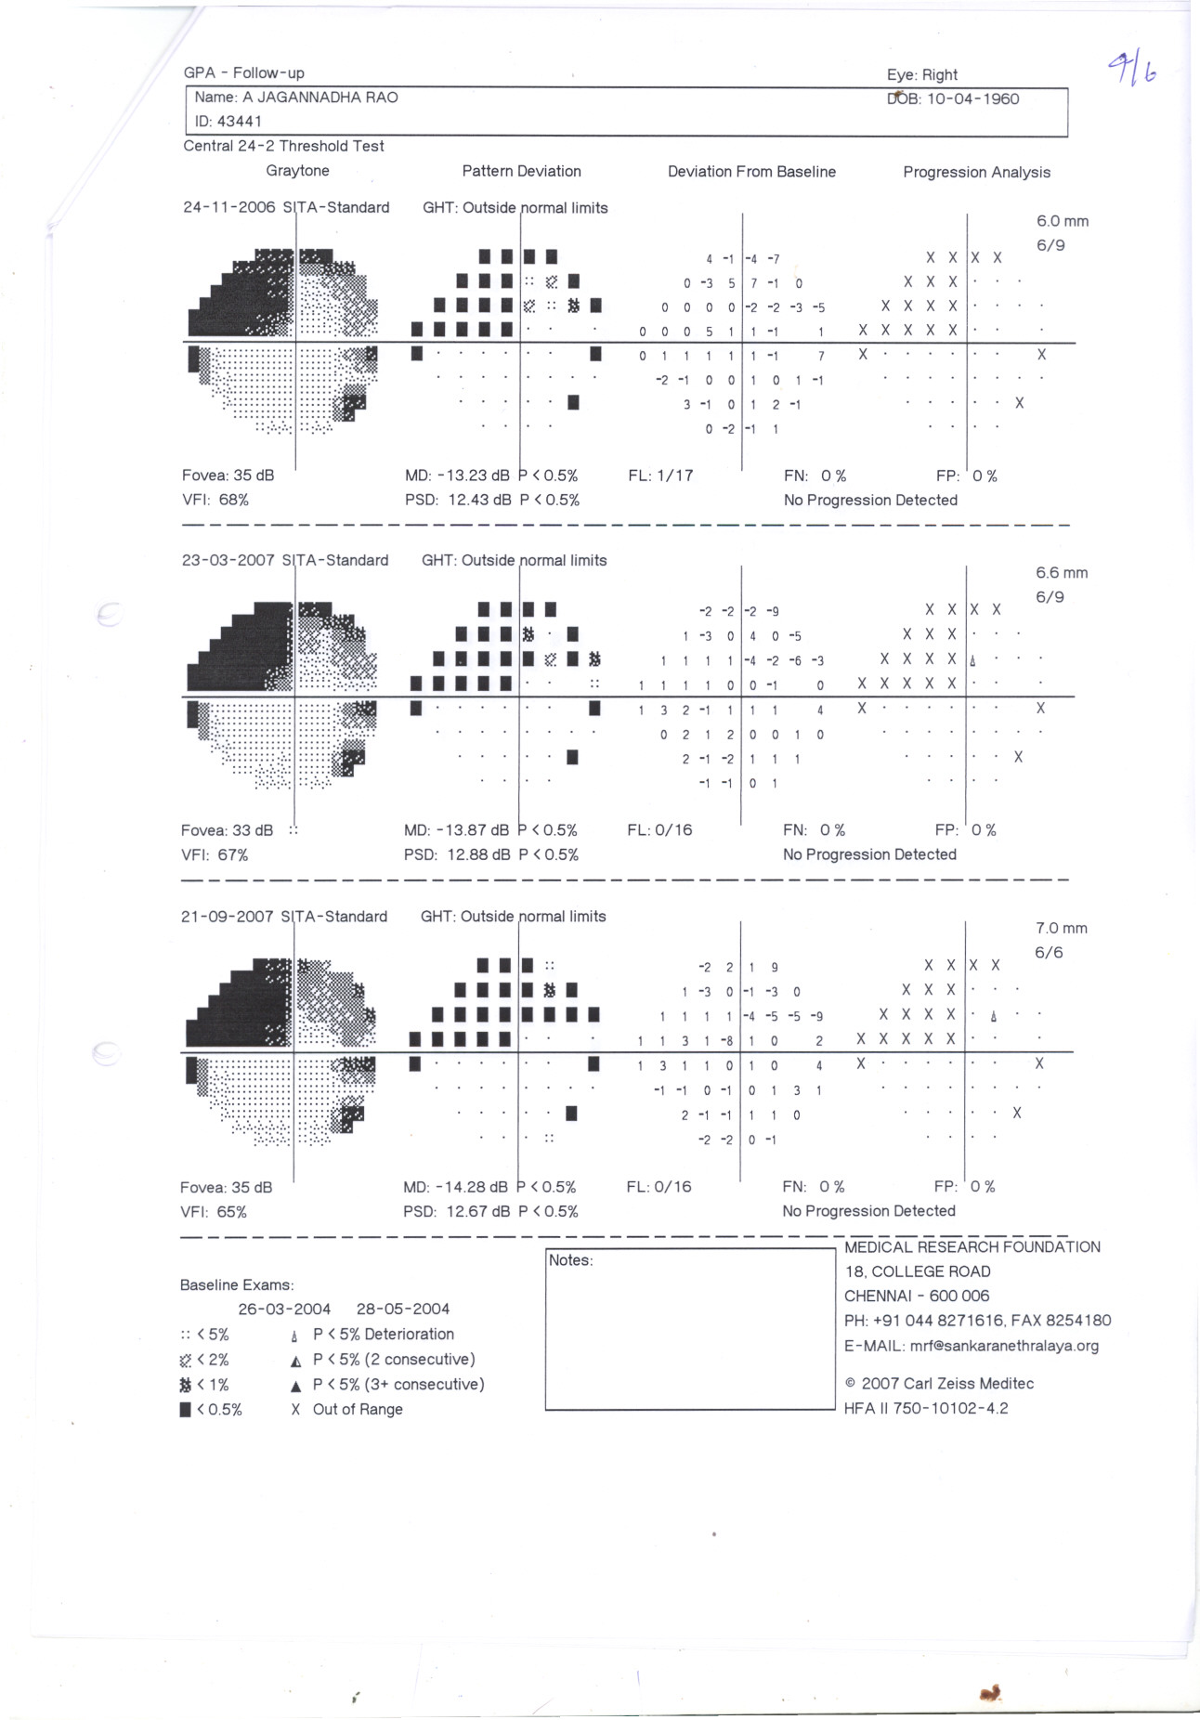
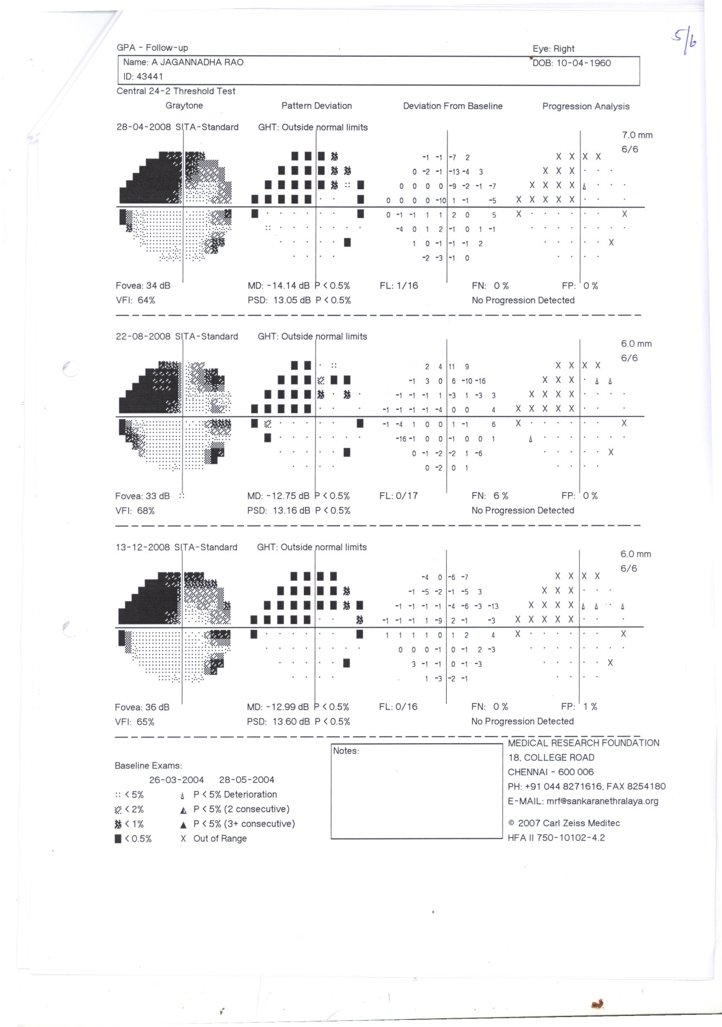
Notes:
These slides show follow-up fields from a young patient over a 4-year period.

Slide 62
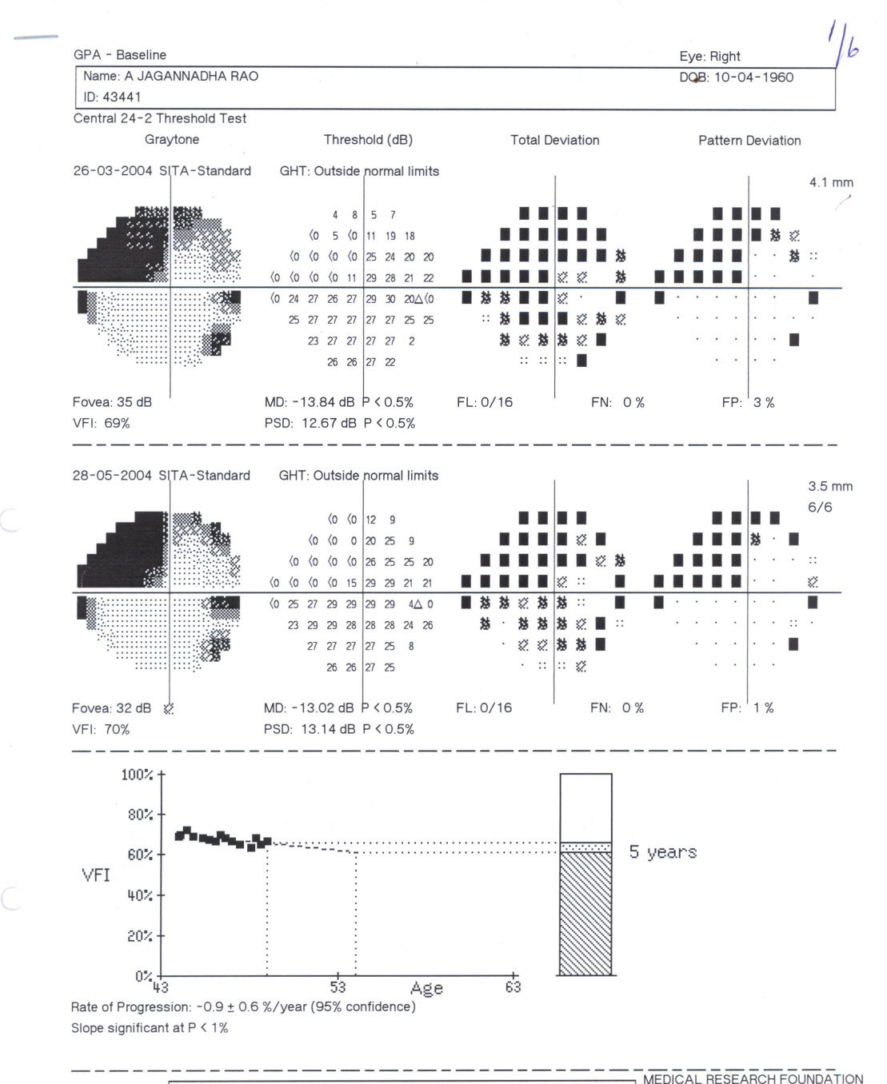
Stable field
Notes:
The patient has a stable field, suggesting that if the glaucoma is maintained at the same level it is likely to remain stable over next 5 years.

Slide 63
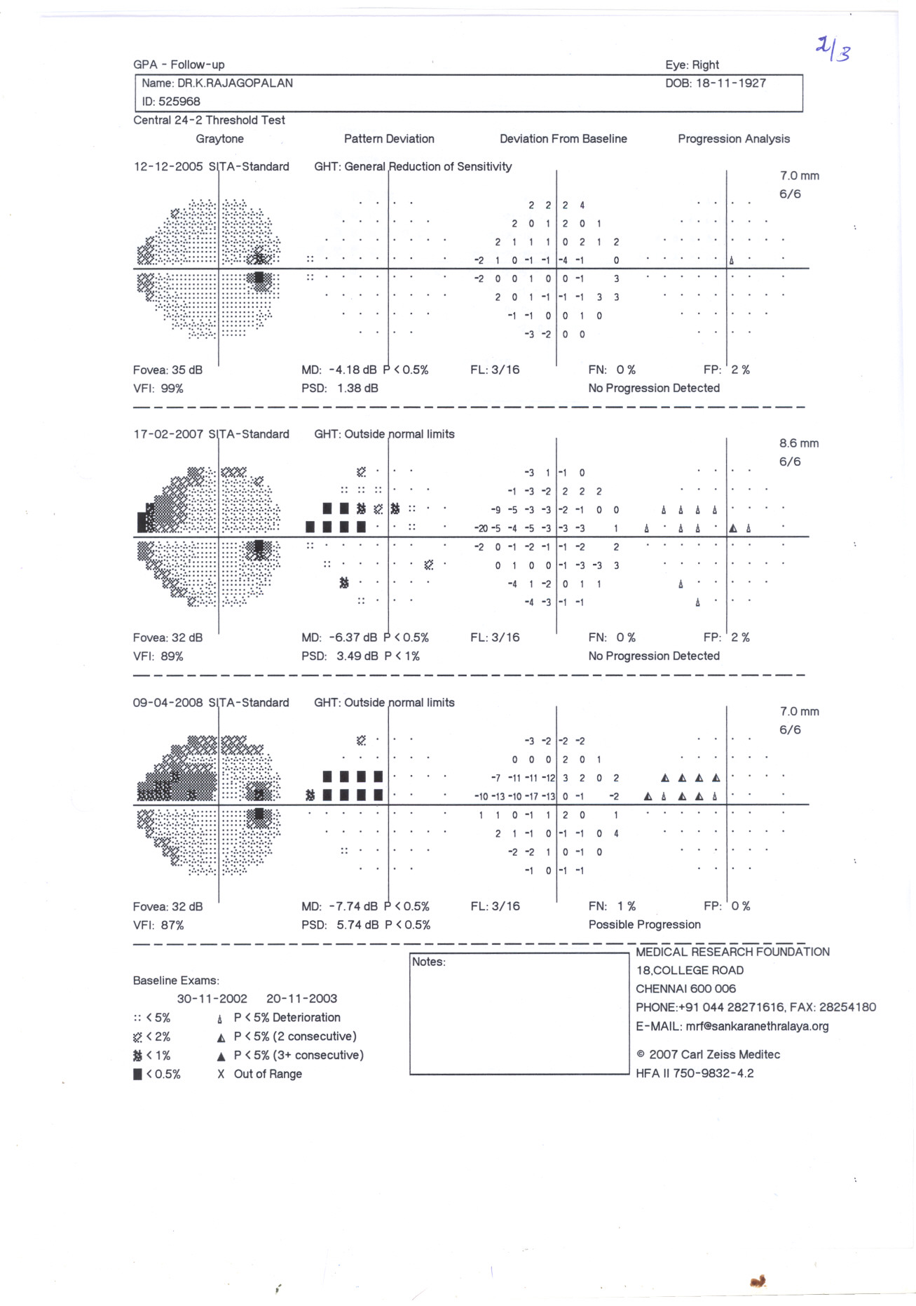
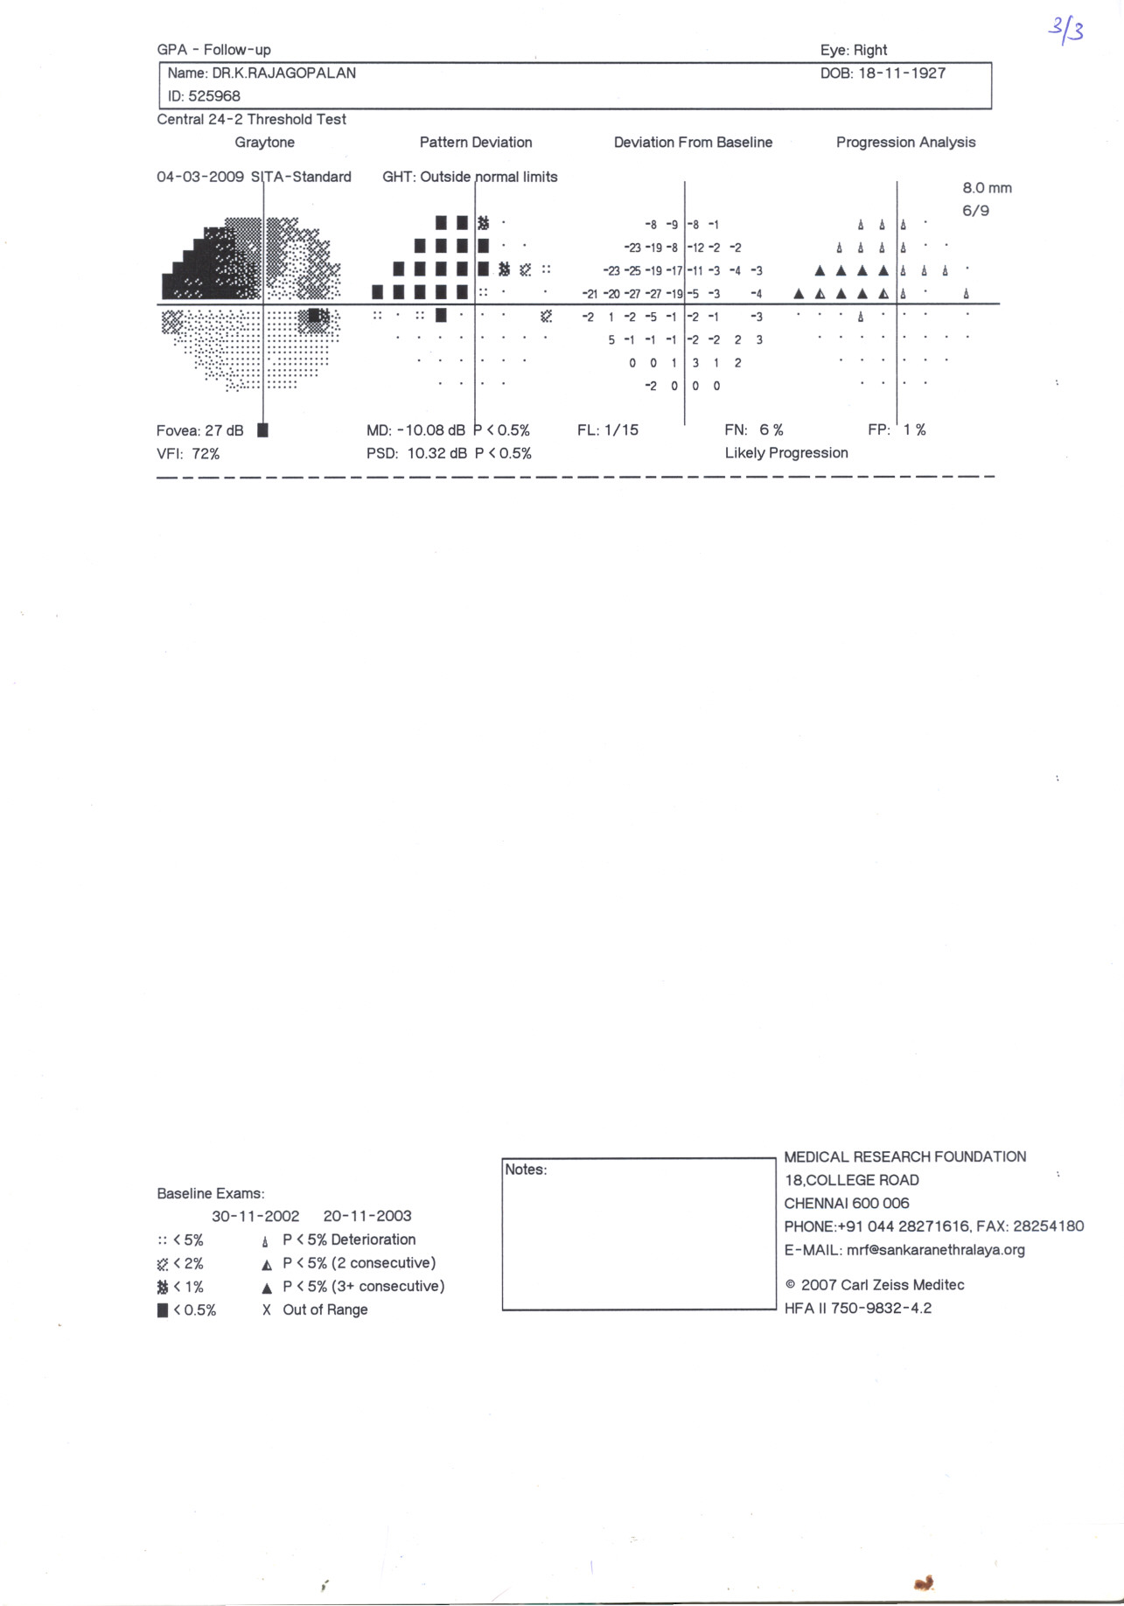

Slide 64
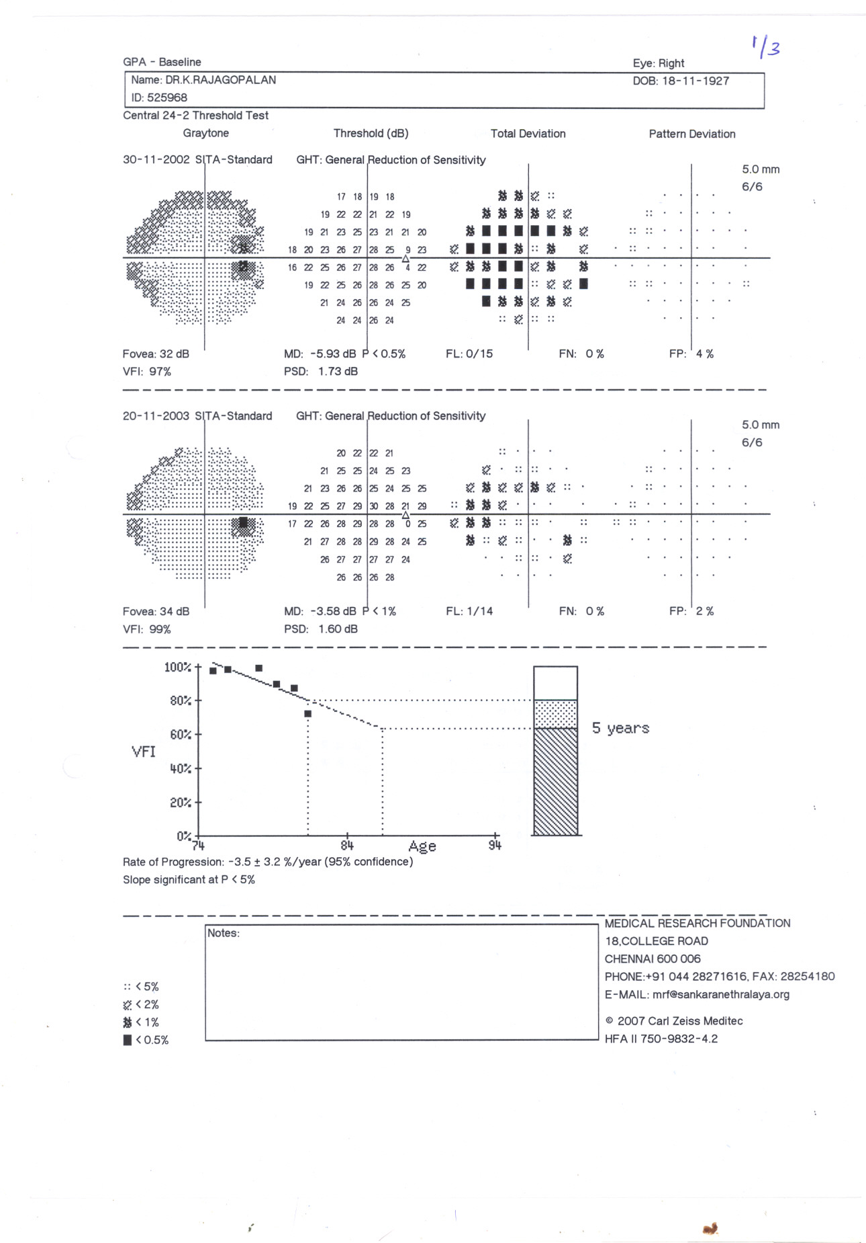
Progressing defect
Notes:
The slide shows progression in an elderly patient, and also projects the likely progression over the next 5 years with present glaucoma control.

Slide 65
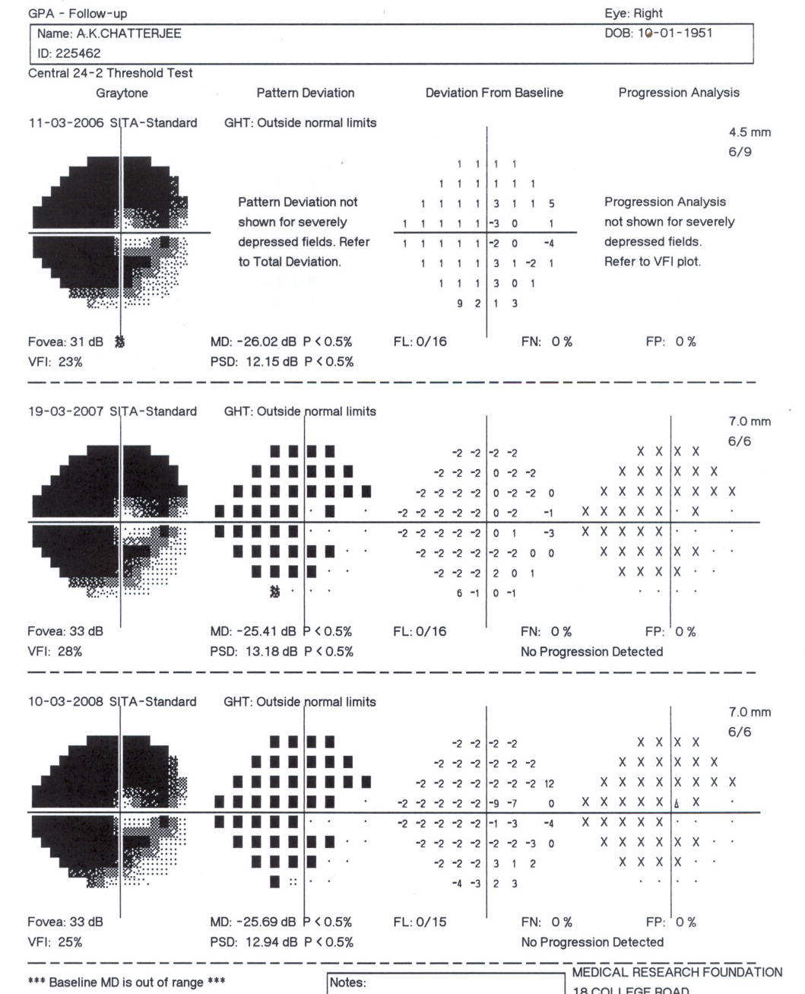
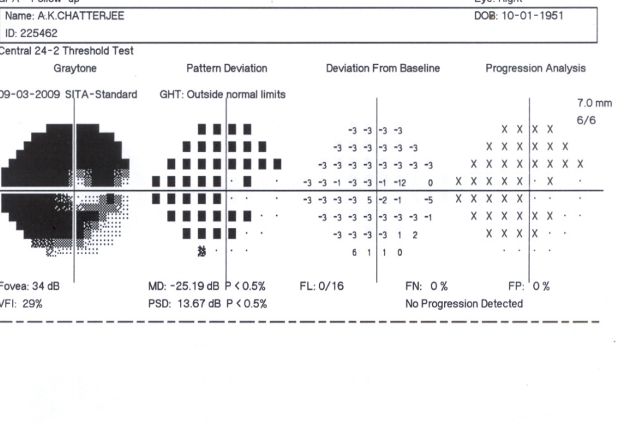
Notes:
This slide and the next slide show results from a young patient with advanced field loss.

Slide 66
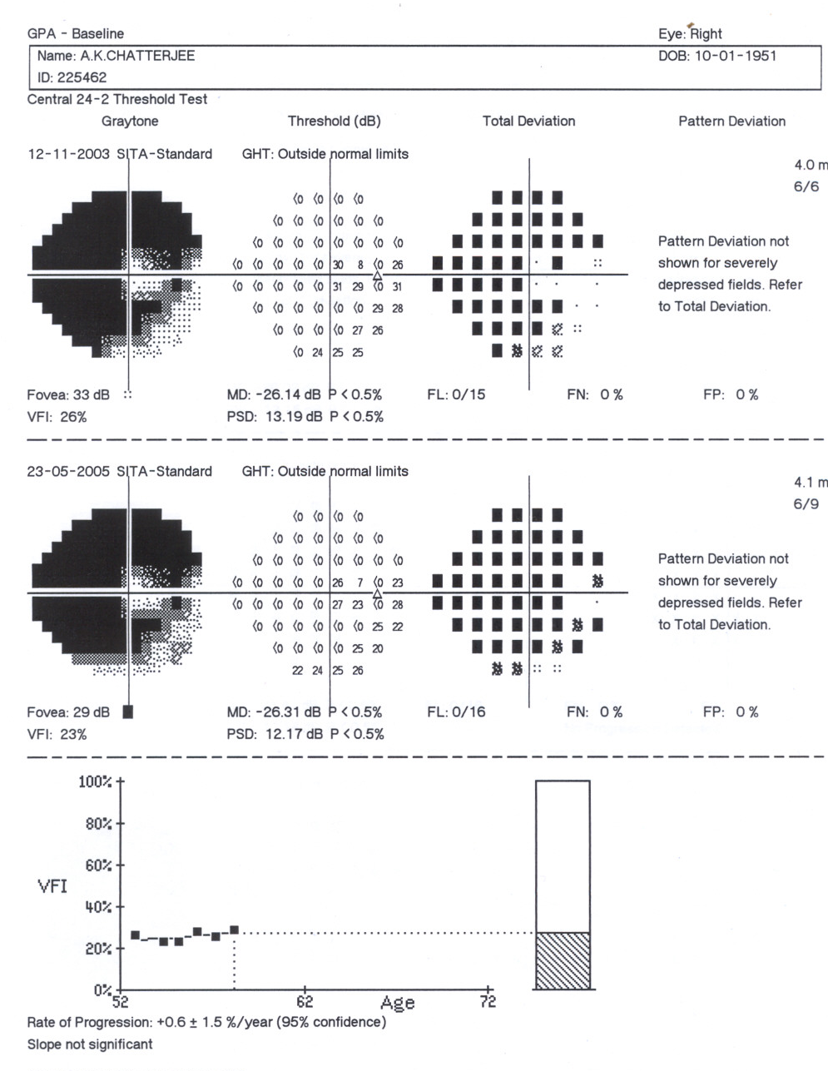
Stable field
in advanced glaucoma
Notes:
Advanced field loss is apparent in this young patient with a stable field. The field is likely to remain stable in the coming years with present glaucoma treatment.

Slide 67
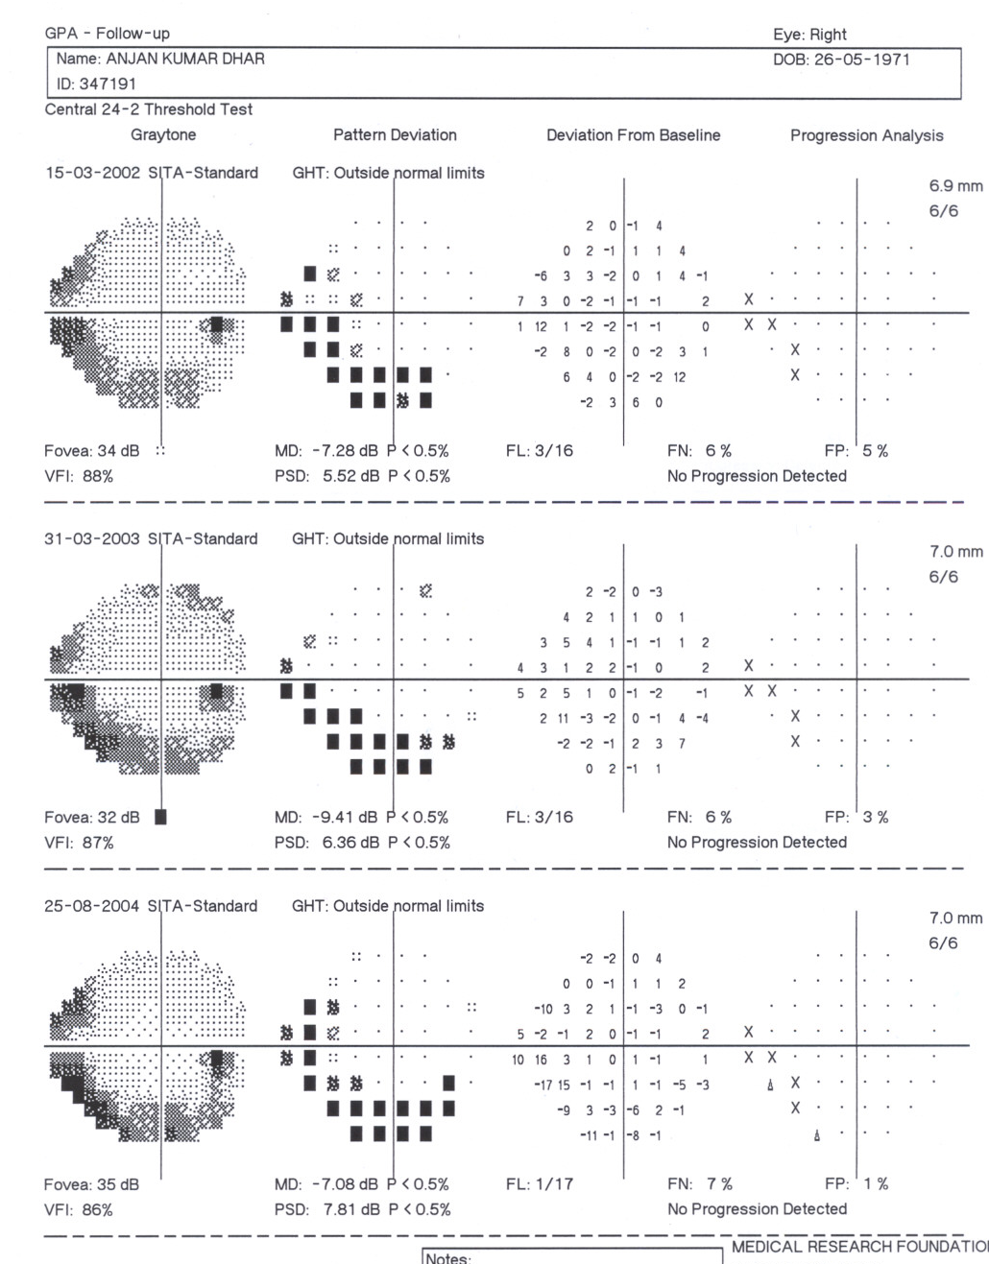
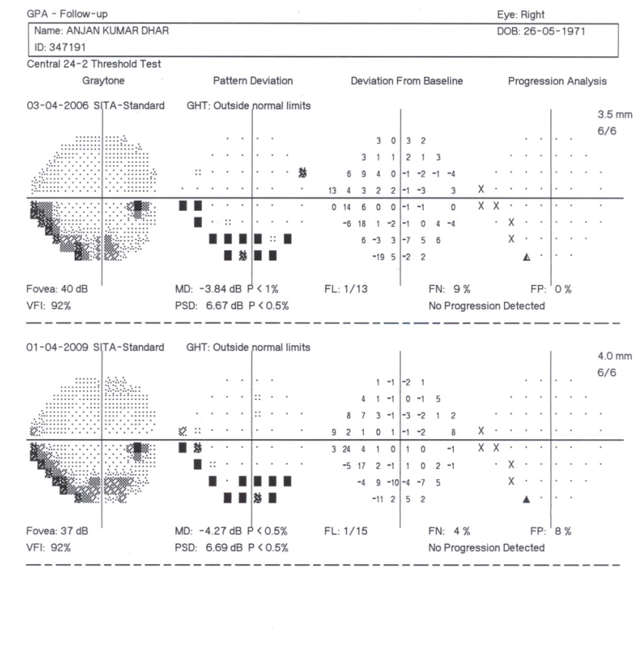

Slide 68
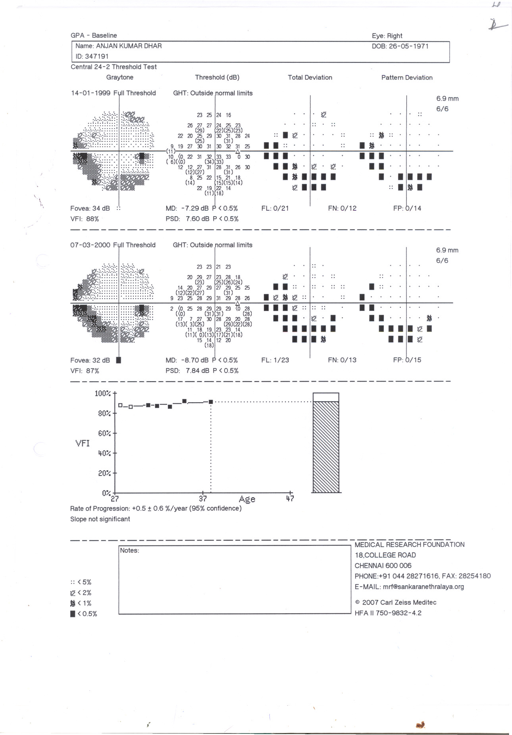

Slide 69
Visual Field Index – points to remember
Slow progression may not be
vision-threatening – consider the patient’s life expectancy
Re-establish a baseline after a significant treatment change
Exclude non-representative exams
Notes:
69
Life expectancy is an important consideration – slow progression may not be vision-threatening in an elderly patient.
Practical considerations when interpreting the VFI Plot include the need to update the baseline after a significant treatment change, and to exclude non-representative exams where the patient may have had a bad test day. Re-establishing the baseline after a significant change in treatment can help to determine whether the visual field has stabilised. Non-representative exams will alter the VFI regression line and the calculated progression rate.
Reference
Carl Zeiss Meditec, Inc. HFA II-i with Guided Progression Analysis™ (GPA): Sample Cases. Dublin, CA: Zeiss, 2008. Available at: www.meditec.zeiss.com/C125679E00525939/EmbedTitelIntern/HFA_GPA_sample_cases/$File/HFA_GPA_sample_cases.pdf. Accessed: 21 March 2012.

Slide 70
Diagnosis of visual field progression
Different for research purposes
  Set criteria in isolation
Clinical follow-up scenario
  Other criteria (IOP, disc changes) to consider
  A corresponding repeatable change is sufficient
  If in doubt, REPEAT
Baseline fields are not constant
  Select accordingly
© Thomas R
Notes:
A diagnosis of progressive glaucoma should be based on the clinical evidence as well as perimetric evidence of visual field progression.
Before changing the patient’s therapy, the perimetry results should be re-examined to confirm that the baseline fields were appropriate and representative, and that the follow-up fields are reliable. In addition, other potential causes of perimetric change should be considered.
A new baseline may be needed if there is a significant change in therapy or the patient undergoes ocular surgery.
Reference
Carl Zeiss Meditec Inc. Humphrey® Glaucoma Progression Analysis™ (GPA™) Software. An advanced approach to monitoring disease progression. Company white paper. Dublin, CA: Zeiss, 2003. Available at: www.zeiss.de/C125679E00525939/EmbedTitelIntern/OFS_White_Paper16_eng/$File/OFS_whitepaper16_eng.pdf. Accessed: 1 March 2012.

Slide 71
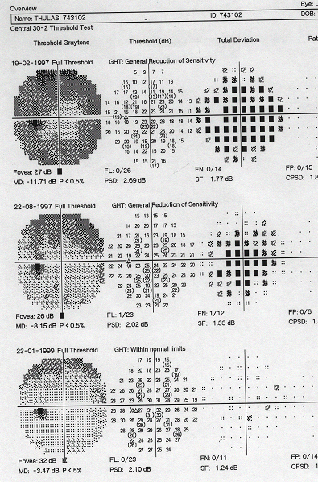
Don’t forget to discard ‘learning’ fields from baseline
© Thomas R
Notes:
The learning curve as the patient becomes familiar with perimetric testing is clearly evident in the printout shown.

Slide 72
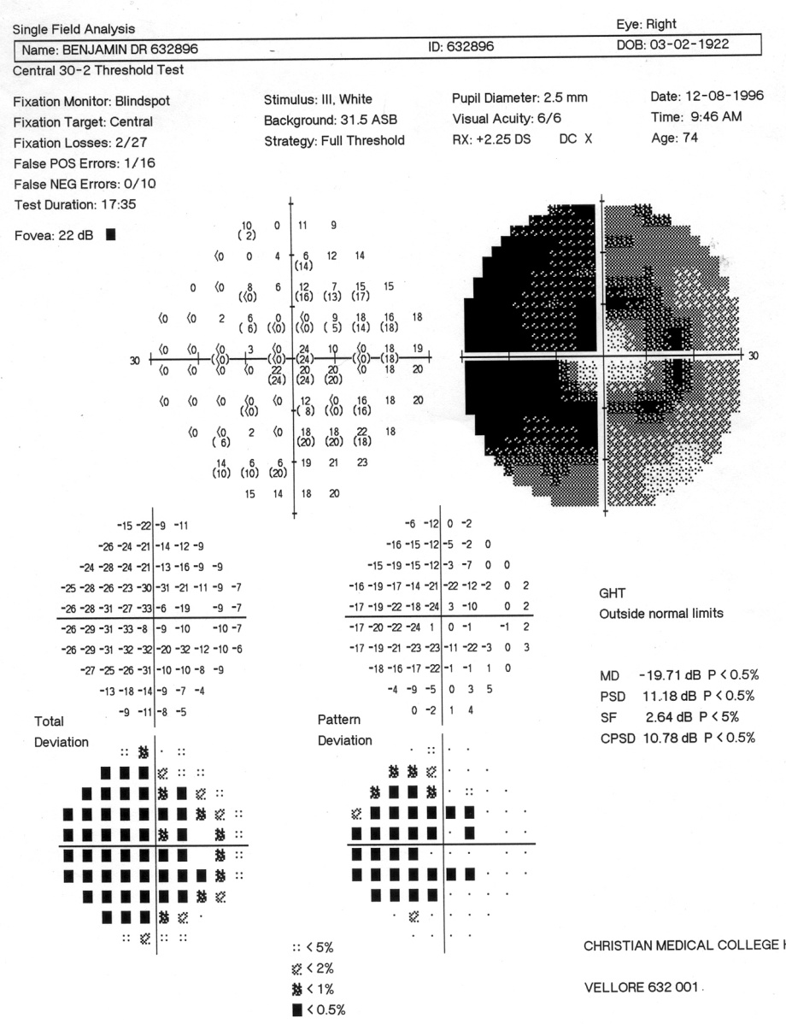
Monitoring advanced field defects
© Thomas R
Notes:
The next few slides discuss the follow-up of patients with advanced glaucoma, which may require a different approach to examination.

Slide 73
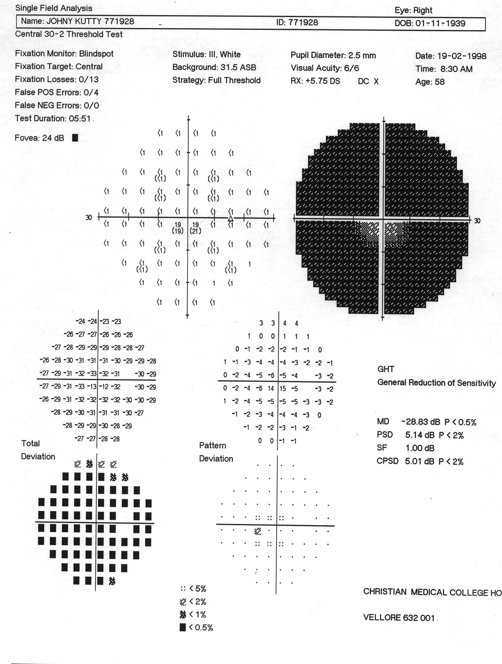
Advanced field defect
Why is the pattern deviation plot not showing a defect?
© Thomas R
Notes:
The patient has advanced glaucoma, but although the total deviation plot shows depression, the pattern deviation plot is clear.

Slide 74
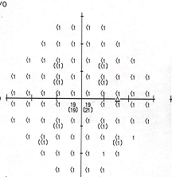
Not enough points with sensitivity to produce the pattern deviation plot
© Thomas R
Notes:
In patients with advanced glaucoma, most points have a zero threshold, with very few sensitive points. Under these conditions, the statistical assumptions underlying the pattern deviation plot no longer hold true and a blank pattern is generated.
A 30–2 (or 24–2) single field analysis is of limited use when the visual field is very advanced. In these circumstances, a 10–2 program should be used.
Reference
Thomas R, George R. Interpreting automated perimetry. Indian J Ophthalmol 2001; 49: 125–40.

Slide 75
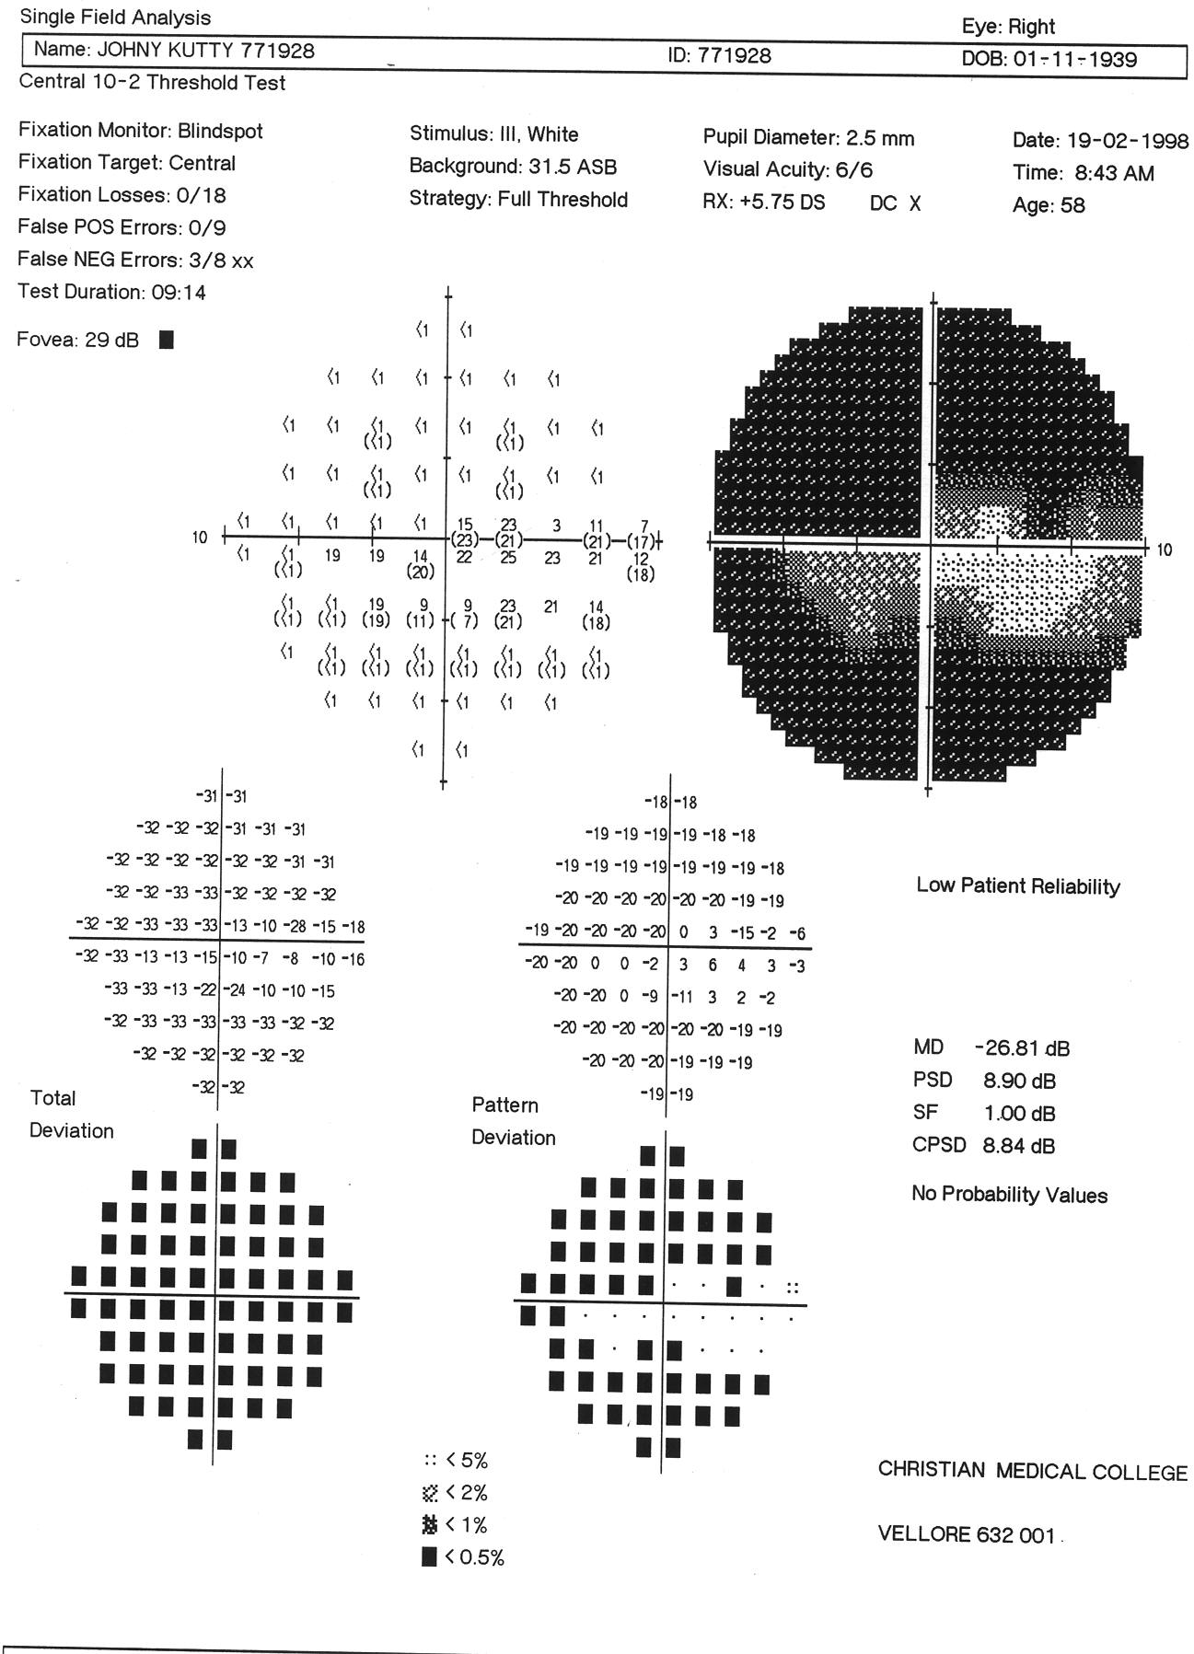

Follow-up with a 10–2 programme –
now there are enough sensitive points
to produce a pattern deviation plot
© Thomas R
Notes:
This slide shows an HFA 10–2 test for the same patient. Covering the central 10 degrees with points to give a two-degree resolution has provided enough threshold points to fulfil the statistical assumptions required for the pattern deviation plot, which now reveals a double arcuate scotoma.
Reference
Thomas R, George R. Interpreting automated perimetry. Indian J Ophthalmol 2001; 49: 125–40.

Slide 76

Advanced defect
and/or low sensitivities – follow-up with a size V target
Disadvantage: we lose statistical help for interpreting the total and pattern deviation plots
© Thomas R
Notes:
A size V target is recommended when most points have a sensitivity of below 10–15 dB. The size V target returns the defect depth and actual threshold values rather than the total and pattern deviation plots.
Reference
Thomas R, George R. Interpreting automated perimetry. Indian J Ophthalmol 2001; 49: 125–40.

Slide 77

More advanced defects: follow with macular programme
© Thomas R
Notes:
A macular programme with either a size III or size V target may be used to determine whether the macula is split. The programme is normally used only when the central five degrees of field are preserved. A macular programme is used in addition to standard programmes if a defect is disrupting fixation, but other points in the field are intact.
Reference
Thomas R, George R. Interpreting automated perimetry. Indian J Ophthalmol 2001; 49: 125–40.

Slide 78

Macular programme in advanced glaucoma
© Thomas R

Slide 79

Size V target: macular split
Macular split (0 dB) next to the fovea
with a size V target may predict ‘wipe out’
Return to main presentation
© Thomas R
Notes:
If testing using a size III target shows a split macula, the procedure should be repeated using a size V target, as the visual prognosis is better if there is no split macula with the larger target.
Reference
Thomas R, George R. Interpreting automated perimetry. Indian J Ophthalmol 2001; 49: 125–40.

